Slide 1
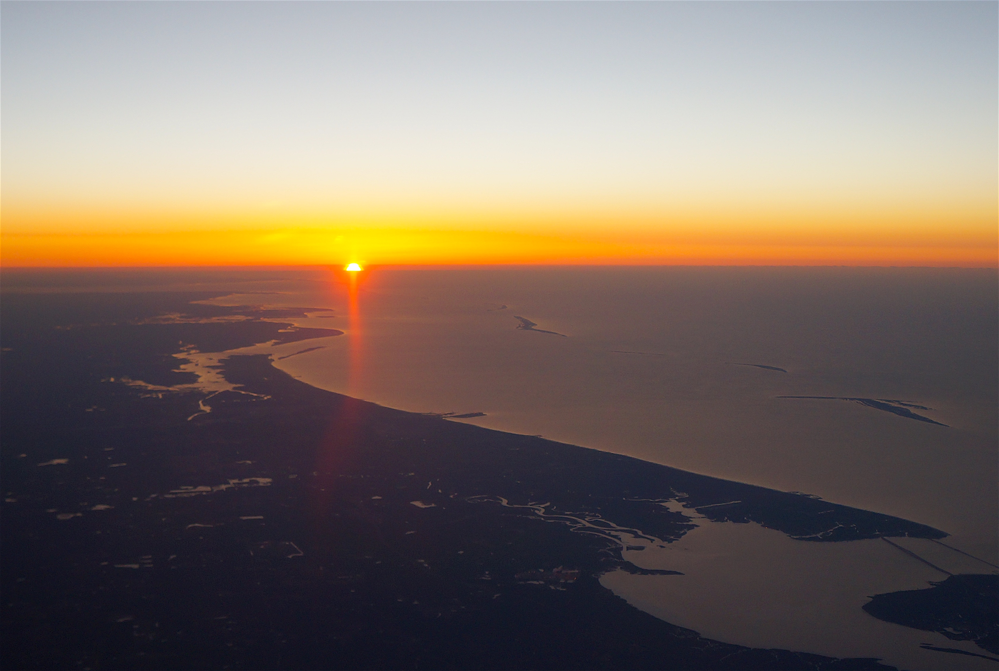


Surface Biology and Geology (SBG)
Pre-Formulation Study
Summary and Status
Surface Biology and Geology (SBG)
Pre-Formulation Study
Summary and Status
Kevin R. Turpie
UMBC, NASA GSFC
kturpie@umbc.edu
Liane Guild
NASA ARC
liane.s.guild@nasa.gov
sbg.jpl.nasa.gov
AquaRS
Aquatic Studies Group
(ASG)
NASA Ocean Color Research Team Meeting
26 & 28 May 2020
in the Ætheric Plane
Follow us
@nasa_sbg
#nasasbg

Slide 2
AquaRS – the Aquatic Studies Group (ASG)
The Aquatic Studies Group (ASG) is a community of practice, promoting and advancing the coastal and inland sciences by connecting RS community needs to aquatic remote sensing resources.
Adopting the name AquaRS in 2014, the group has grown to over 120 affiliates with international and domestic institutions, including government, university, research or application organizations.
If you are interested in participating in the AquaRS COP, please contact Kevin Turpie (kturpie@umbc.edu).
Established in 2012
2

Slide 3
SBG Science: Data for 5 science focus areas and applications, and for two critical spectral regions
Coastal & Inland Waters
3

Slide 4
SBG is here in its mission life cycle…
Advanced Studies |  | Formulation |  | Implementation
Pre-phase A |  | Phase A | Phase B | Phase C | Phase D | Phase E | Phase F
DO Mission Study | MCR Prep | Mission and System definition | Preliminary Design | Design & Build | Assembly, Test & Launch Ops | Operations | Closeout
If approved by NASA, there will be many opportunities for the R&A community to engage throughout the mission lifecycle, e.g.:
Key and driving requirements will be reassessed in Phase A
The Applications Community Assessment Report will be finished in Phase A
Calibration and Validation strategy definition in Phase A/B and implementation in Phases C-E
Algorithm selection and testing in Phases A-D
Competed Science Team at some point in the mission lifecycle
4

Slide 5
Define Capability Needs- Architecture Tradespace
SBG Pre-Formulation Study Organization
Phase 1
Community Inputs via Working Groups
Jamie Nastal
Study Lead
Chip Miller
International Coordination
Synthesized Capability Needs
Architecture Element Design Session Participation
Phase 2
Research & Applications
Team
Architecture
Team
Costing
Team
Assess Instruments
Build Architectures
3 Recommendations
HQ Selection
5

Slide 6
SBG Research and Applications Team
Research and Applications
Steering Committee
- Closed Working Groups
Dave Schimel
Ben Poulter
R&A Co-leads
Liane Guild,
Jeff Luvall, Rob Green, Simon Hook
and Working Group Leads
- Open Working Groups
SBG Pathfinder
Michelle Gierach
Phil Townsend
Science Systems Engineering
Natasha Stavros Shannon Zareh
Ryan Pavlick David Thompson
Algorithms
Kerry Cawse-Nicholson
Phil Townsend
Cal/Val
Kevin Turpie
Ray Kokaly
Applications
Christine Lee
Stephanie Uz
Jeff Luval
Modeling
Ben Poulter
Shawn Serbin
Weile Wang
6

Slide 7
NRC Committee on ESAS
Decadal Survey
Science and Application
TraceabilityMatrix
Satellite Development Community
International Partnerships
Science and ApplicationsCommunity
R & A TEAM
Working Groups
Cal/Val
ARCHITECTURE
TEAM
SBG
Request for Information (RFI) 1 & 2
Algorithm
NASA HQ
Applications
SBG MISSION CONCEPT
Modeling
COMMUNITY INPUT TO ARCHITECTURE STUDY
7

Slide 8
COMMUNITY ENGAGEMENT
RESEARCH AND APPLICATIONS WORKING GROUPS
ANNUAL COMMUNITY WORKSHOPS
ALGORITHMS
Kerry Cawse-Nicholson
Kerry-Anne.Cawse-Nicholson@jpl.nasa.gov
State-of-Research Algorithms
Representative Data Products
APPLICATIONS
Stephanie Schollaert Uz
stephanie.uz@nasa.gov
Representative applications
Applications supportability
PHASE 1
12-14 June 2019
Holiday Inn Capitol
Washington, D.C. USA
PHASE 2
26 March 2020 – Webinar
27 May 2020 – Webinar
15 July 2020 – Webinar
SBG will host annual community meetings.
CAL/VAL
Kevin Turpie
kturpie@umbc.edu
Cal/Val Infrastructure
Connecting Engineering to Science
MODELING
Ben Poulter
benjamin.poulter@nasa.gov
Observation System Simulation Experiments (OSSE)
Uncertainty Quantification
Information regarding the SBG
Study at the mission website:
sbg.jpl.nasa.gov
8

Slide 9
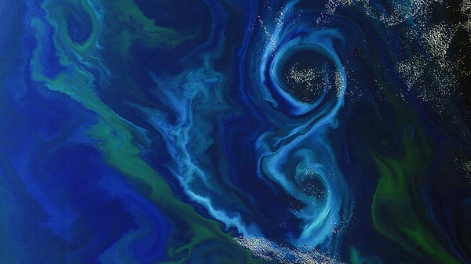
Cross-Mission Discussion Group
Identify shareable resources, mutually beneficial opportunities, overlapping activities and find ways to synergize efforts across aquatic missions in order to reduce risk, save cost and better our support of the research and applications needs of the aquatic remote sensing communities.
Member Missions: PACE, GLIMR, SBG
Jeremy Werdell (PACE Proj Scientist)
Heidi Dierssen (PACE Science Team Lead)
Carlos Del Castillo (PACE Ocean Ecology Lab Chief)
Joe Salisbury (GLIMR PI)
Antonio Mannino (GLIMR Co-I, PACE Deputy Proj Scientist)
Maria Tzortziou (GLIMR Co-I)
Kevin Turpie (SBG Cal/Val Co-Lead, Aquatic Studies Group Chair)
Liane Guild (SBG R&A Steering Committee, Aquatic Studies Group Co-Chair)
Stephanie Schollaert Uz (SBG Applications Co-Lead)
Phil Townsend (SBG Pathfinder Co-Lead, Algorithms Co-Lead, Terrestrial Liaison)
Michelle Gierach (SBG Pathfinder Co-Lead)
9

Slide 10
Surface Biology and Geology (SBG)
RFI Target Capabilities
Performance Parameters | Spectral Range | Spectral Resolution | SNR or NeDT (R=0.25) | GSD | Revisit | Coverage | Local Time for Acquisition
VSWIR | 0.35 or 0.4 to 2.5µm | Resolution: 10nm or better Coverage: Continuous | SNR: VNIR: >400 SWIR: >250 | 30-45m | 2-16 days | Global | 10:30am to 1:30pm
TIR | 8 to 12µm 3 to 5µm | Bands: >5 desired | NEdT: <0.2 K | 40-60m | 1-7 days | Global | Can vary across the diurnal cycle
10

Slide 11
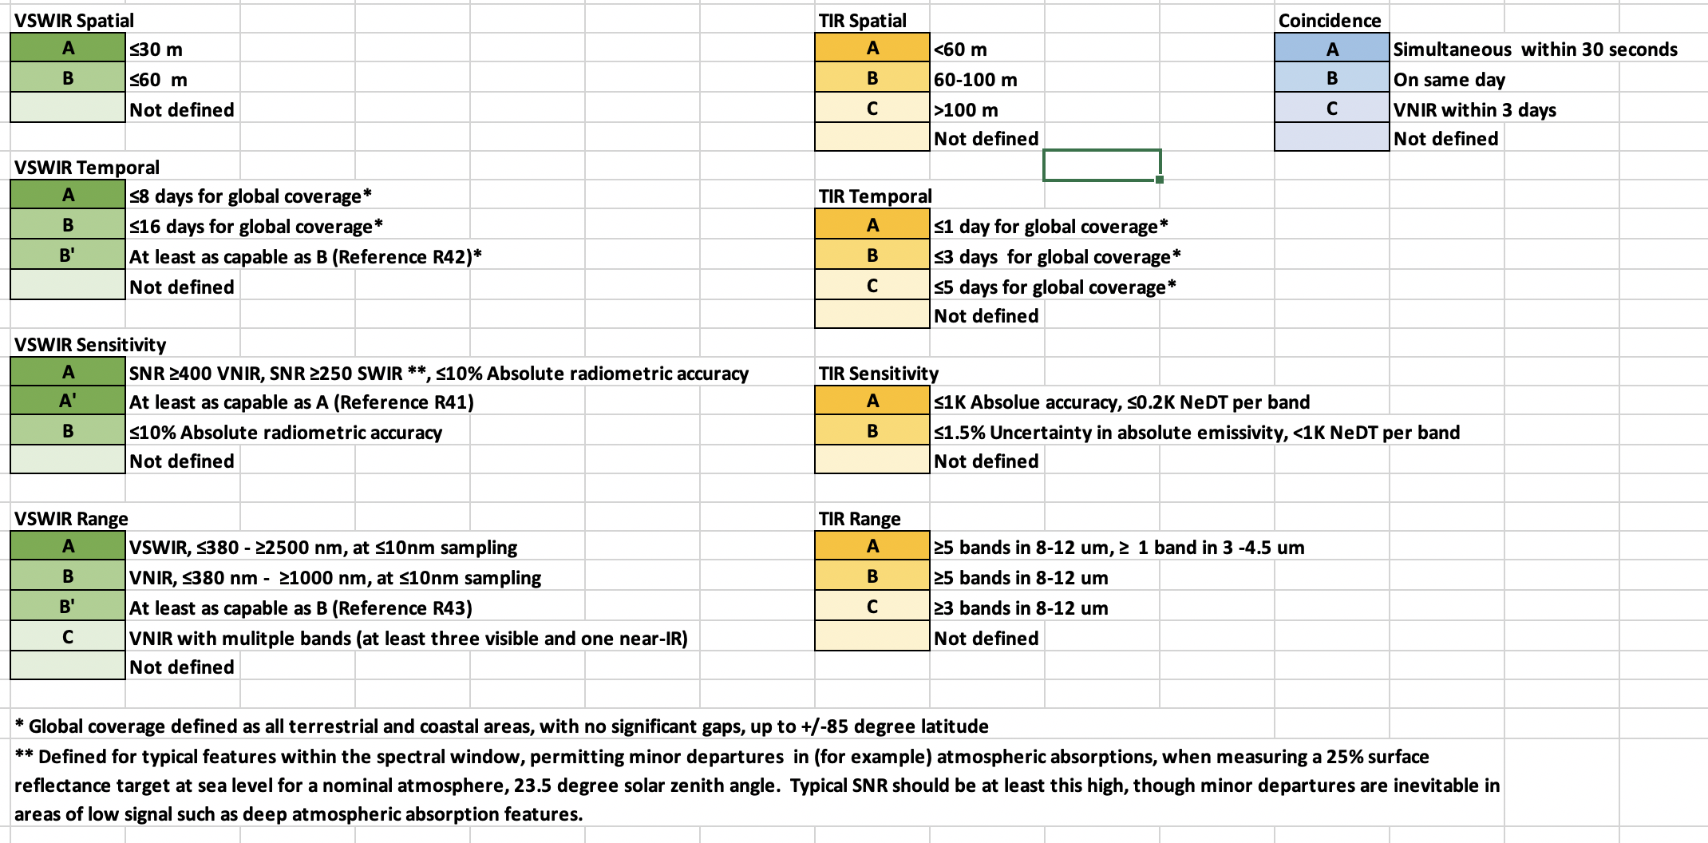
Capability Needs were transcribed into Capability Codes for
the Science and Application Traceability Matrix (SATM)
11

Slide 12
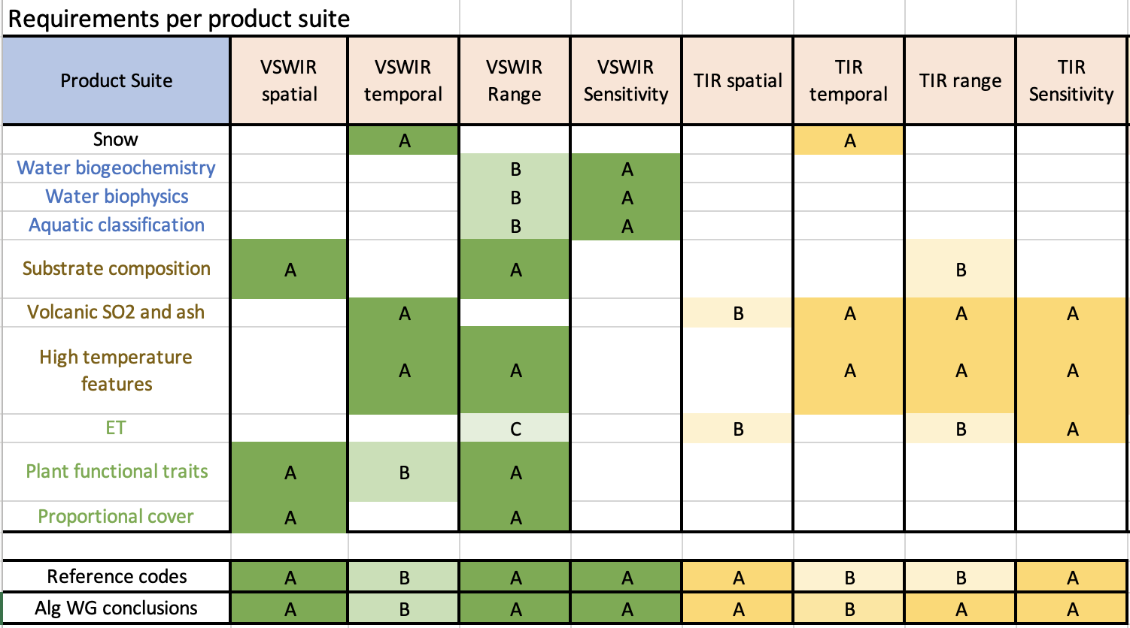
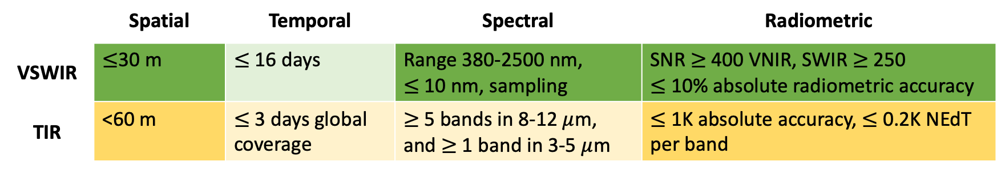
Algorithms Working Group
Engaged with community regarding potential data products and algorithms (273 recommendations, 90+ from the aquatic community).
Per Cal/Val Working Group’s (CVWG) request, polled community for existing validation protocols, measurement assets, and product sampling statistics.
Preparing a survey paper based on input.
Discussed with CVWG and Modeling Working Group uncertainty targets and threshold conditions that break algorithms.
Determined an additional 4 𝜇m band is necessary for volcanology objectives.
Initial product suite of 10 recommended, generalized products were identified for Observing System Simulation Experiment (OSSE) efforts.
 | Spatial | Temporal | Spectral | Radiometric
VSWIR | $≤$30 m | $≤$ 16 days | Range 380-2500 nm, $≤$10 nm, sampling | SNR $≥$ 400 VNIR, SWIR $≥$ 250 $≤$ 10% absolute radiometric accuracy
TIR | <60 m | $≤$ 3 days global coverage | $≥$5 bands in 8-12 $μ$m, and $≥$ 1 band in 3-5 $μ$m | $≤$1K absolute accuracy, $≤$0.2K NEdT per band
12

Slide 13
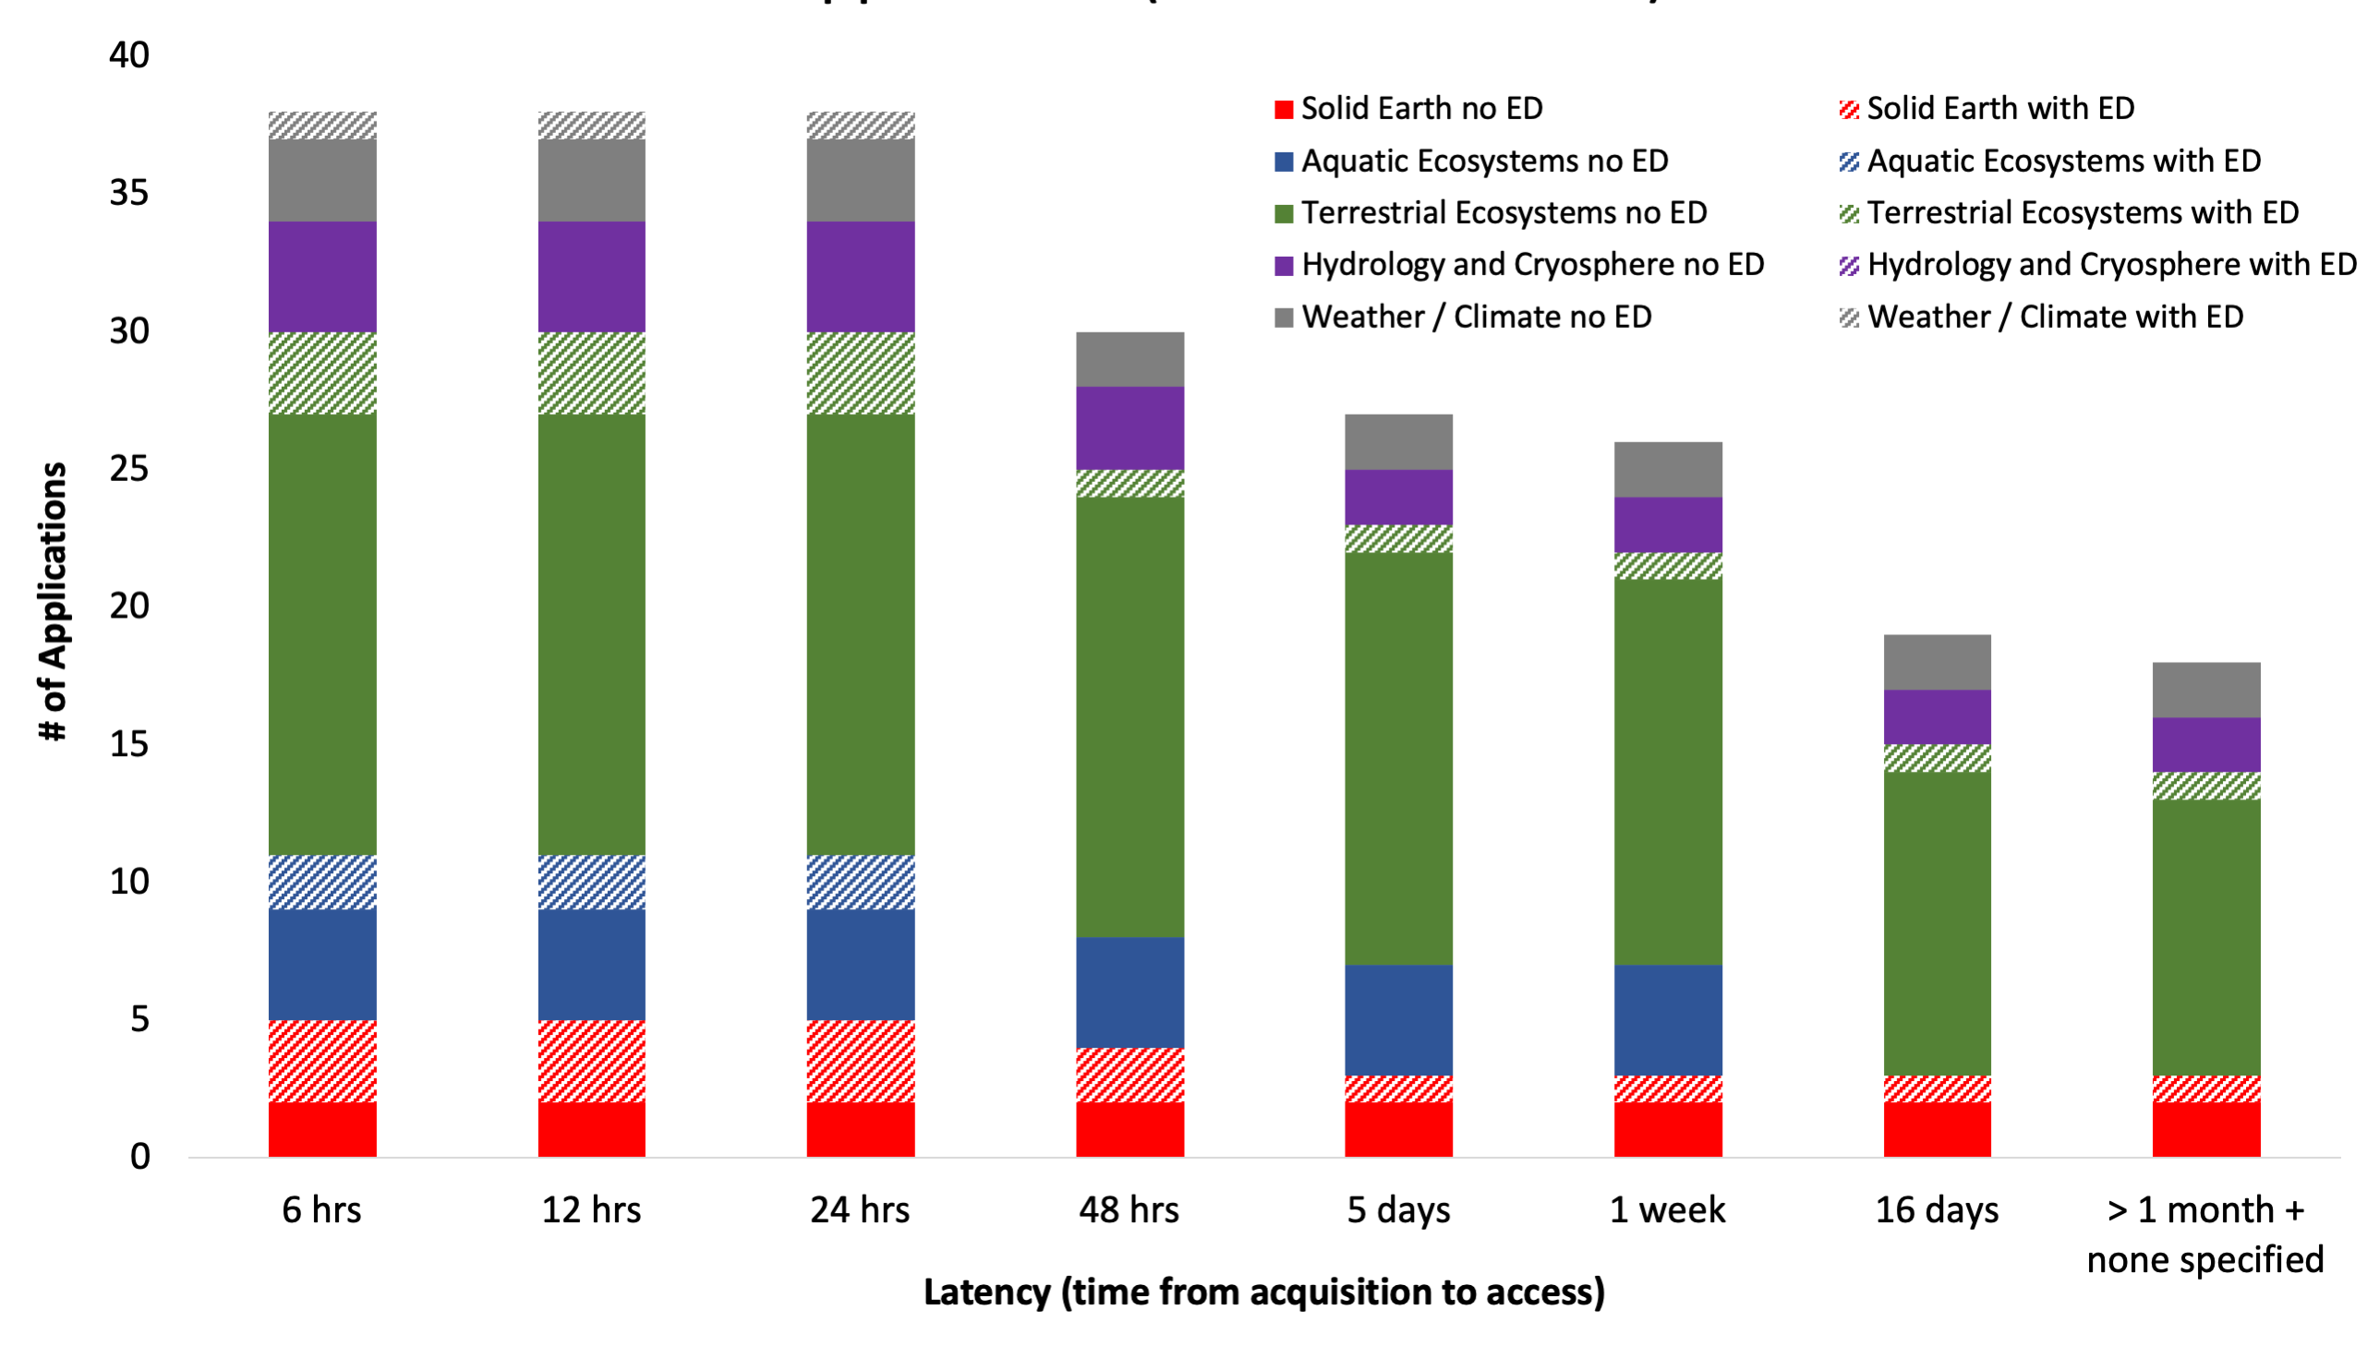
Applications Working Group
Analyzed 49 applications for dependence on event response speed (opportunity and pointing capability), architecture capability, and latency (time to end-user).
77% require target capabilities, quick event response speed, and latency ≤ 24 hours
(+ ≤ 8 revisit supports 100%).
Contractor RTI polling community to form profiles of end-user archetypes.
Information will feed into a Community Assessment Report (CAR).
Aquatic Applications
ED = Event Driven
13

Slide 14
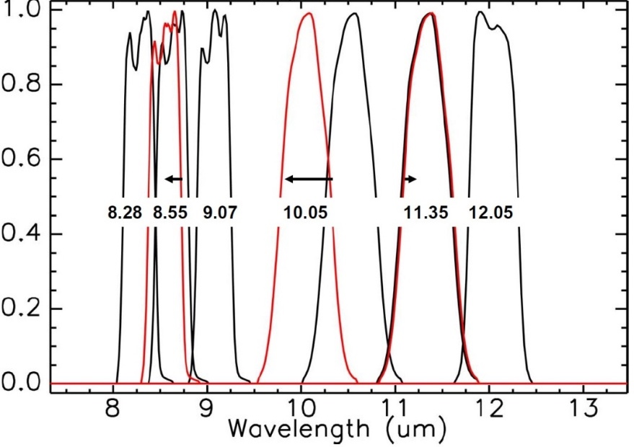
Modeling Working Group
Developed instrument model suite (HYPERTRACE) based roughly on RFI responses.
Simulated propagation of noise and calibration uncertainty to surface reflectance and temperature.
14

Slide 15






Cal/Val Working Group
Calibration: Radiometric (R), Thermal (T), Spectral (S), & Geometric (G)
Calibration strategy recommendations for architectures assumed:
  Accuracy → 5% rel. uncertainty surface reflectance, inc. dark targets
        → ≤ 1°K abs. uncertainty surface temperature
        → Pointing knowledge for subpixel geometric accuracy
  Stability → Change detection, geolocation and global mosaics
Started a Cal/Val webinar to collect more information about potential capabilities for pre-launch characterization, on-orbit calibration, and validation.
 | Guidance to Architecture Team |  | Purpose
On-Orbit Calibration and Monitoring |  | Lunar Calibration (R,S,G) | Accuracy | Stability (long-term)
 |  | Solar Calibration (R,S) | Accuracy | Stability (short-term)
 |  | Black Body (T) | Accuracy | Stability (short-term)
 |  | Stellar Navigation (G) | Maneuvers, Geolocation
 |  | Vicarious Calibration (R,T,S,G) | Accuracy | Stability (long-term)
15

Slide 16
SUMMARY
SBG has defined capability needs based on the ESAS Decadal Survey and community input.
Two RFIs were released and responses including instruments were assessed
Will continue looking at RFI 2 responses (closes 3 July) (Cal/Val responses encouraged)
Architecture elements were developed around instruments in design sessions.
Architectures candidates were down selected based on cost and feasibility.
R&A high-level guidance was supplied for use in design sessions.
  Alg WG added 4 μm band to implement volcanology science objectives.
  App WG assessed no. of applications supported as function of latency.
  Mod WG estimated effect of instrument uncertainty on data product quality.
  CVWG provide calibration strategies based on observational needs.
Information regarding the SBG
Study at the mission website:
sbg.jpl.nasa.gov
kturpie@umbc.edu
16

Slide 17
NEXT STEPS
A preferred architecture with two alternatives will be submitted to NASA HQ.
Soliciting community perspective on science and applications impact of the 3 recommended architectures (Webinar 3: 15 July, 9 AM Pacific/12 pm Eastern).
Form and materials for Webinar 3 provided to those who register in advance: https://tinyurl.com/sbgwebinar
R&A team will perform a science value assessment (TBD).
Final selection will be made by NASA HQ.
Preparations for Mission Confirmation Review (MCR) made based on NASA HQ selection.
Mission enters Phase A/B formulation.
Information regarding the SBG
Study at the mission website:
sbg.jpl.nasa.gov
THANK YOU
kturpie@umbc.edu
17

Slide 18
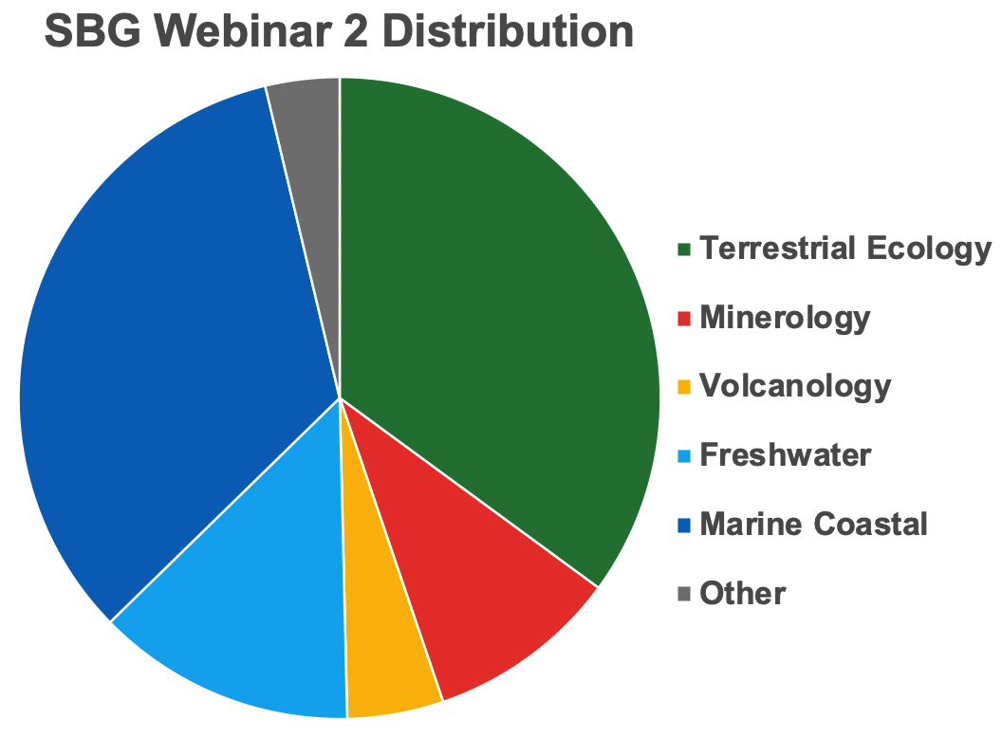
SBG WEBINAR 2 – AQUATIC PRESENCE
Q. The target of <10% radiometric accuracy for VSWIR -- this is not sufficient for oceanic / coastal applications. Can this be improved?
A. Don’t take the 10% very seriously. Take the “less than” more seriously. Only snow albedo specified radiometric accuracy in the Decadal Survey. So we included the 10% number for completeness, but we are aware it is insufficient for many applications. A more accurate threshold will be determined in the uncertainty quantification work that the modeling working group is carrying out.
Q. Regarding SNR, it might be useful to define that value based on the darkest target of interest -- deep, clear water. If we don't define the conditions that the SNR is computed for, we don't know what it means.
A. We need to consider all five application areas, and will absolutely be considering SNR over both bright and dark targets.
Total Number of Participants = 248
18

Slide 19
BACKUP SLIDES

Slide 20

 | Spatial | Temporal | Spectral | Radiometric
VSWIR | $≤$30 m | $≤$ 16 days | Range 380-2500 nm, $≤$10 nm, sampling | SNR $≥$ 400 VNIR, SWIR $≥$ 250 $≤$ 10% absolute radiometric accuracy
TIR | <60 m | $≤$ 3 days global coverage | $≥$5 bands in 8-12 $μ$m, and $≥$ 1 band in 3-5 $μ$m | $≤$1K absolute accuracy, $≤$0.2K NEdT per band
Algorithm WG verified Phase 1 ESAS Assessment for optimal capability code combination by analyzing across 125 (of the 273 identified) algorithms
Ten final product suites were identified
  Based on algorithm maturity
  And decadal survey science questions
Algorithm requirements listed in terms of SATM capability codes
The following capabilities meet all cliff requirements (i.e., the full set of algorithms is not possible to implement with ABAA-ABBA):

Slide 21

SBG DATA PRODUCT SUITES AND KEY CAPABILITIES
*A blank box indicates no algorithm dependency on that parameter
Primary Finding: Adding a 4 $μ$m band would allow existing algorithms to be implemented for volcano suites

Slide 22
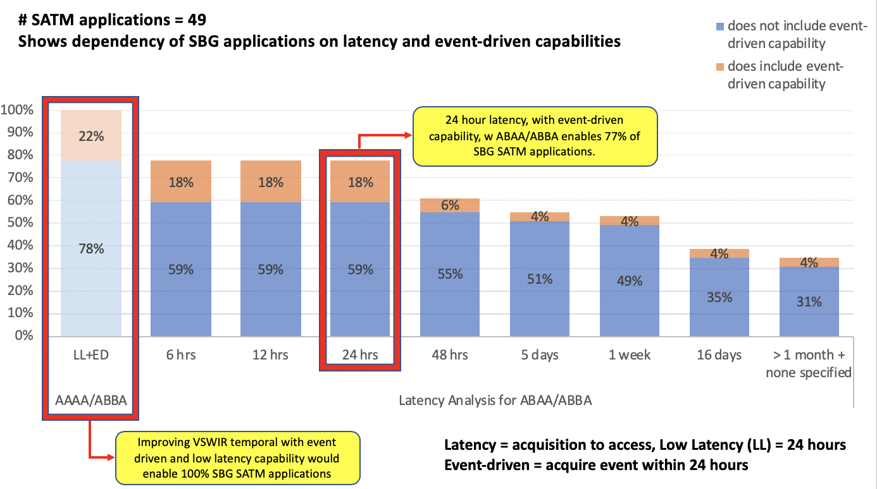
Improving VSWIR temporal with event-driven and low latency capability would enable 100% of SBG SATM capabilities

Slide 23
Modeling WG conducted uncertainty quantification using different VSWIR and TIR instrument models
(left) example of VSWIR instrument models and how SNR varies with respect to wavelength
(right) example of TIR instrument model, with switching of band placement

Slide 24
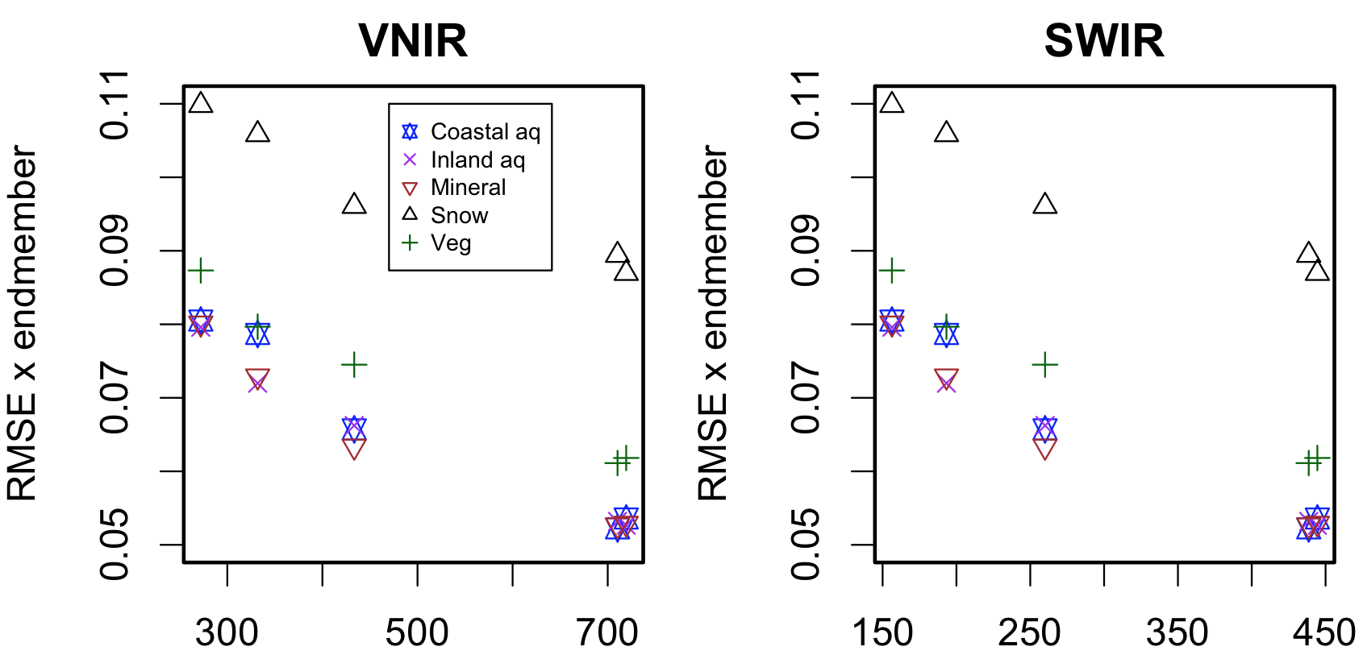
Modeling WG conducted uncertainty quantification for VSWIR instrument models
HYPERTRACE software developed to evaluate VSWIR instrument model performance for different research areas under varying atmospheres, sun-sensor geometries, and retrieval algorithms.
Instrument model SNR defined by integration Time = f(SNR by band, altitude, GSD, F#, pixel pitch)
RMSE by endmember
SBG Class A
SBG Class A
Signal to noise ratio

Slide 25
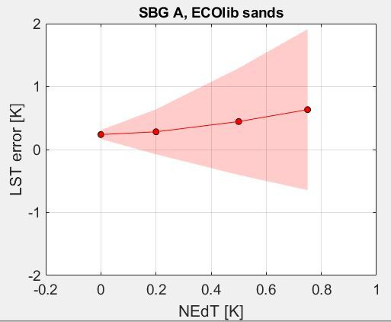
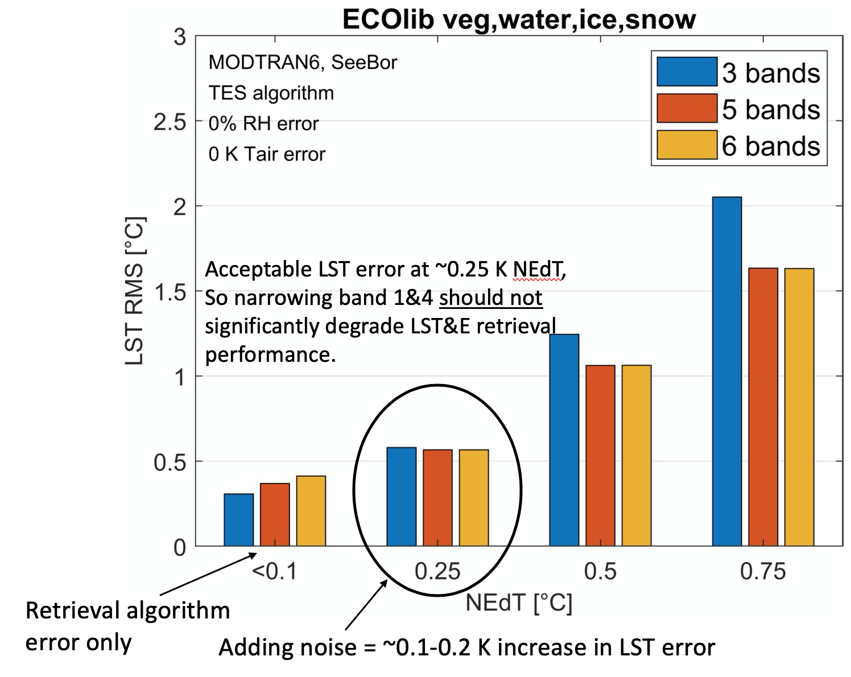
Modeling WG conducted uncertainty quantification for TIR instrument models
TEUsim software adapted to evaluate TIR instrument model performance for the ECOLIB spectral library, using MODTRAN and the SeeBor V4.0 radiosonde profiles, and three sensor view angles.
Instrument model SNR defined by per-band NEdT.
SBG Class A
(Glynn Hulley)

Slide 26
SBG CVWG Cal/Val Webinar Series Schedule |  |  |  | Please note that times are subject to change.
DATE | US EDT | SPEAKER | AFFILIATION | TITLE | Dial-in Link and Numbers
7-May | 7:00 PM | Joe Rice | National Institute of Standards and Technology | The Hyperspectral Image Projector (HIP) | Click here to attend.
 | 7:30 PM | - | - | - | +1-415-527-5035 US Toll +1-929-251-9612 USA Toll 2
21-May | 7:00 PM | Brandon McAndrew | NASA, Goddard Space Flight Center | Goddard Laser for Absolute Measurement of Radiance (GLAMR) | Click here to attend.
 | 7:30 PM | Joe Rice | National Institute of Standards and Technology | NIST Support of GLAMR (SIRCUS) | +1-415-527-5035 US Toll +1-929-251-9612 USA Toll 2
4-Jun | 7:00 PM | Chris Durell | LabSphere | The FLARE Sensor Calibration Network
 | 7:30 PM | - | - | -
11-Jun | 7:00 PM | Cindy Ong | CSIRO | Australian Cal/Val Field Assets
 | 7:30 PM | OPEN
18-Jun | 7:00 PM | Cindy Ong | CSIRO | International CEOS WGCV efforts
 | 7:30 AM | - | - | -
25-Jun | 7:00 PM | Tom Stone | United States Geological Survey | Lunar Calibration using the Robotic Observatory Lunar Observatory (ROLO) Model
 | 7:30 PM | Constantine Lukashin | NASA, Langley Research Center | ARCSTONE: Lunar Spectral Albedo Characterization and SBG Calibration
2-Jul | 7:00 PM | Kevin Turpie | University of Maryland, Baltimore County | The airborne Lunar Spectral Irradiance (air-LUSI) Mission
 | 7:30 PM | Steven Maxwell | National Institute of Standards and Technology | Mauna Loa Observatory - Lunar Spectral Irradiance (MLO-LUSI)
9-Jul | 9:00 AM | Ken Voss | University of Miami | Aquatic Vicarious Calibration with Marine Optical Buoy (MOBY)
 | 9:30 AM | Eric Hochberg | Bermuda Institute of Ocean Sciences | The CORAL Mission: Validation Effort and Lessons Learned
16-Jul | 9:00 AM | Kevin Ruddick | Royal Belgian Institute for Natural Sciences | The Pan-and-Tilt Hyperspectral Radiometer System (PANTHYR)
 | 9:30 AM | David R. Thompson | Jet Propulsion Laboratory, California Institute of Technology | Field Validation of Predicted Uncertainties in Level 2 and Level 3 Products, for EMIT and beyond
23-Jul | 12:00 PM | Martin Bachmann | Deutsches Zentrum für Luft- und Raumfahrt | DESIS Calibration and Validation Activities
 | 12:30 PM | Kevin Alonso or Emiliano Carmona | Deutsches Zentrum für Luft- und Raumfahrt | EnMAP Calibration and Vlidation Activites

