Slide 1
Demonstrating Fresh and Coastal Water Products from PACE/OCI Proxy Observations
Ryan E. O’Shea^{1,2} (ryan.e.o’shea@nasa.gov); Nima Pahlevan^{1,2}; Brandon Smith^{1,2}; Caren Binding³; Emmanuel Boss⁴; Ruth Briland⁵; Todd Egerton⁶; Raphael Kudela⁷; Stephanie Schollaert Uz²; Jennifer Wolny⁸
¹Science Systems and Applications Inc., Lanham, MD, United States; ²NASA Goddard Space Flight Center, Greenbelt, MD, U.S.; ³Environment and Climate Change Canada; ⁴School of Marine Sciences, University of Maine;
⁵Division of Drinking and Ground Waters, Ohio Environmental Protection Agency; ⁶Virginia Department of Health;
⁷Ocean Sciences Department, Institute of Marine Sciences, University of California-Santa Cruz;
⁸Office of Regulatory Science, Center for Food Safety and Applied Nutrition, U.S. Food and Drug Administration
Notes:
Add uncertainty graphic. Add wavelengths to complex slide

Slide 2
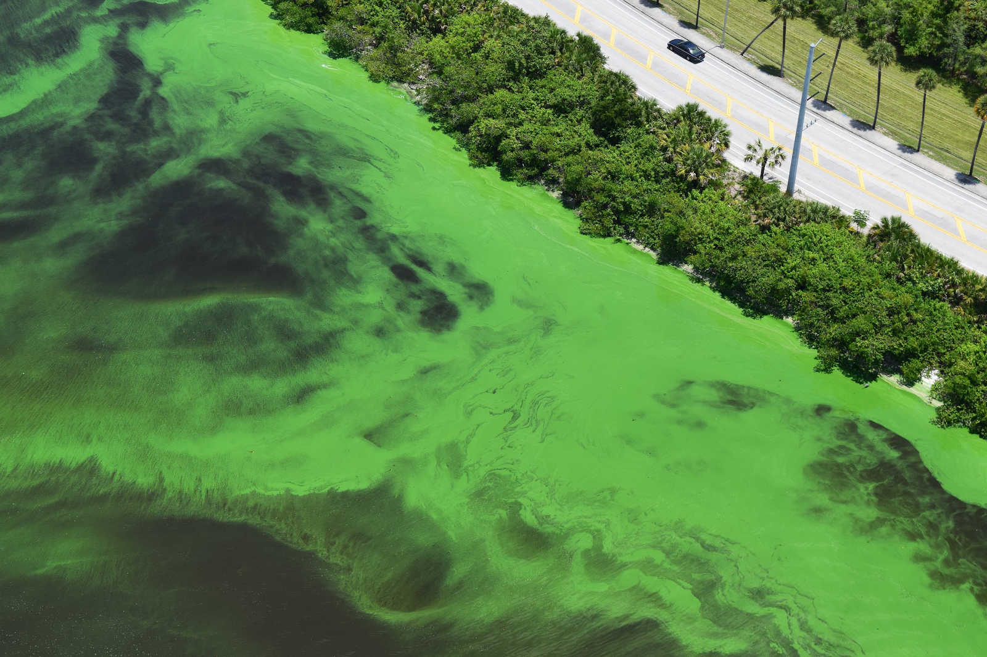
Motivation
Florida Atlantic University
Water Quality Management
Earth Observation
Timeliness
HICO/PRISMA as proxy for PACE/OCI
Ecosystem
Harmful Algal Blooms
(HABs)
Representative Sampling
Public Health
Toxins, hypoxia, & scums
Temporally & Spatially Consistent Observations
Quantify & characterize
Simultaneously estimate biogeochemical parameters & IOPs
Recreation/
Tourism
Issue warnings & implement remediation efforts
Inform in situ sampling & remediation efforts
Water Resources
Stumpf, et. al.. (2016). Challenges for mapping cyanotoxin patterns from remote sensing of cyanobacteria. Harmful Algae, 54, 160-173
Kudela, R. M. et al. Harmful Algal Blooms. A Scientific Summary For Policy Makers (IOC/UNESCO, 2015).
Notes:
Abundance + phytoplankton community composition
Refer to Moritz Leman Presentation on Tuesday – most of chla tss and CDOM are published and available – mention his poster
- IOP will be published
Add red circle around numbers chla N =
Ask arun about slide
Send Slides to Emmanuel and Raphael
Slide 9: Say out loud the Mdsa accuact
Aph at the top
Slide 11 Pahlevan is 2021
Slide 11: enlarge the fonts for measured in situ remote, add red box around
Slide 13: Change the color of the shapes
Slide 14: Indicate on the slide HICO derived Rrs from these specific Rrs à that we use as input to estimate these values
Slide 15: Mention that we only use 5, but we can reconstruct
Slide 16/15: add maps with stars for these regions
Future applications: workshop
Any additional information for the model is great.
Stakeholder engagement workshop – preliminary engagement workshop à focus on 4 specific parameters, chla/tss/cdom/pc from OLCI over Lake Erie
Acknowledgements: NASA Pace SAT
NASA OBPG

Slide 3
Hyperspectral Inversion Framework
Chla
Chlorophyll a
R_{rs}(λ₁)
Machine Learning model for non-unique inverse problems:
Mixture Density Network (MDN)
PC
Phycocyanin
TSS
Total Suspended Sediment
Dedicated MDNs worked well for specific individual parameters in prior research^{1,2,3, etc.} or 3 parameter simultaneous retrievals
R_{rs}(λ₂)
CDOM
Colored dissolved organic matter
a_{ph}(λ)
Phytoplankton absorption
In this research we simultaneously estimate all products, to better learn covariance between products.
a_{g}(λ)
CDOM absorption
R_{rs}(λ₃)
a_{d}(λ)
Non-algal particle (NAP) absorption
¹Pahlevan et al. 2021
²Pahlevan et al. 2022
³O’Shea et al. 2021`
Notes:
Updated Graphic

Slide 4
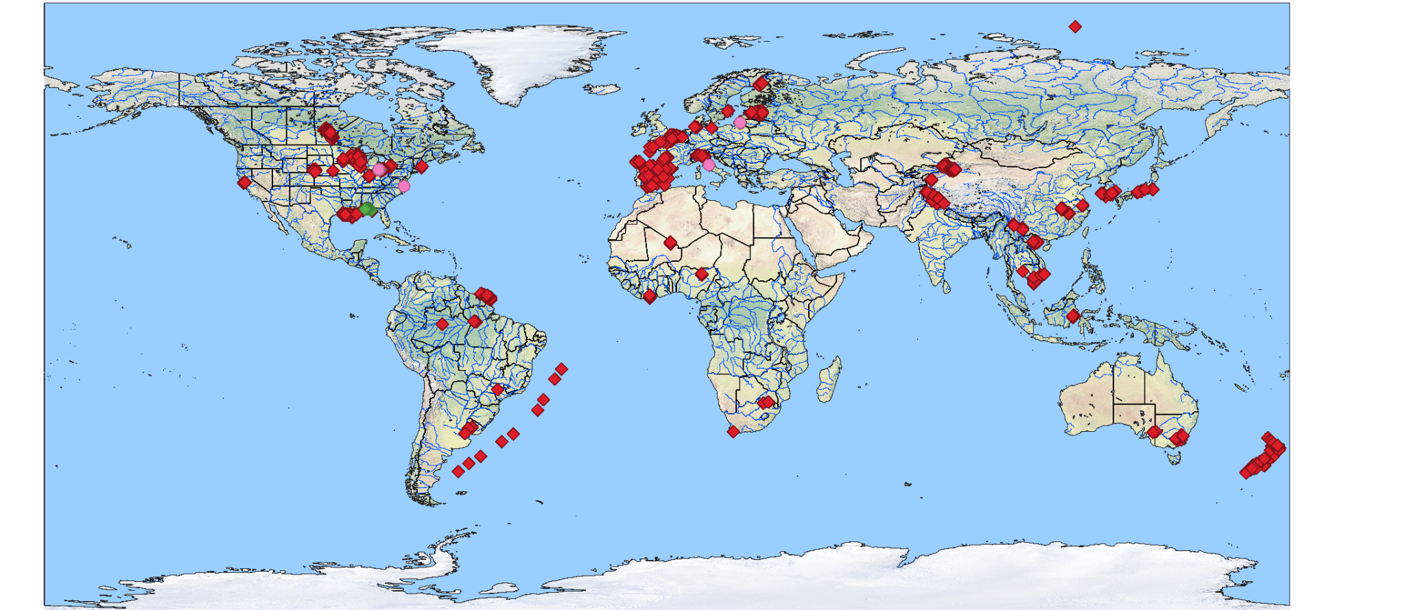
Large (N=~8,237) Globally Distributed In situ Dataset¹:
IOPs & biogeochemical parameters from coastal and inland waters
In situ measurement & hyperspectral R_{rs}
In situ measurement & R_{rs} + satellite R_{rs}
In situ sampling + satellite R_{rs}
¹Lehmann, M.K., et al. GLORIA - A globally representative hyperspectral in situ dataset for optical sensing of water quality. Scientific Data. https://doi.org/10.1038/s41597-023-01973-y.
Notes:
Add legend to the graphic

Slide 5
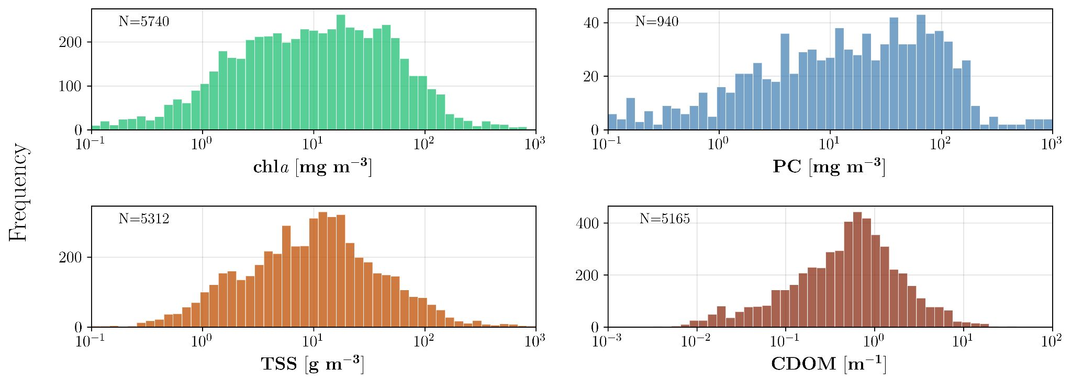
In situ Chla, PC, TSS, & CDOM each span ~4 orders of magnitude concentration range with thousand(s) of samples
In situ a_{ph}, a_{d}, & a_{g} span a range of optical scenarios with N>2,000
Wavelength (nm)
Notes:
most of chla tss and CDOM are published and available – mention his poster

Slide 6
Hyperspectral Inversion Framework
Chla
Chlorophyll a
R_{rs}(λ₁)
Machine Learning model for non-unique inverse problems:
Mixture Density Network (MDN)
PC
Phycocyanin
TSS
Total Suspended Sediment
Dedicated MDNs worked well for specific individual parameters in prior research^{1,2,3, etc.} or 3 parameter simultaneous retrievals
R_{rs}(λ_{k})
CDOM
Colored dissolved organic matter
a_{ph}(λ)
Phytoplankton absorption
In this research we simultaneously estimate all products, to better learn covariance between products.
a_{g}(λ)
CDOM absorption
R_{rs}(λ_{N})
a_{d}(λ)
Non-algal particle (NAP) absorption
¹Pahlevan et al. 2021
²Pahlevan et al. 2022
³O’Shea et al. 2021`
Notes:
Updated Graphic

Slide 7
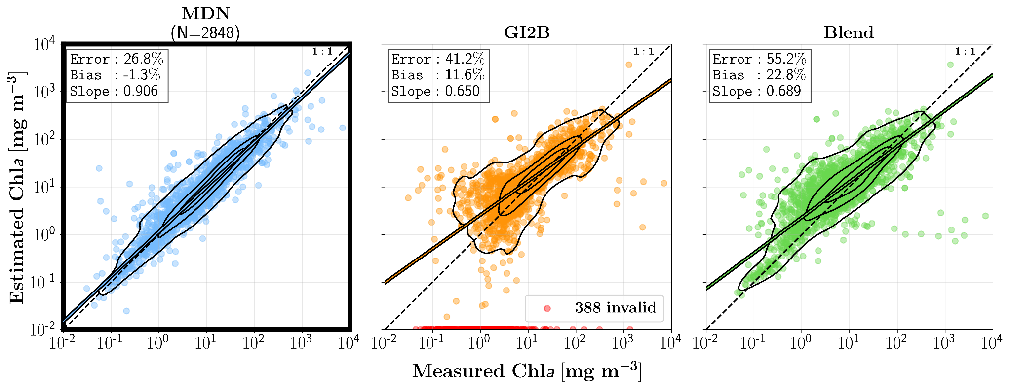
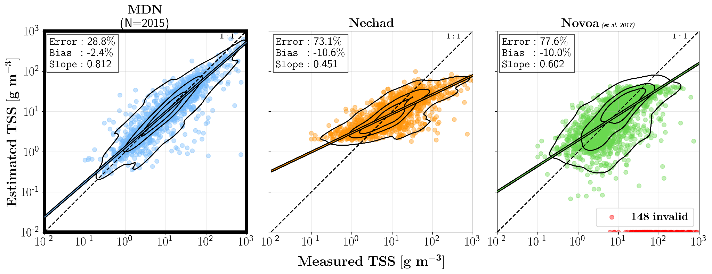
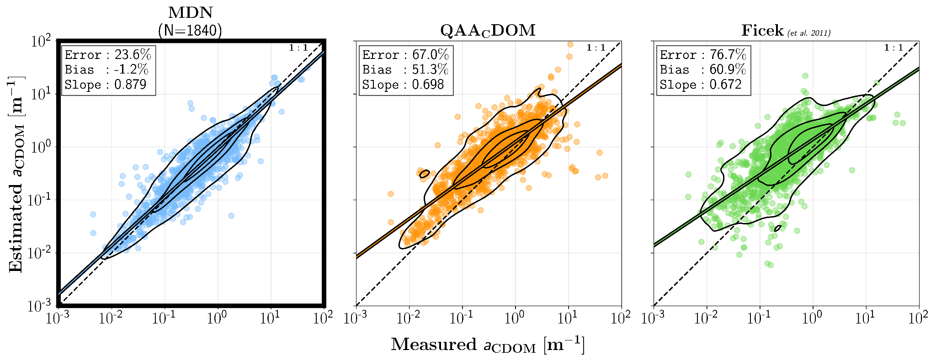
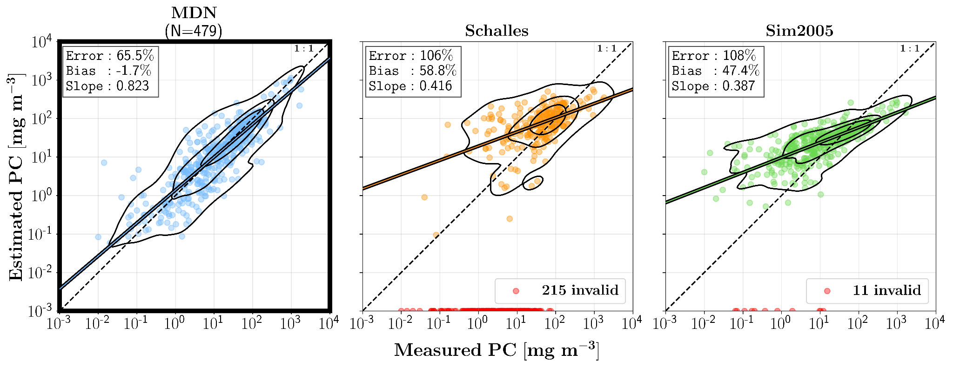
Biogeochemical Parameter Performance Evaluation: 50/50 in situ dataset split
Chla: 26.8% Ɛ ~= 24.5% Ɛ of dedicated MDN¹
TSS: 28.8% Ɛ ~< 32.6% Ɛ of dedicated MDN²
CDOM: 23.6% Ɛ ~< 32.6% Ɛ of dedicated MDN²
PC: 65% Ɛ > 42% Ɛ of dedicated MDN³
Simultaneous model beats (unoptimized) benchmark algorithms
Simultaneous model matches dedicated models (not shown) on larger database
¹Pahlevan et al. 2021
²Pahlevan et al. 2022
³O’Shea et al. 2021`
3. a_{ph}, a_{d}, & a_{g} achieve 20-40% uncertainty (not shown)
Notes:
Say out loud the Mdsa accuact

Slide 8
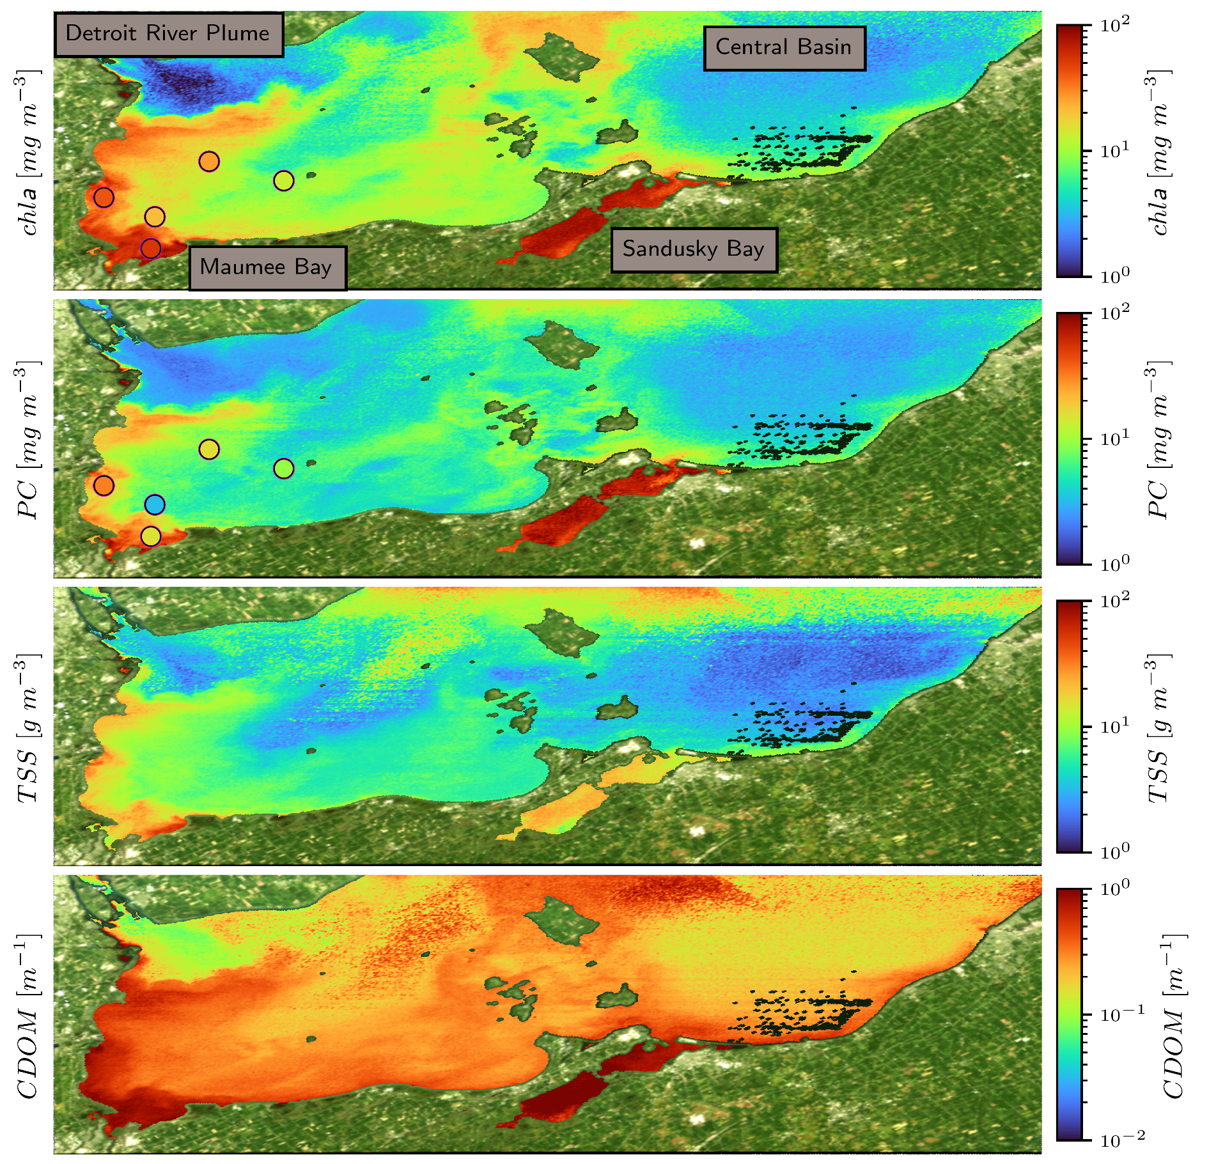
Impacts of Uncertainties in Satellite Rrs on MDN retrievals:
Co-aligned satellite (HICO) & in situ PC/Chla from Lake Erie (09/08/14)
Detroit River Plume
Central Basin
In situ concentration
Sandusky Bay
Complex spatial distribution in Maumee Bay confirmed via in situ measurements
Maumee Bay
Lots of in situ data
Historically low chl, pc, tss, & acdom in Detroit River Plume & Central Basin^{1,2}
Historically high chl, pc, tss, & acdom in Maumee Bay and Sandusky Bay^{1,2}
Spatially consistent products, minimal artifacts
¹Moore et al. 2017
²Binding et al. 2019
Notes:
High nutrients supported by agricultural runoff

Slide 9
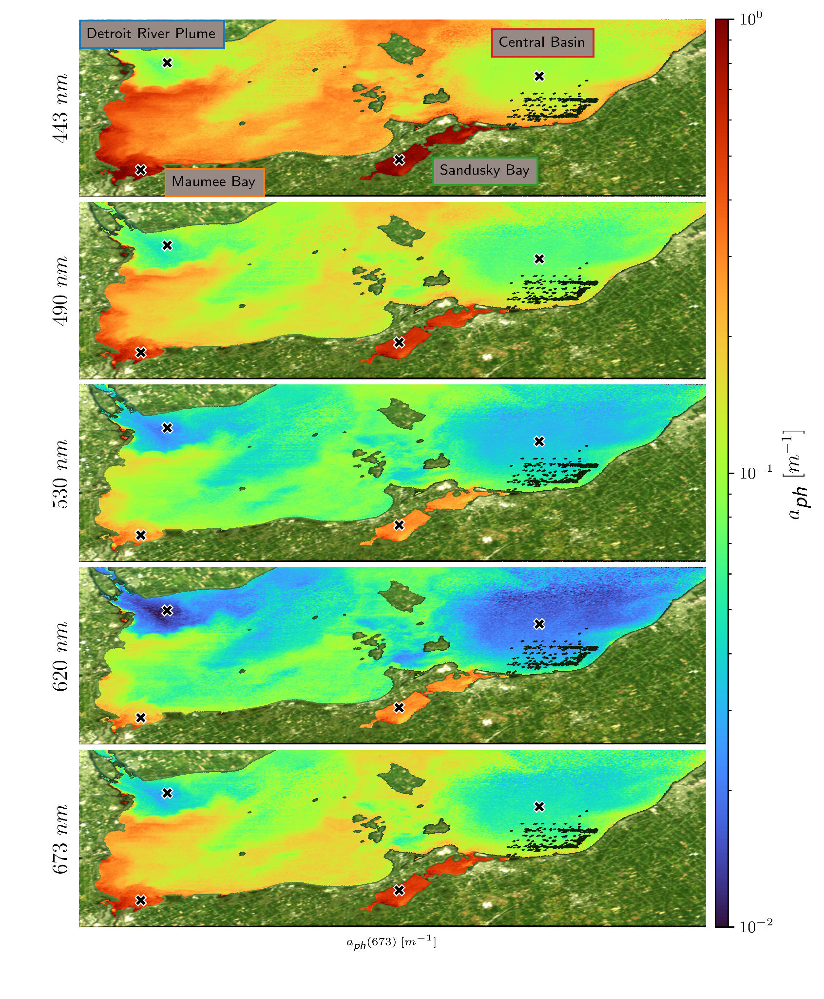
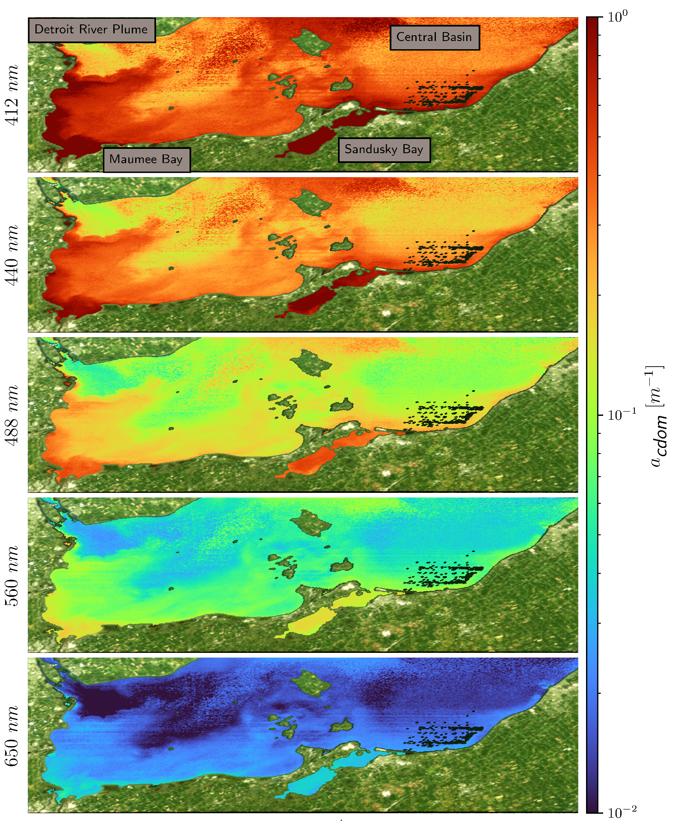
Impacts of Measurement Uncertainties in Satellite Rrs on MDN retrievals:
HICO Product Maps of Lake Erie vs. Historical Understanding (09/08/14)
Notes:
Slide 14: Indicate on the slide HICO derived Rrs from these specific Rrs à that we use as input to estimate these values

Slide 10
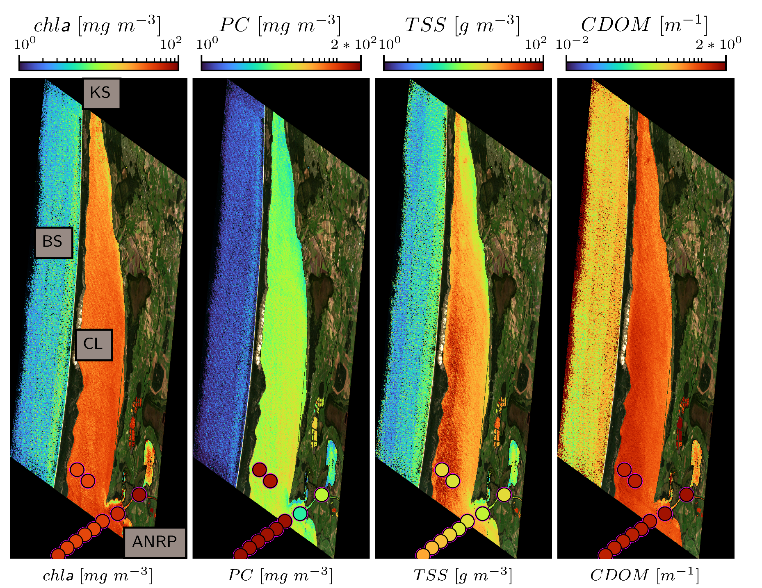
Impacts of Uncertainties in Satellite Rrs on MDN retrievals:
PRISMA Product Maps of Curonian Lagoon against in situ matchups
In situ concentration
Little in situ data
¹Vaicute et al. 2021
*in situ data provided by C. Giardino & M. Bresciani
Notes:
Slide 16/15: add maps with stars for these regions

Slide 11
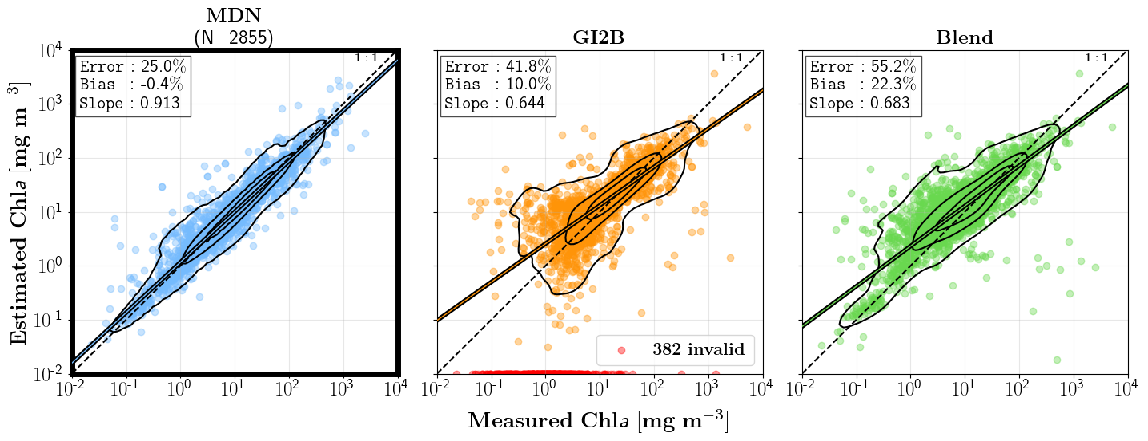
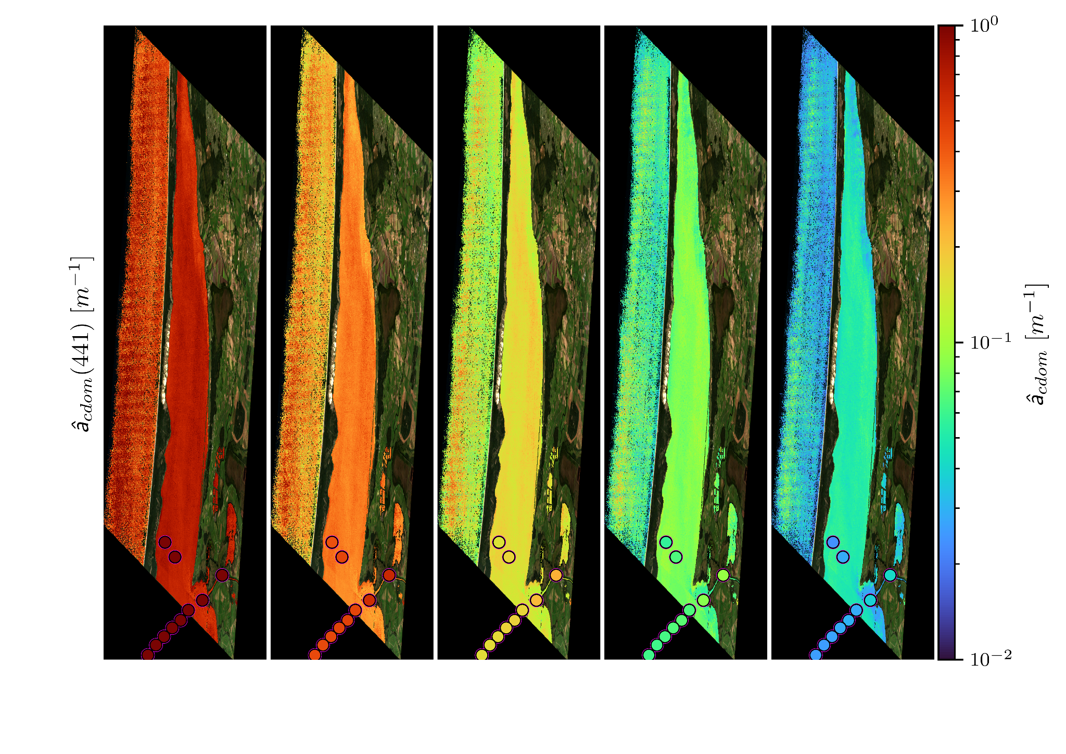
Conclusions
1. Expected ranges of in situ uncertainties
25 – 30% for Chla/TSS/a_{cdom}(440)
60% for PC
20-40% a_{ph}, a_{d}, & a_{g}
2. Product maps consistent with literature understanding & in situ measurements despite atmospheric correction uncertainties
3. Model can be rapidly redeployed to new hyperspectral (or old multispectral) sensors
Similar architecture model, with particulate backscatter, will be pushed to PACE SDS
Visit my poster for more validation exercises with OLCI!

Slide 12
Acknowledgements
Funding:
PACE Science & Applications Team
Ocean Biology & Biogeochemistry
Data providers: C. Binding, C. Giardino, M. Bresciani, Keith et al., Z. Lee, S. Simis, Schalles, Valente et al., Nechad et al., SeaBASS, and many more.
Notes:
Add uncertainties backup slide
NASA Ocean Ecology Lab (for?? / HICO)

Slide 13
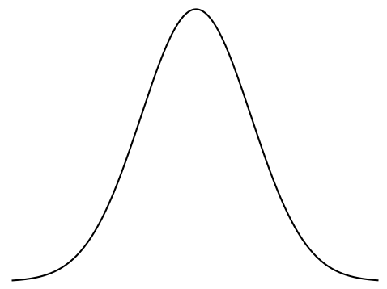
Hyperspectral Inversion Framework
BR(λ₁, λ₂)
α₁
Chla
BR(λ₁, λ₃)
R_{rs}(λ₁)
σ₁
µ₁
PC
Gaussian 1
TSS
LH(λ₁, λ₂ , λ₃)
α₂
Normalization
Need a Machine Learning model for non-unique inverse problem: Mixture Density Network
Neural Network
σ₂
Combination Function
R_{rs}(λ₂)
CDOM
LH(λ₄, λ₂ , λ₅)
µ₂
Gaussian 2
a_{ph}(λ)
a_{g}(λ)
R_{rs}(λ₃)
MA(λ₁, λ₂)
α₅
σ₅
a_{d}(λ)
µ₅
MA(λ₃, λ₄)
Gaussian 5
Notes:
Updated Graphic

Slide 15
Error in 20-40% and is ~ to in situ data magnitude, comparable to dedicated a_{ph} MDN¹
¹Pahlevan et al. 2021, RSE

Slide 16
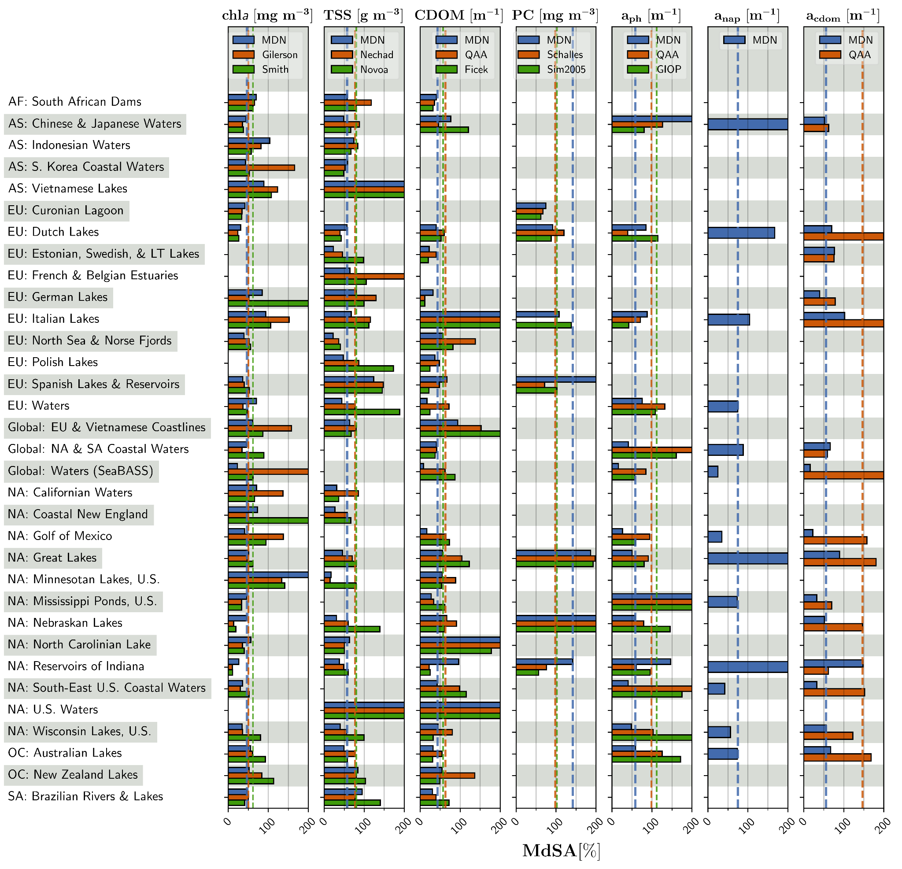

Slide 17
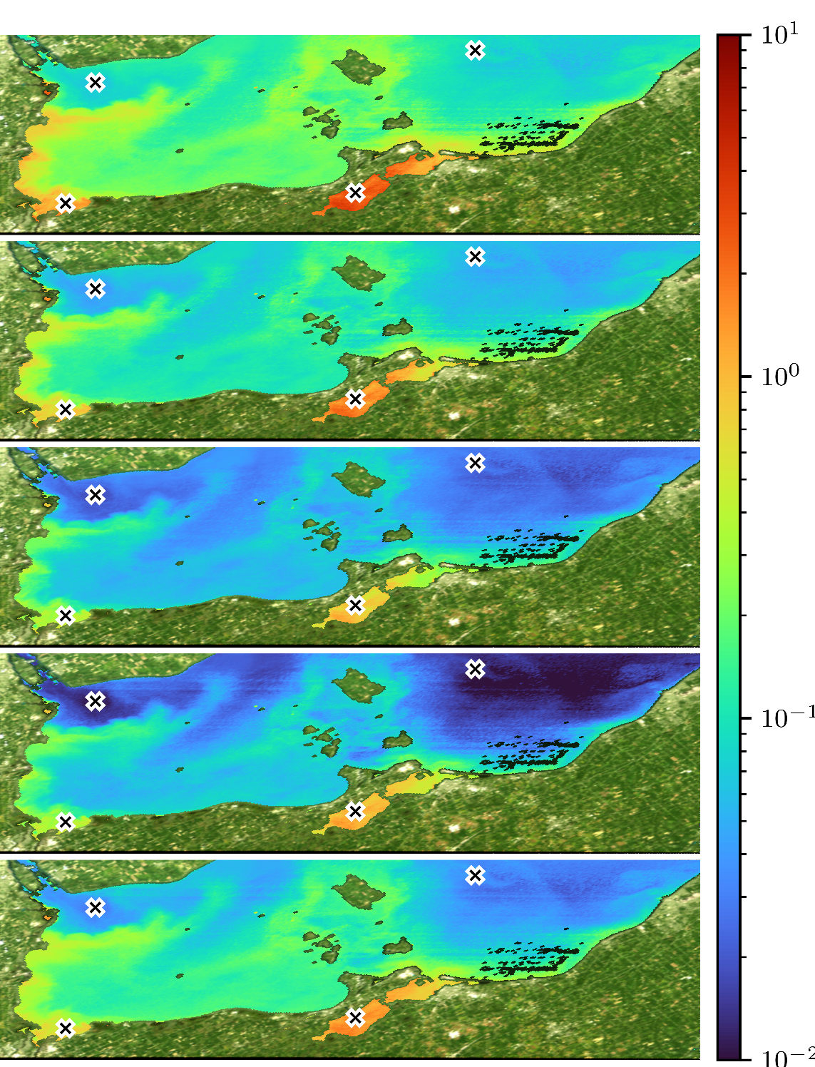
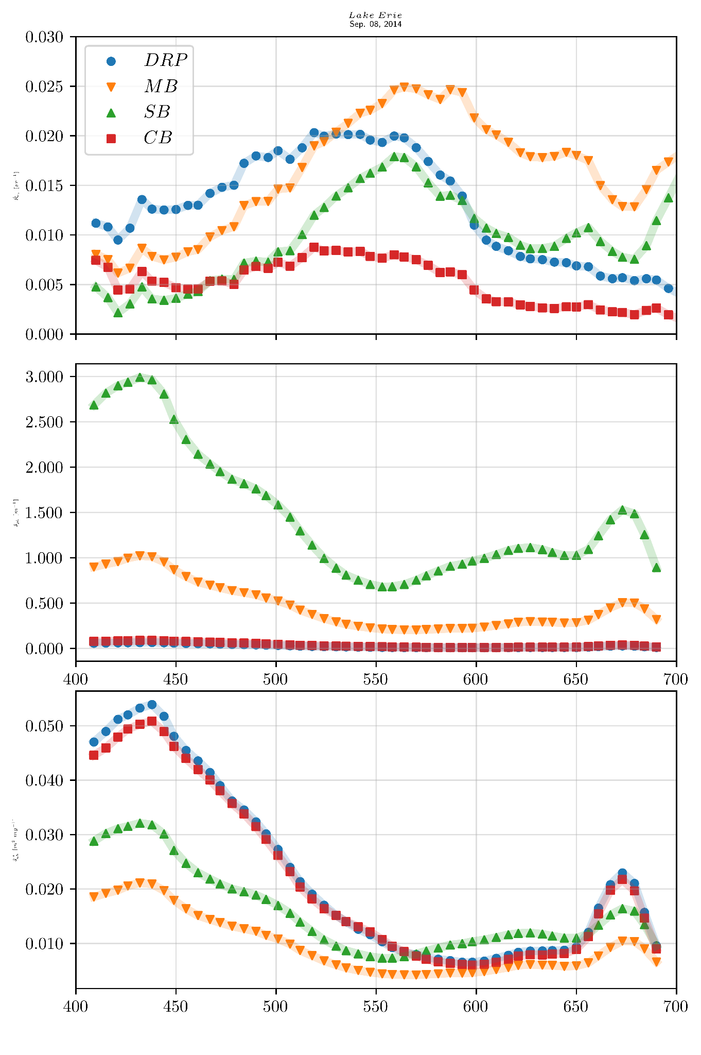
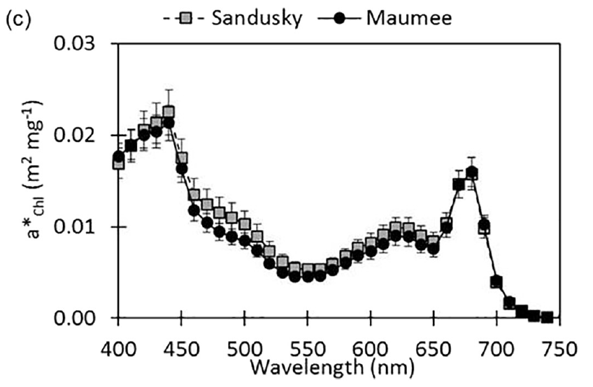
Impacts of Uncertainties in Satellite Rrs on MDN retrievals:
HICO Product Maps of Lake Erie vs. Historical Understanding (09/08/14)
a_{ph} [m⁻¹]
CB
DRP
DRP
MB
444 nm
SB
MB & SB visible absorption dips/peaks at 620 nm (PC absorption max) for R_{rs}/a_{ph}
CB
R_{rs} [sr⁻¹]
SB
MB
490 nm
a_{ph} [m⁻¹]
a_{ph} [m⁻¹]
530 nm
DRP & CB near 0 a_{ph}
MB specific absorption consistent with literature
620 nm
Binding et al. 2019
a*_{ph} [m⁻¹]
673 nm
Wavelength [nm]
Notes:
Slide 14: Indicate on the slide HICO derived Rrs from these specific Rrs à that we use as input to estimate these values

Slide 18
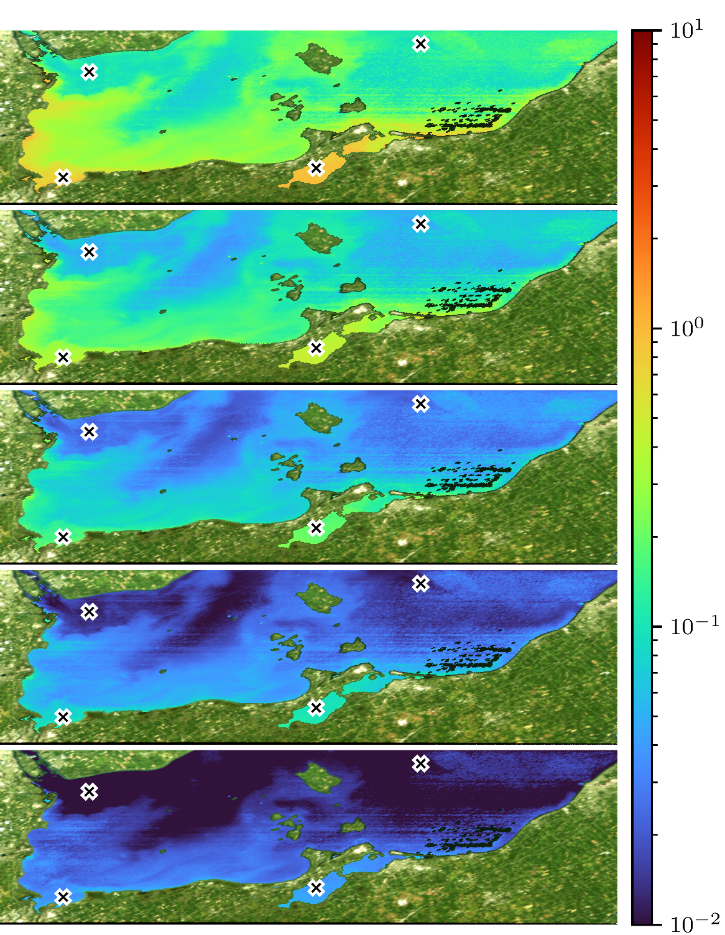
Impacts of Uncertainties in Satellite Rrs on MDN retrievals:
HICO Product Maps of Lake Erie vs. Historical Understanding (09/08/14)
a_{g} [m⁻¹]
DRP
CB
MB
Spatially consistent products, minimal artifacts
DRP
SB
444 nm
CB
R_{rs} [sr⁻¹]
SB
MB
490 nm
a_{g} [m⁻¹]
a_{g} [m⁻¹]
547 nm
DRP & CB low a_{g}
593 nm
Wavelength [nm]
644 nm
Notes:
Mention that we only use 5, but we can reconstruct

Slide 19
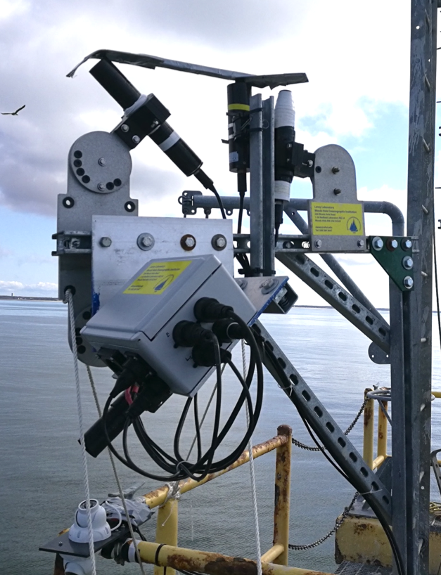
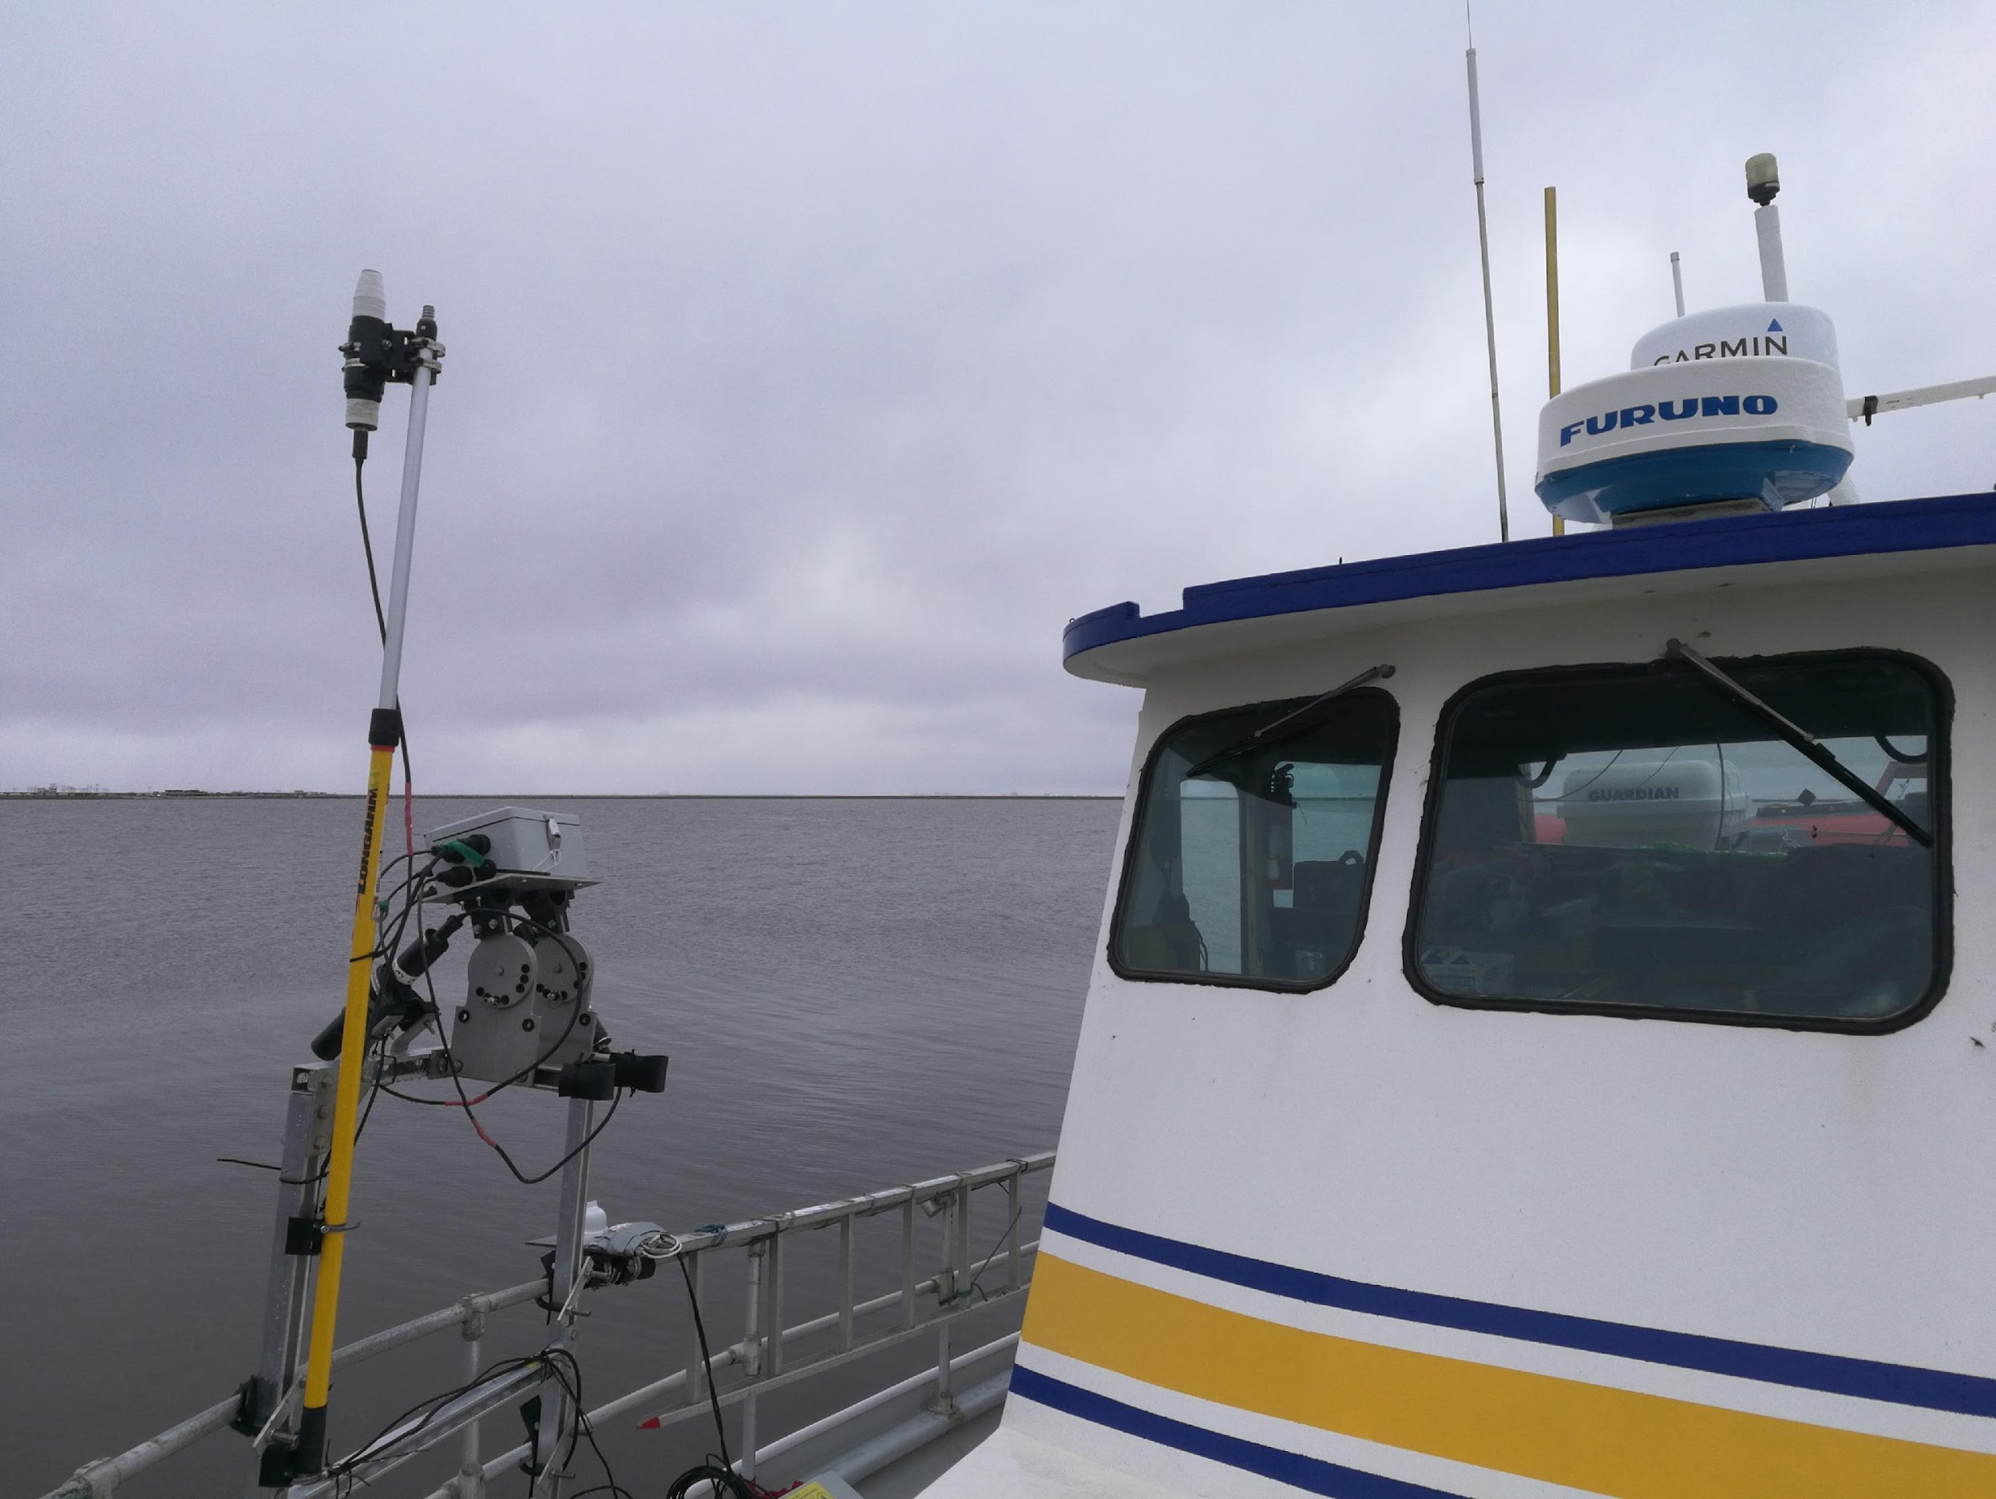
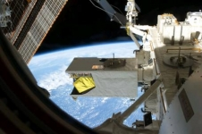
Impacts of Uncertainties in Satellite Rrs on MDN retrievals:
Co-aligned satellite (HICO) & in situ IOP comparison from Florida Bays
Uncertainties in HICO Rrs magnitude & spectral shape
Some in situ data
In situ absorption measurement
MDN estimates from in situ R_{rs}
MDN estimates from HICO R_{rs}
MDN a_{ph} from in situ Rrs matches measured a_{ph}
MDN a_{ph} from HICO Rrs is sensitive to uncertainties, approximates measured a_{ph}
In situ R_{rs}
MDN a_{d}/a_{g} from in situ Rrs match measured a_{d}/a_{g}
MDN a_{d}/a_{g} from HICO Rrs match measured a_{d}/a_{g} slope (~20% error) & magnitude (~40% error)
HICO R_{rs}
Compare MDN estimates from HICO R_{rs} to MDN estimates from in situ R_{rs} to assess model sensitivity to uncertainties in Rrs
Photo credit: NASA
Data from Keith et al. 2014
Notes:
enlarge the fonts for measured in situ remote, add red box around

