Slide 1




Remote Sensing of Biophysical Properties in Coastal Arctic Waters – Preliminary Results
Wesley J. Moses, Steven G. Ackleson, J. Blake Clark, Ahmed El-Habashi, Daniel W. Koestner, Alana Menendez, Jonathan Sherman, Kyle Turner, Maria Tzortziou, and Hisatomo Waga
OBB Awards: 80HQTR21T0050 and 80NSSC22K1043

Slide 2
Objective
Objectives
Quantify the concentrations and composition of optically significant constituents in coastal Arctic waters
Characterize their optical properties
Investigate the ability to retrieve constituent concentrations and composition and monitor ecosystem changed through remote sensing
Develop a coastal Arctic aquatic ecosystem model
Obtain baseline measurements to initiate time-series data for analysis of short-term and long-term changes

Slide 3
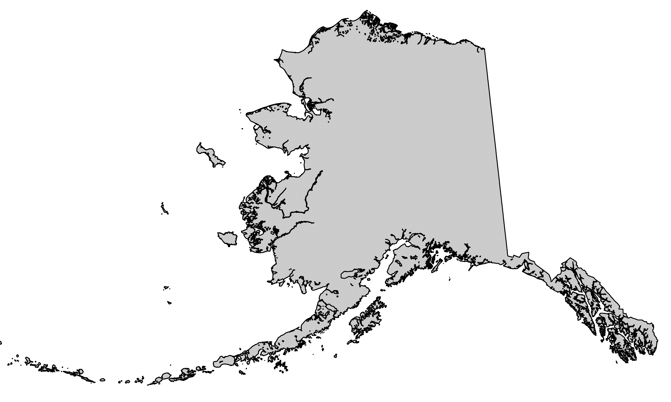
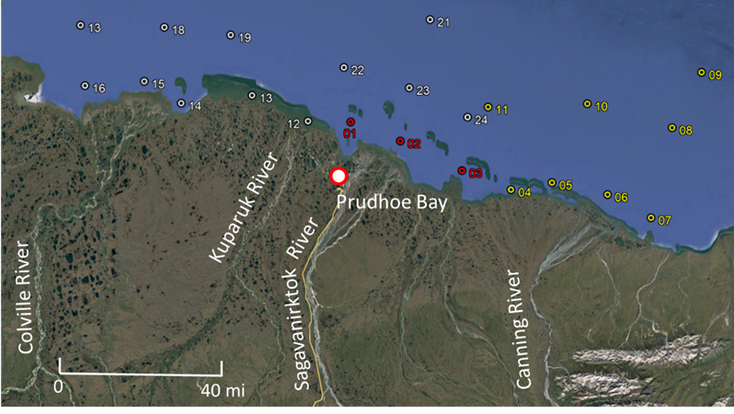
Study Area
17
18
21
19
ALASKA
22
09
16
15
14
13
23
10
11
12
24
08
01
02
03
04
05
06
07
Two field campaigns in summers of 2021 and 2022
2021 2022 2021 & 2022

Slide 4
Measurement Parameters
Category | Parameter
Imagery | Hyperspectral imaging data
Radiometry (Above-water) | Lu, Lcal, Lsky Instruments: ASD, SVC
Radiometry (In-water) | Lu, Ed Instrument: Hyperpro
IOP (Package 1) | a_{p}, c_{p}, a_{g}, b_{b}, Chl, PSD (1–2500 µm), particle shape Instruments: ac-s, ac-9 (0.2 µm filter), bb-3, Fluorometer, LISST-100, LISST-Holo
IOP (Package 2) | VSF, b, b_{b}, c, DoLP Instrument(s): LISST-VSF
Biophysical | Chl-a (HPLC and fluorometric), SPM, POC, ap, aph, DOC, CDOM/fDOM, nutrients

Slide 5
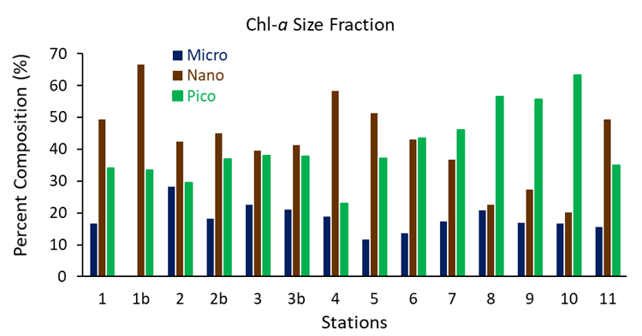
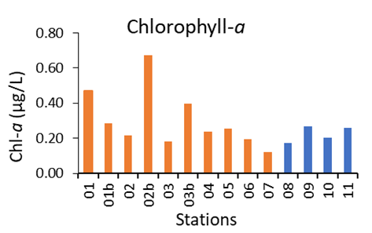

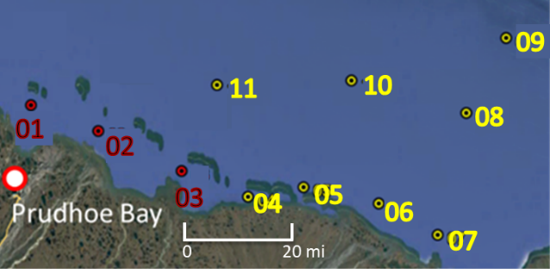
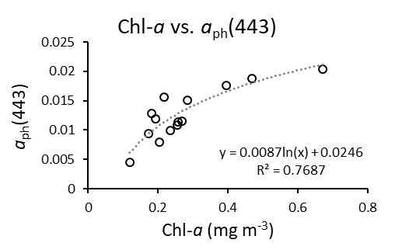
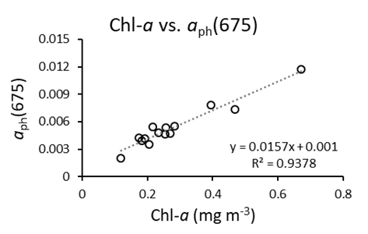
Biophysical Properties
1 1b 2 2b 3 3b 4 5 6 7
8 9 10 11

Slide 6
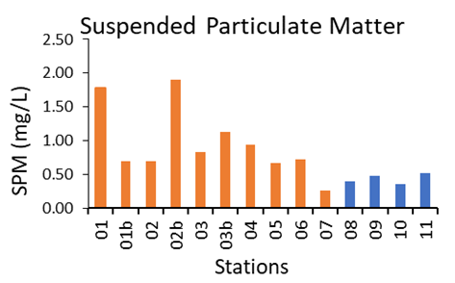
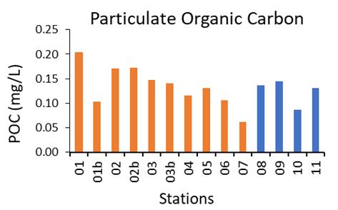
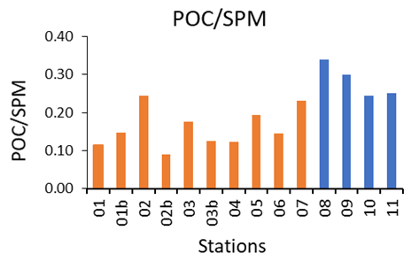
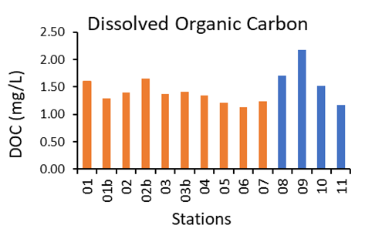
Biophysical Properties

Slide 7
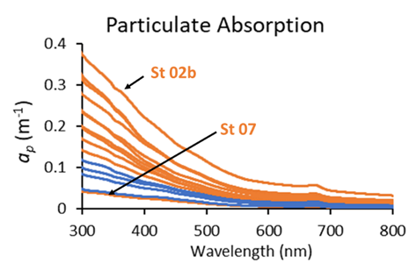
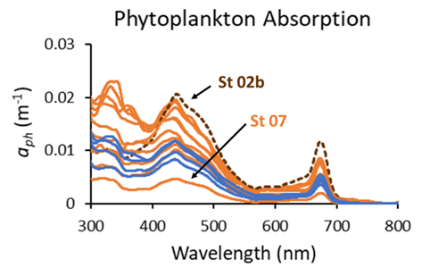
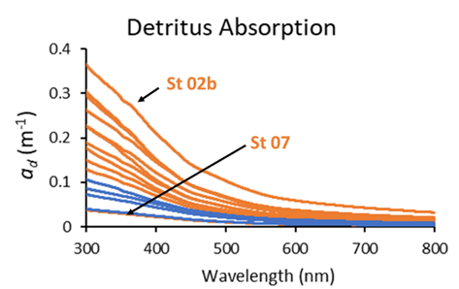
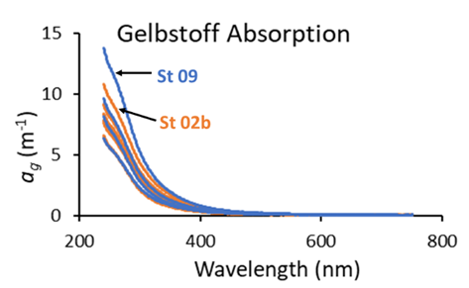
Optical Properties

Slide 8
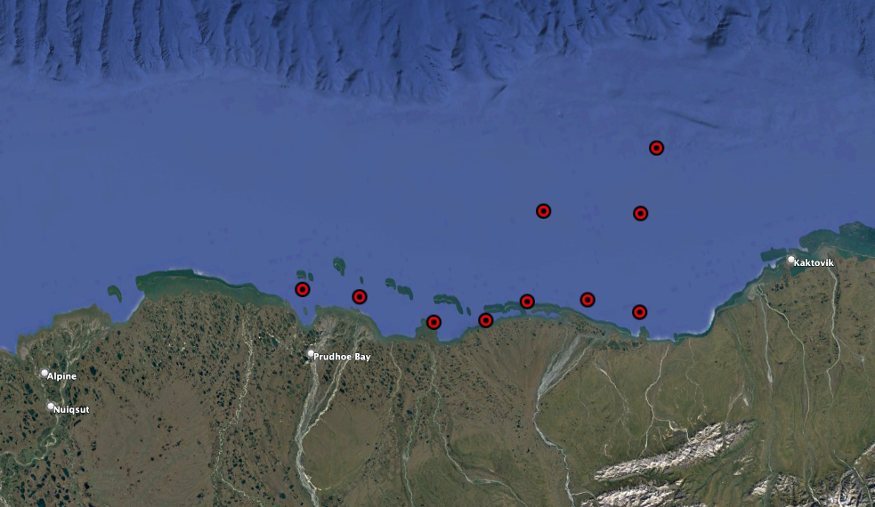
Total Particle Volume Size Ratio
Total Particle Volume Size Ratio; Vp > 10 μm / Vp < 10 μm
15
10
5
0
09
10
08
11
01
02
05
06
07
03
04

Slide 9
Particle Diameter
LISST Holo-2 Particle Sauter Diameter (D_{s})
μm
180
140
100
60
20
09
10
08
11
01
02
05
06
07
03
04

Slide 10
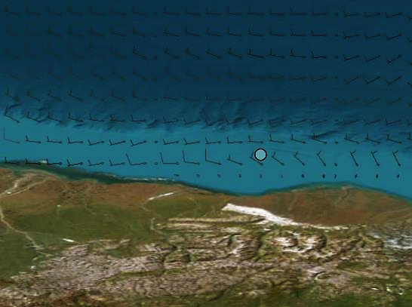
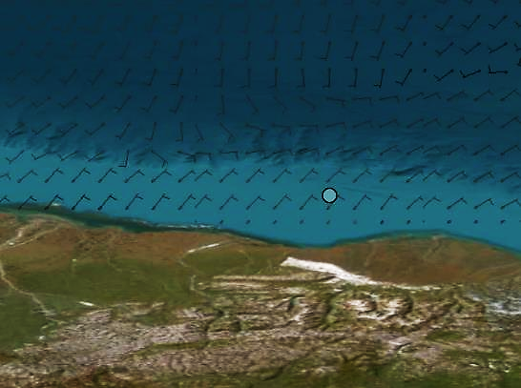
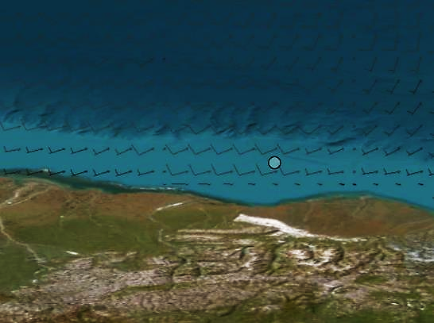

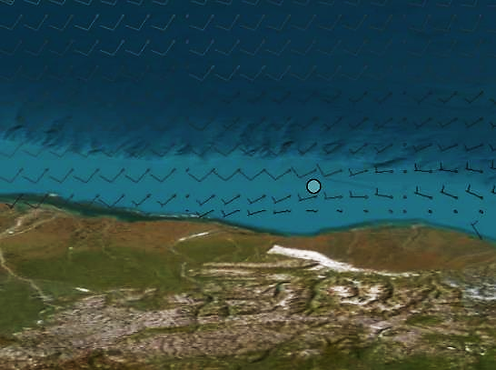
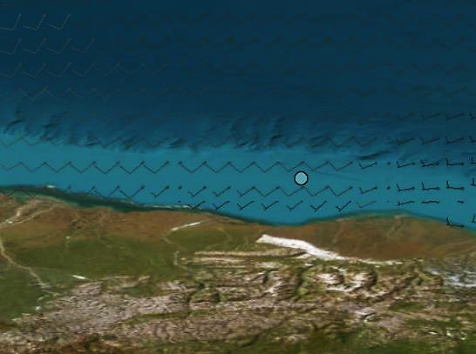
Wind Barbs
10 Aug 2021
11 Aug 2021
12 Aug 2021
St 9
13 Aug 2021
14 Aug 2021
15 Aug 2021

Slide 11
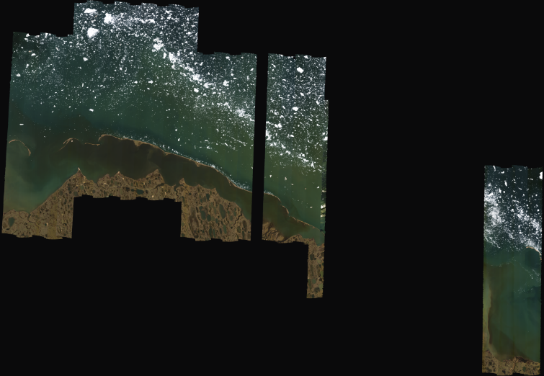
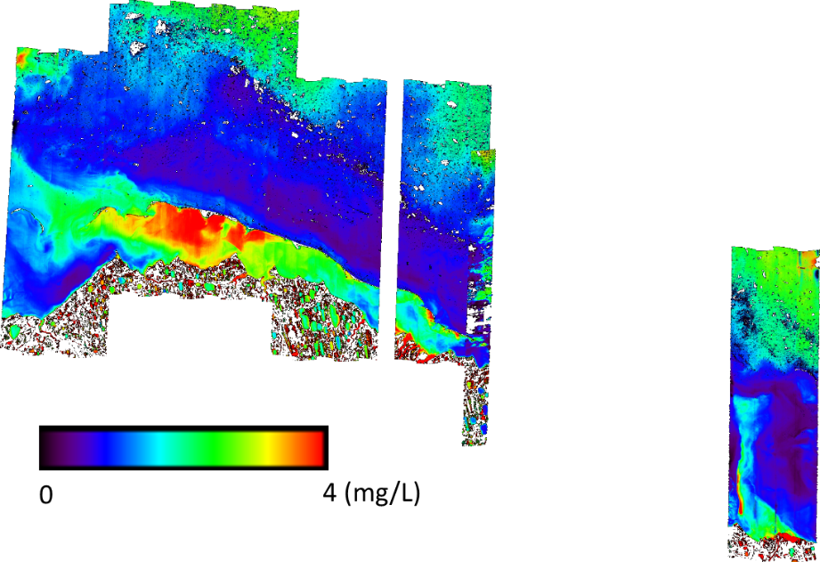

AVIRIS-NG Airborne Data Analysis
Retrieved Dissolved Organic Carbon
14
13
12
 | DOC, mg/L (AVIRIS-NG) | DOC, mg/L (ASD) | DOC, mg/L (SVC)
Stn 12 | 2.9 | 2.29 | 1.65
Stn 13 | 2.92 | 2.46 | 2.12
Stn 14 | 1.99 | 2.08 | 1.95
(from Cao and Tzortziou, 2021)
B1: 442 nm
B2: 487 nm
B3: 563 nm
B4: 663 nm
Band locations chosen based on the closest AVIRIS-NG bands to the bands used in Cao & Tzortziou (2021)

Slide 12
Arctic Coastal Ecosystem Project
From ~50 m MSL around the lower reaches of the rivers to the continental shelf break
Spatial resolution: ~50 m in the shallowest parts to ~2.5 km offshore
Model forced using measured and interpolated physical and biological data
The model will include components that deal with hydrodynamics, sediment transport, light attenuation, and trophic linkages/dynamics to model the physical and biological response to environmental changes
(Blake Clark, NASA GSFC)

Slide 13
Conclusion
Pigment concentrations are generally low
As expected, nearshore waters are distinctly different from offshore waters
Interesting phenomenon at one particular offshore stations that suggests interesting ocean circulation/mixing process that deserves further investigation
Algorithm development for biophysical parameters ongoing
Coastal Arctic aquatic ecosystem under development

Slide 14
Thank You!

Slide 15
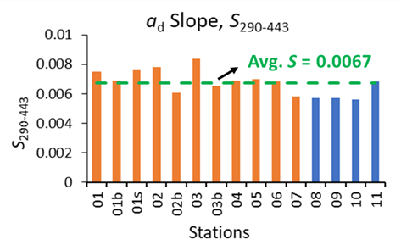
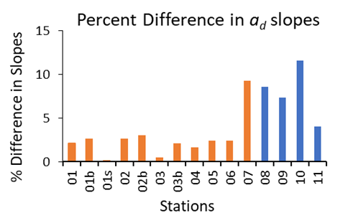
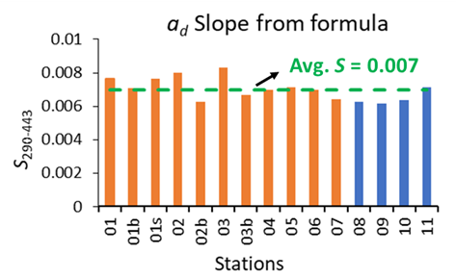
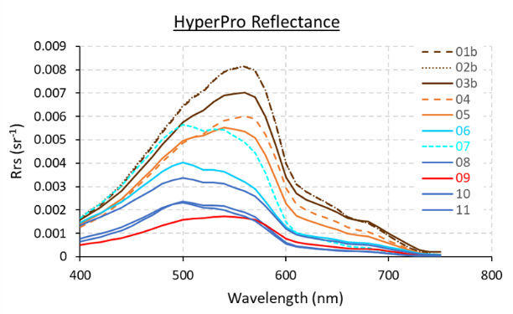
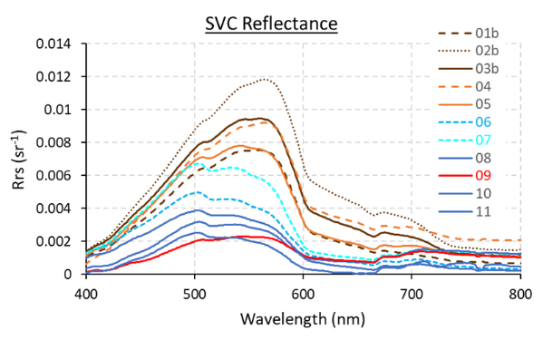

Optical Properties
$$a_{d}\left(λ\right)=a_{d}\left(λ_{0}\right)e^{−S\left(λ−λ_{0}\right)}$$

Slide 16
Particle Volume
Total Particle Volume (V_{p}) < 10 μm
μL/L
0.4
0.3
0.2
0.1
0
09
10
08
11
01
02
05
06
07
03
04

Slide 17

Size-Fractionated Chl-a
17
Chlophyll-a size distribution (CSD)
Pico-size chla
(Chla_{pico}; <2 um)
Chla (mg m⁻³)
Nano-size chla
(Chla_{nano}; 2–20 um)
Micro-size chla
(Chla_{micro}; >20 um)
Marañón (2015)
Cell size (um)
CSD slope
Hisatomo Waga ● International Arctic Research Center

Slide 18
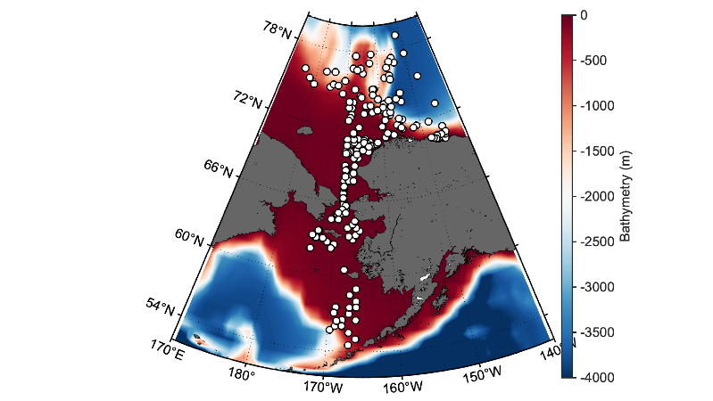
Size-Fractionated Chl-a
18
N=249
Chla: 0.04–23.7
%Micro: 0.0–94.4
%Nano: 0.0–81.6
%Pico: 0.4–100.0
CSD slope: 0.01–2.24
Hisatomo Waga ● International Arctic Research Center

Slide 19
Size-Fractionated Chl-a
19
Machine learning
Hisatomo Waga ● International Arctic Research Center

