Slide 1





Genomic-to-space measurements reveal global ocean nutrient stress
Adam Martiny
Lucas Ustick
Toby Westberry
Michael Behrenfeld

Slide 2

Future warming
Stratification
Nutrients
Nutrients
Large potential impact on marine life and carbon sequestration
Uncertainty:
Physical link between warming and stratification
Ecosystem resilience

Slide 3
Difficult to quantify nutrient stress over large spatial and temporal scales
Future warming
Stratification
Solution:
Combination of large-scale genomics +
Regulation of C:chlorophyll from remote sensing
Nutrients
Nutrients
Large potential impact on marine life and carbon sequestration
Uncertainty:
Physical link between warming and stratification
Ecosystem resilience

Slide 4
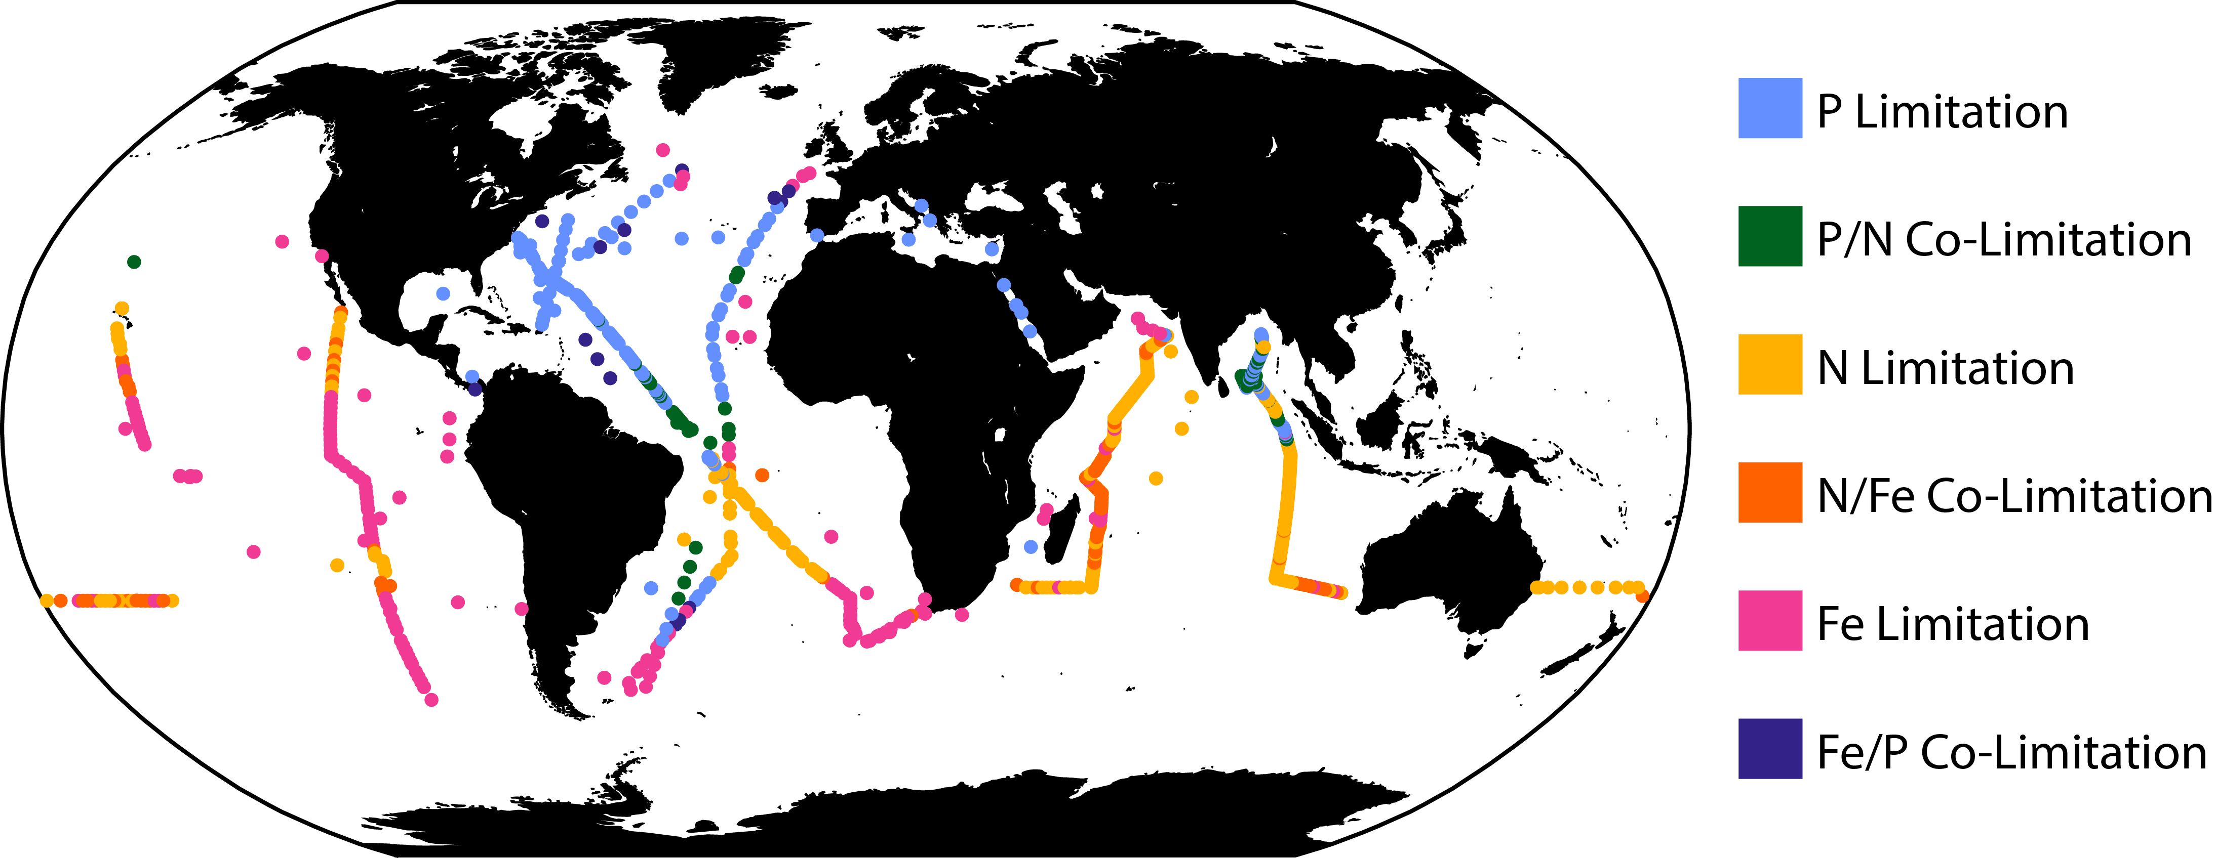
Developing a remote sensing diagnostic for nutrient stress
Physiology:
Cells adjust chlorophyll in response to light and nutrient stress
Metagenomics:
Biomarkers for type and severity nutrient stress
Ustick et al., 2021 – based on Bio-GO-SHIP activities
Laws and Bannister, 1980
Notes:
Uncertainties associated with each – both combined can describe ocean nutrient stress
Carbon – to – chlorophyll can be observed remotely

Slide 5
Remote sensing of nutrient stress
Remote sensing ‘ingredients’
Chlorophyll
Backscattering -> C_{phyto}
PAR
Light attenuation (K_{d})
+ Mixed layer depth
From MODIS
(can also use SeaWiFS)

Slide 6
Remote sensing of nutrient stress
Remote sensing ‘ingredients’
Isolating nutrient stress signal
Chlorophyll
Backscattering -> C_{phyto}
PAR
Light attenuation (K_{d})
+ Mixed layer depth
Θ’ = Θ_{obs} / Θ_{photo}
Θ_{obs} = C_{phyto}/chlorophyll
(remote-sensed carbon-to-chlorophyll)
Θ_{photo} = f(PAR, K_{d}, MLD)
(i.e., photo-acclimation effect)
Θ’ = 1 (no nutrient stress)
Θ’ >> 1 (nutrient stress)
From MODIS
(can also use SeaWiFS)
Θ_{photo} is described in Behrenfeld et al., 2015
Notes:
Growth restriction due to nutrient stress

Slide 7
Strong correspondence between environment conditions, genomics, and remote sensing of nutrient stress
Observed Nutrient Stress (Θ’)
R = 0.63
High
Estimated nut. stress (Z_{nut}, N_{stress}, P_{stress})
Estimated from Nutricline and biomarkers
Low
Observed nut stress w. MODIS Θ’
Notes:
Poor fit in coastal and beyond polar front – indicates that our metric does not apply to these regions.

Slide 8
Type of nutrient stress important
Atlantic section (AMT28)
Indian Ocean section (I09N)
Env. model

Slide 9
Type of nutrient stress important
Atlantic section (AMT28)
Indian Ocean section (I09N)
Env. model
Nutricline primary driver
N compared to P stress leads to higher overall growth restriction

Slide 10
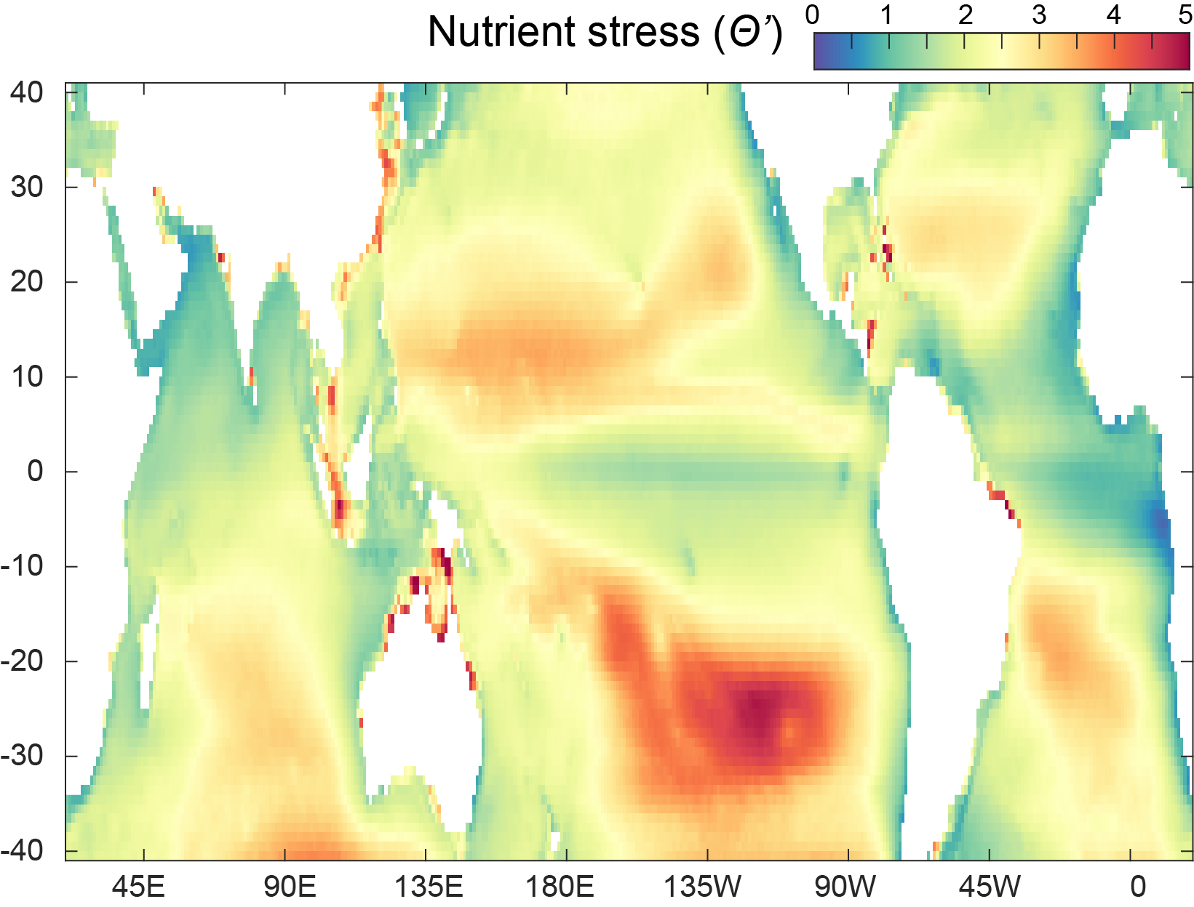
Mean global nutrient stress
Higher nutrient stress in subtropical gyres
Lower nutrient stress in upwelling regions
Southern hemisphere bias

Slide 11
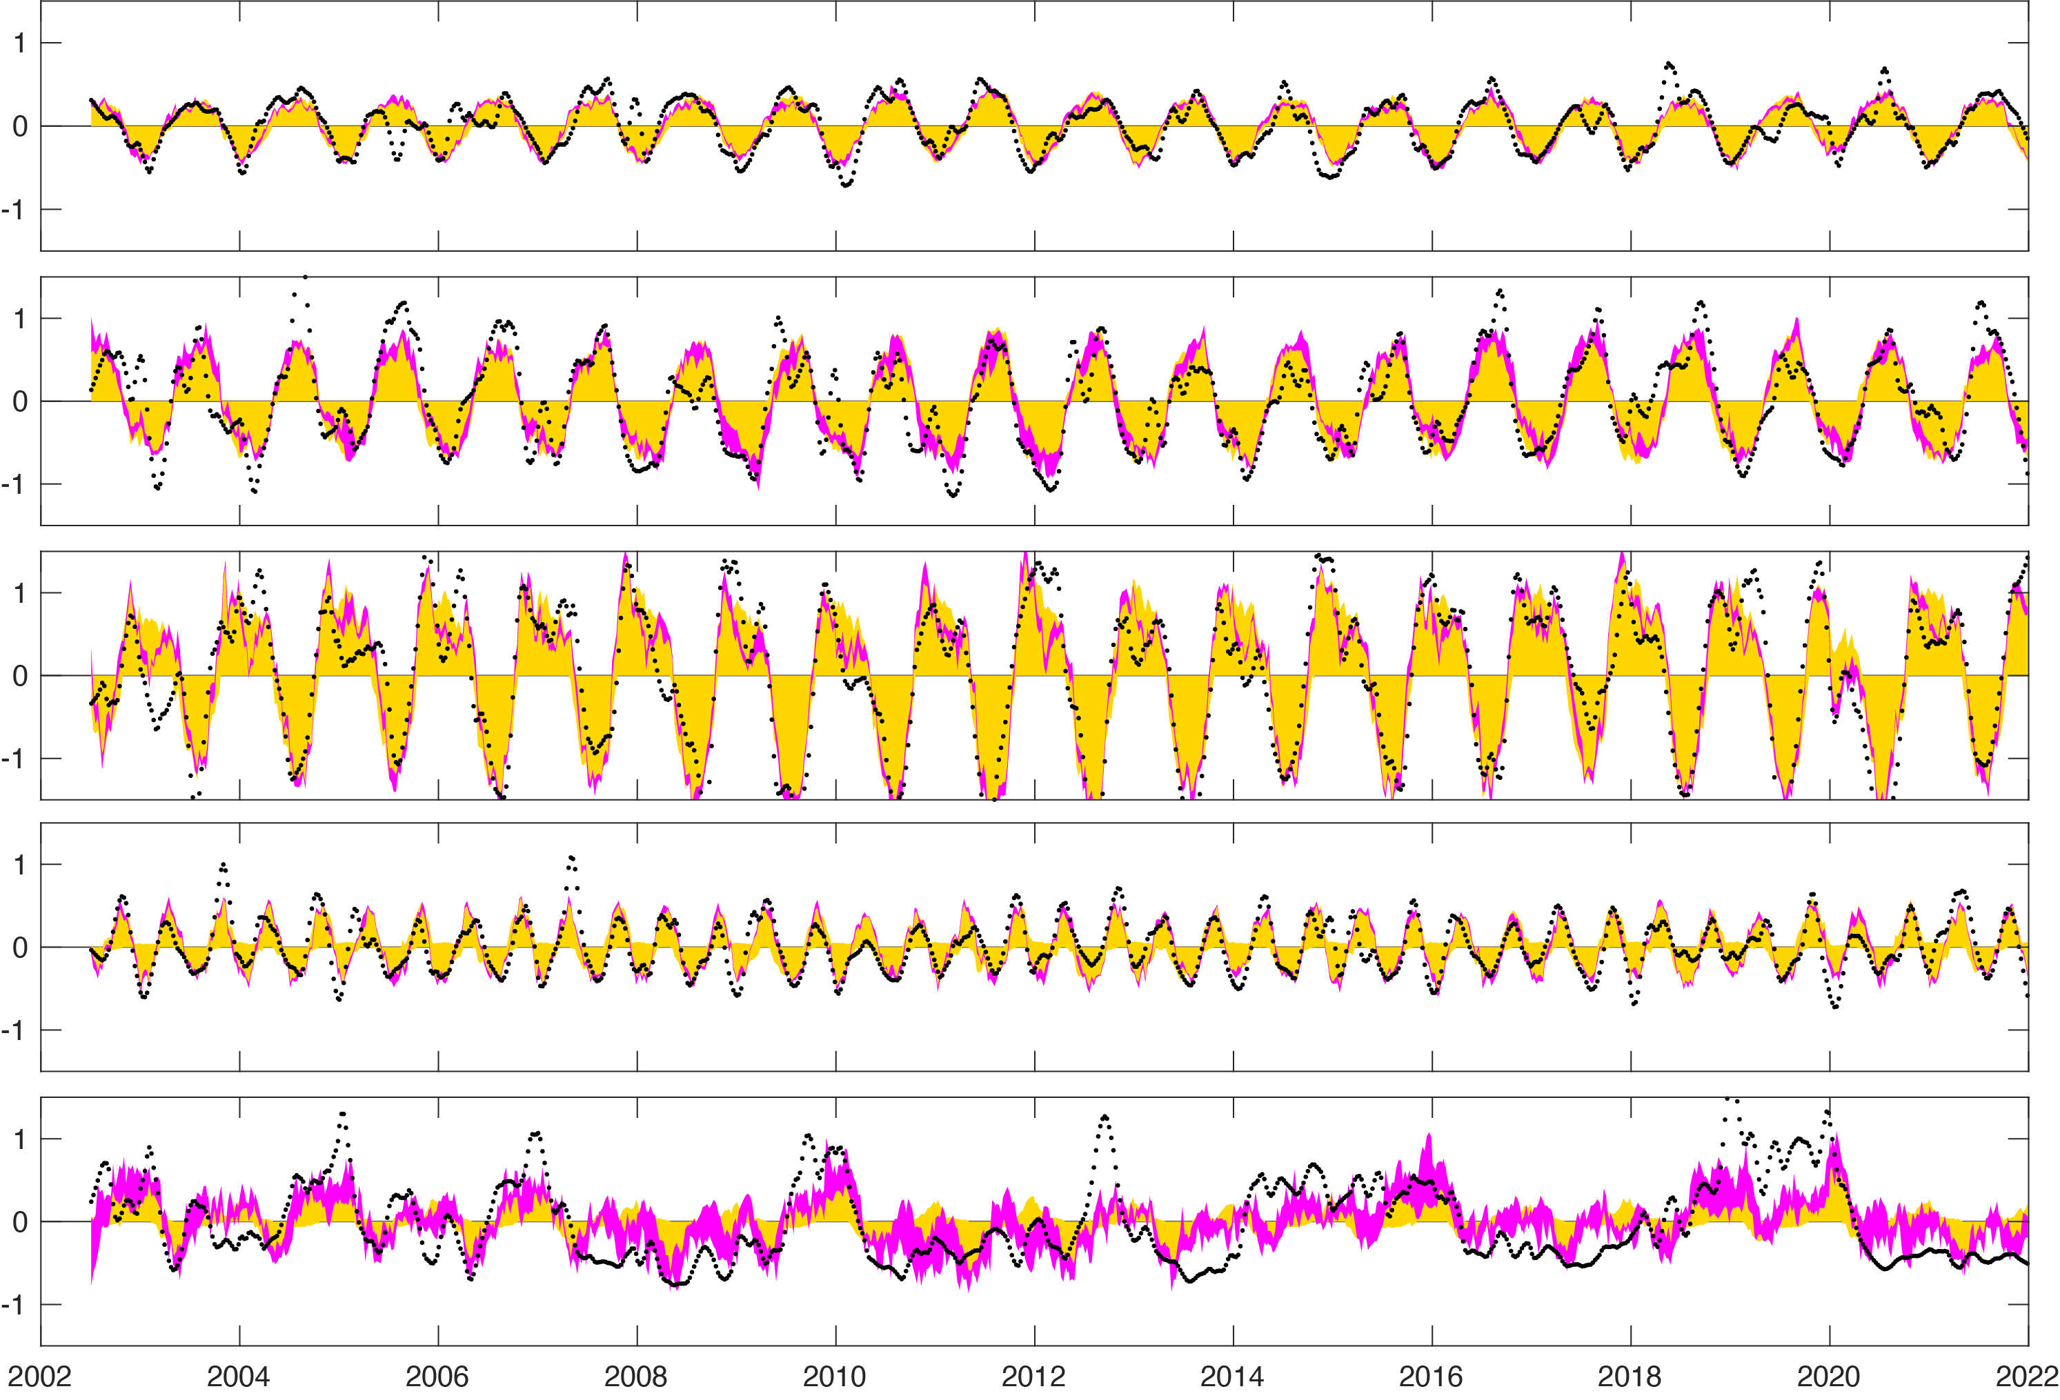
Hawaii Ocean Time-series (HOT)
Nut stress anomaly
X
Time (2002 – 2022)
Clear seasonal cycle with peak in late summer
Observation
Seasonal variation
Interannual variation
From EOF analysis

Slide 12
Equatorial Atlantic Ocean
Nut stress anomaly
Time (2002 – 2022)
X
Two annual peak in the tropics)
Observation
Seasonal variation
Interannual variation
From EOF analysis

Slide 13
Equatorial Pacific Ocean
Nut stress anomaly
Time (2002 – 2022)
X
Most variance interannual
Observation
Seasonal variation
Interannual variation
From EOF analysis

Slide 14
HOT
BATS
X
X
SPac
X
X
Nut stress anomaly
EqAtl
X
EqPac
Observation
Seasonal variation
Interannual variation
Time (2002 – 2022)
From EOF analysis

Slide 15
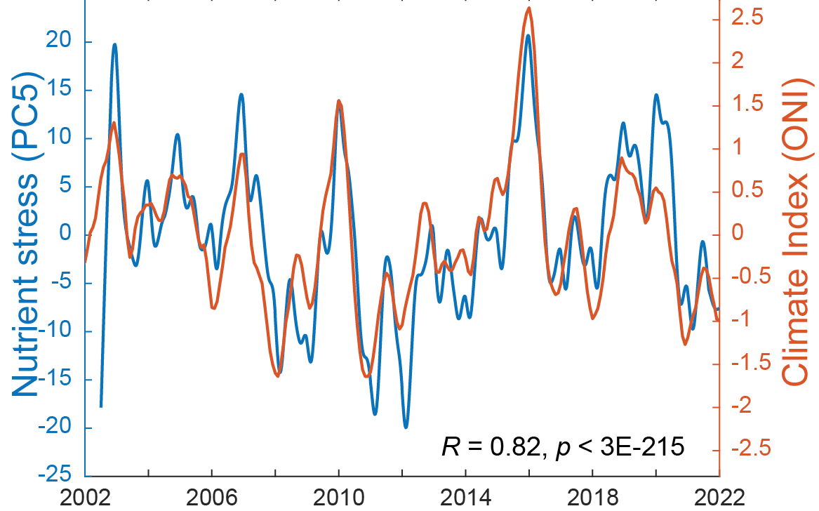
Climate cycles in nutrient stress
Link to ENSO cycles
First interannual principal component from EOF analysis

Slide 16
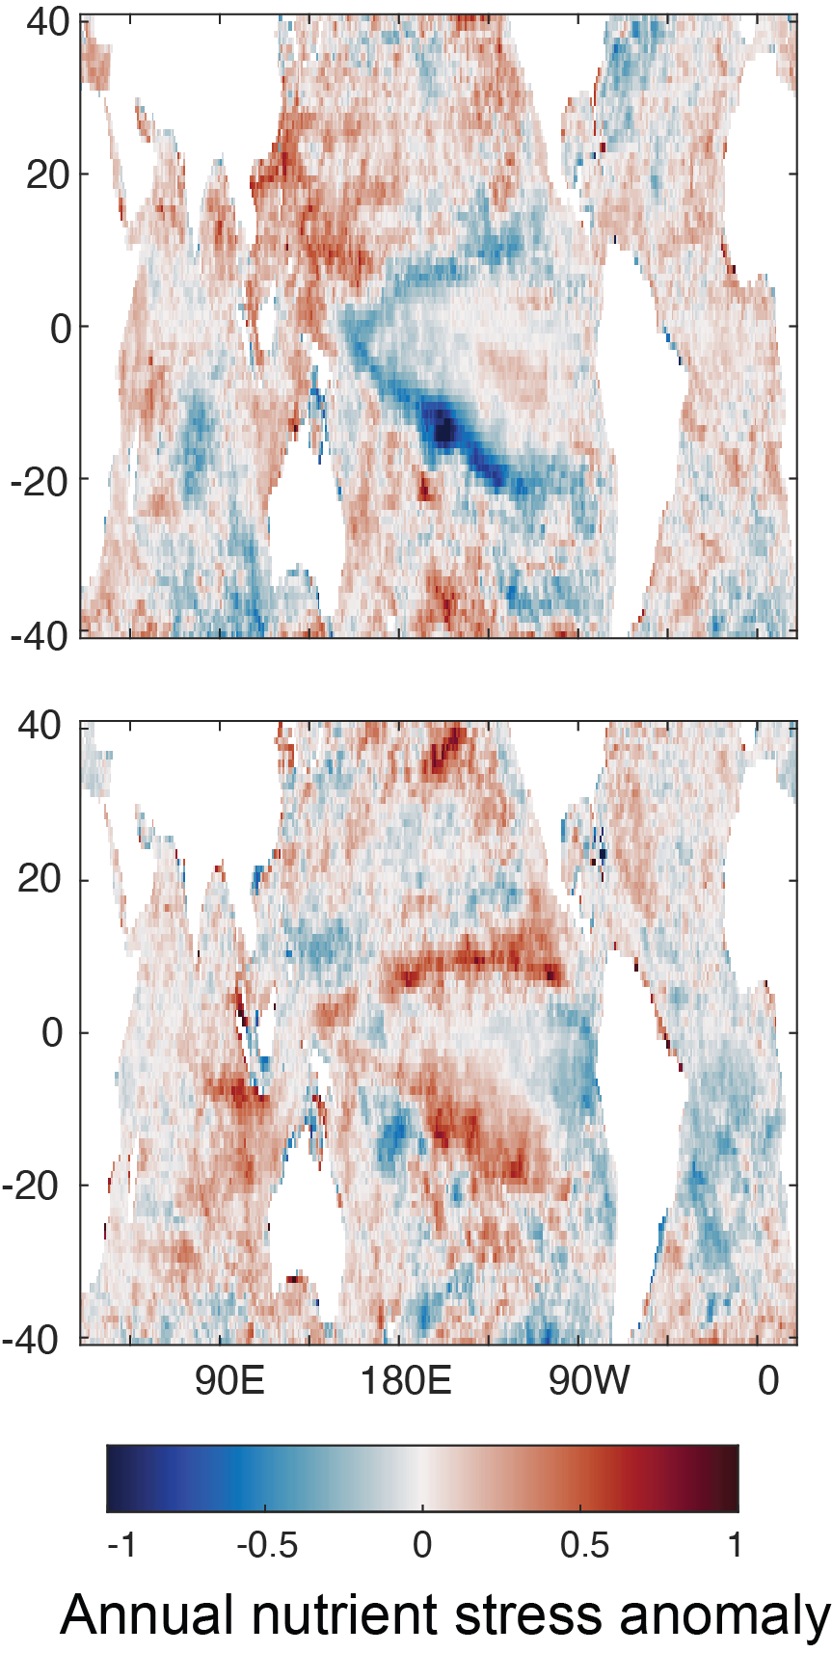
Climate cycles in nutrient stress
Lower stress at edge op upwelling
Higher stress near maritime cont.
Link to ENSO cycles
2011 (La Nina)
2016 (El Nino)
First interannual principal component from EOF analysis

Slide 17
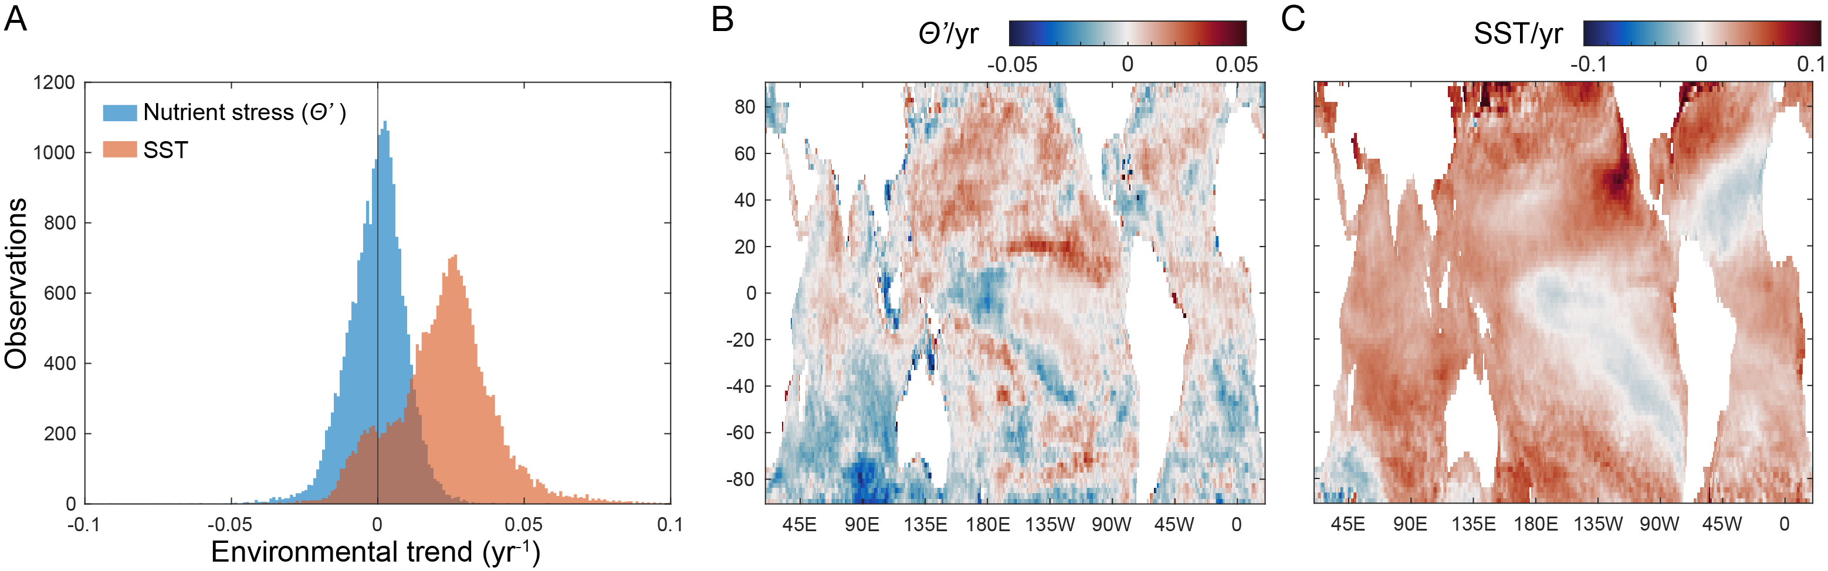
Contemporary trend in nutrient stress vs. temperature
Mean warming ~ 0.4˚C
(2002 – 2021)

Slide 18
No obvious contemporary trend in nutrient stress
Median nutrient stress change ~0
Notes:
Although slightly positive

Slide 19
Summary
Integration of ‘omics and remote sensing -> new validated nutrient stress metric
N limitation leads to higher nutrient stress compared to P
Reveals global spatio-temporal variation in nutrient stress
Link to ENSO cycles with higher equatorial nutrient stress during El Nino
Weak link to climate warming
  Warming ≠ stratification?
  Ecosystem resilience?
  Too short observation period?

Slide 20
Summary
Integration of ‘omics and remote sensing -> new validated nutrient stress metric
N limitation leads to higher nutrient stress compared to P
Reveals global spatio-temporal variation in nutrient stress
Link to ENSO cycles with higher equatorial nutrient stress during El Nino
Weak link to climate warming
  Warming ≠ stratification?
  Ecosystem resilience?
  Too short observation period?
Thank You
Questions?

