Slide 1
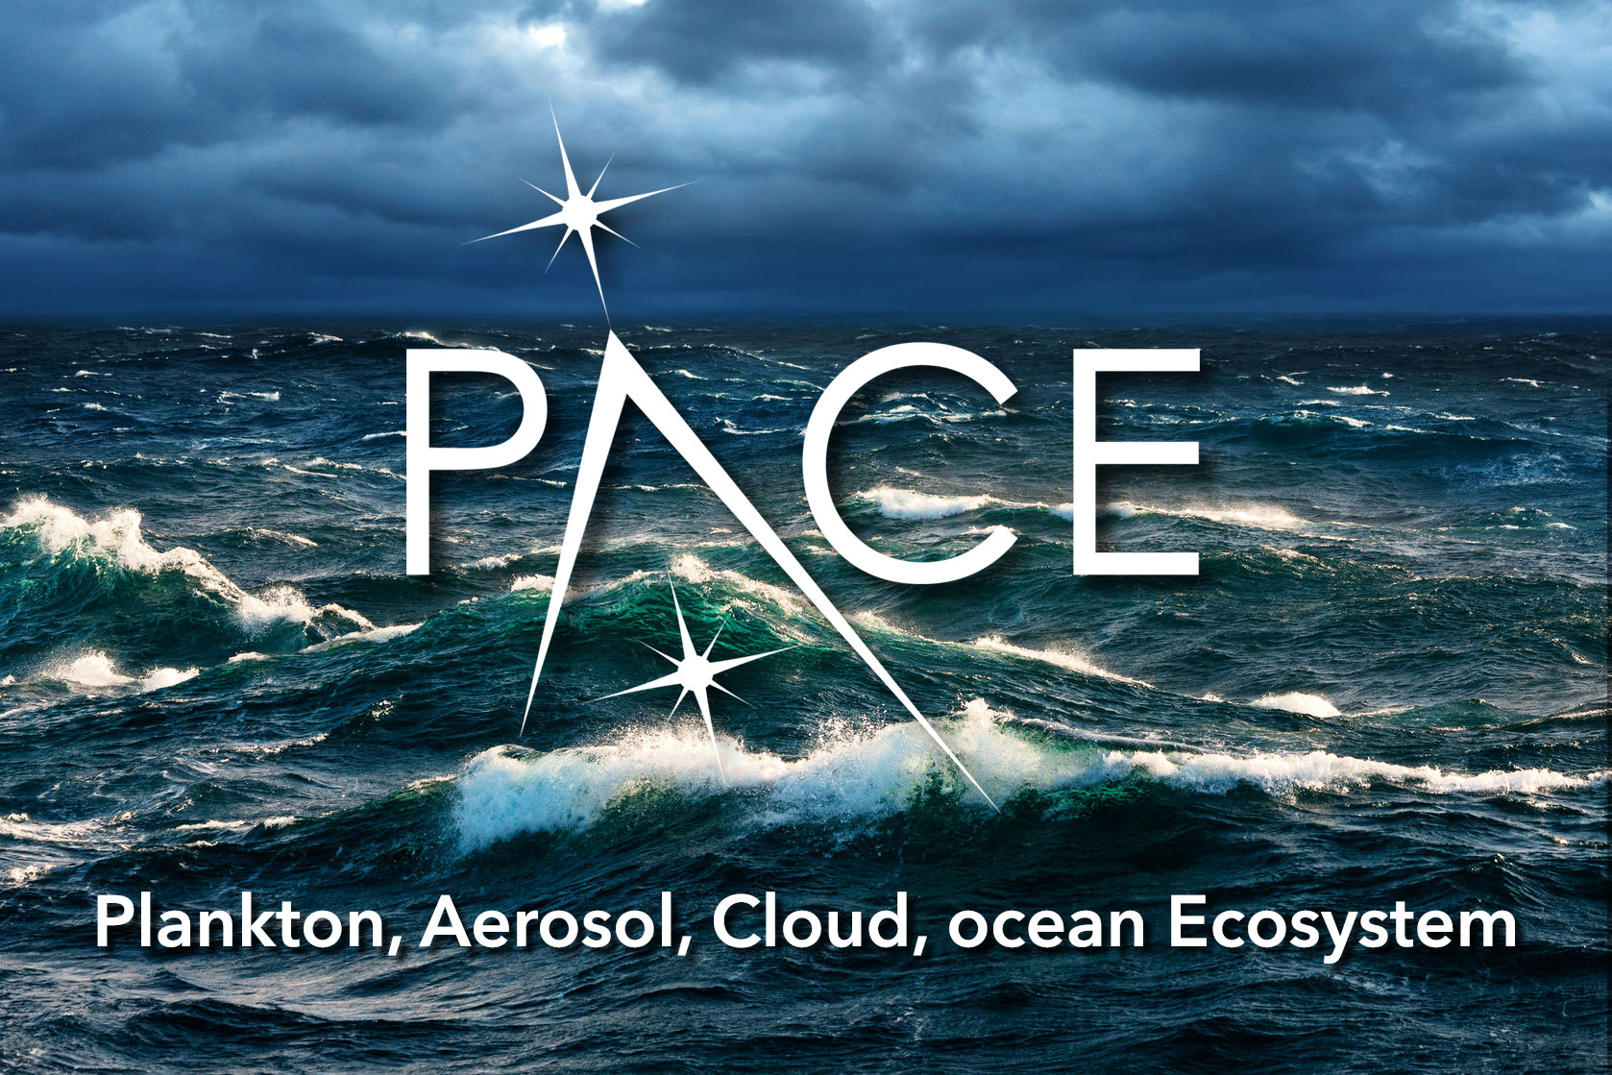
PACE Science & Applications Team
Heidi Dierssen

Slide 2
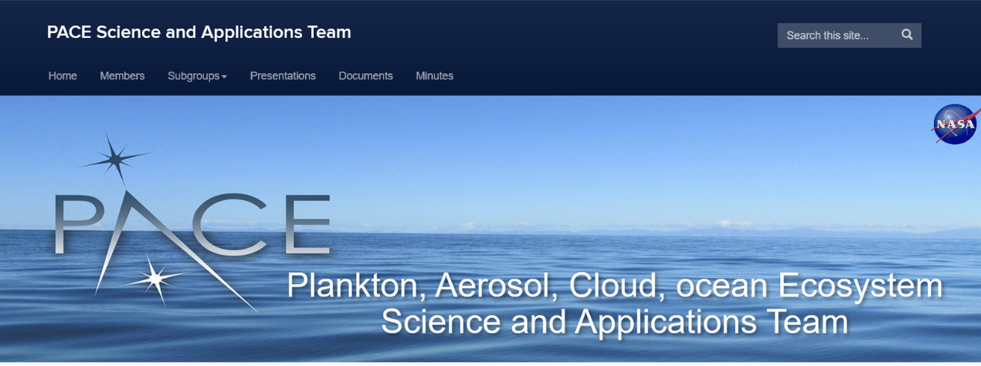

Pace Science and Applications Team
Plankton, Aerosol, Cloud and ocean Ecosystem (PACE) :
Synergies in Data, Science, and Applications
Heidi Dierssen, Jeremy Werdell and Lorraine Remer
University of Connecticut
Science and Applications Team Lead

Slide 3
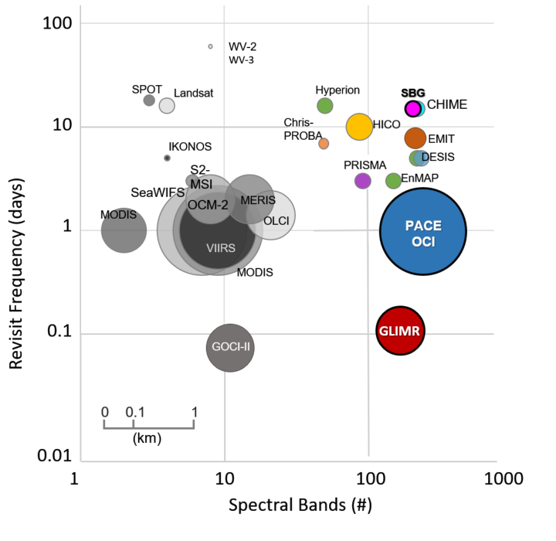

Slide 4
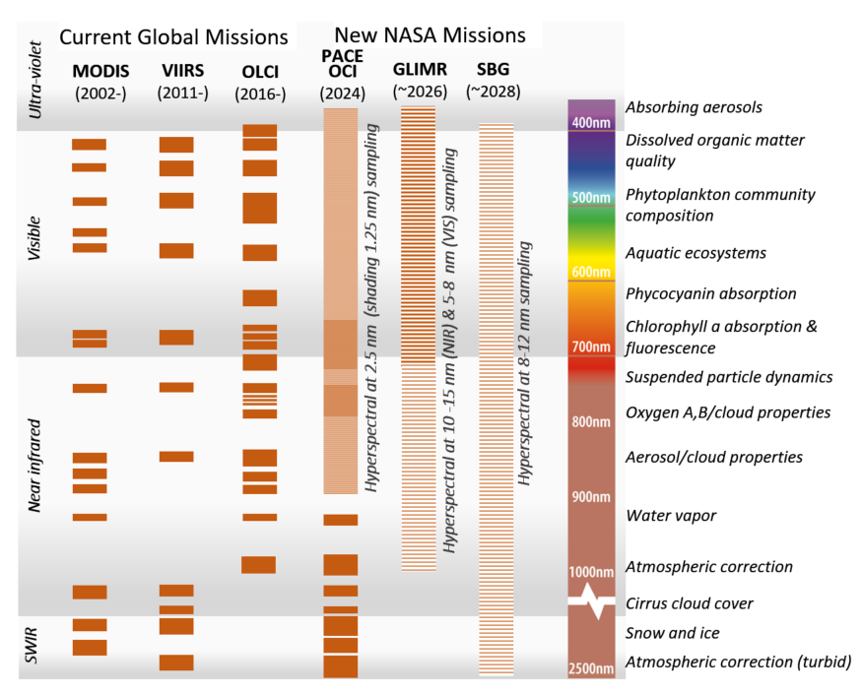

Slide 5
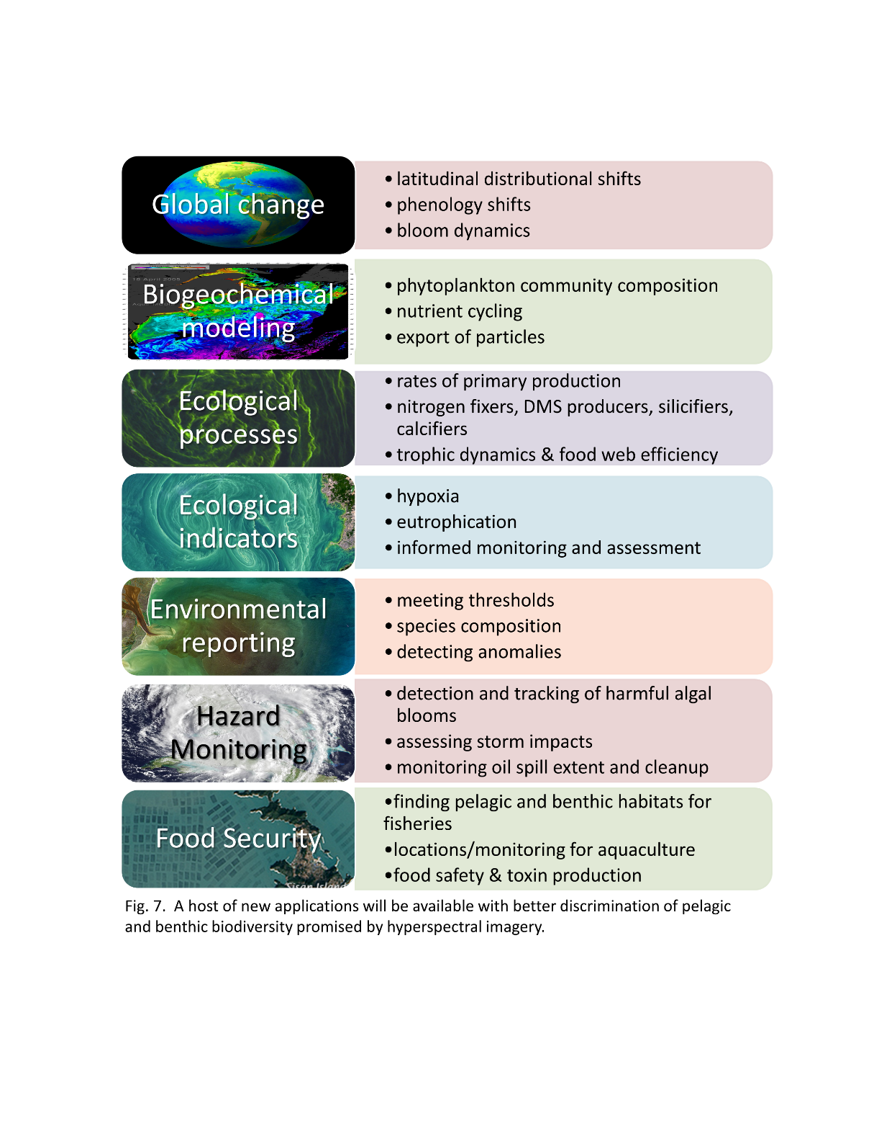
Dierssen et al. 2021

Slide 6
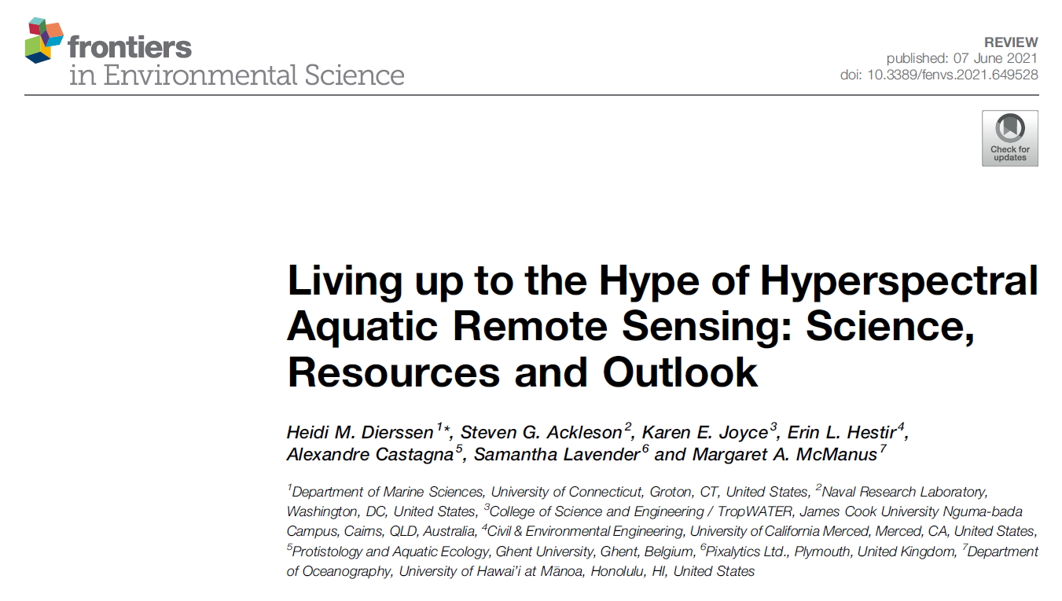
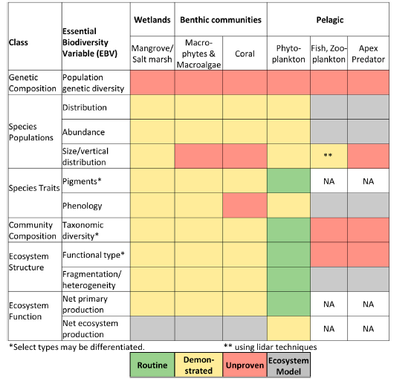
PACE

Slide 7
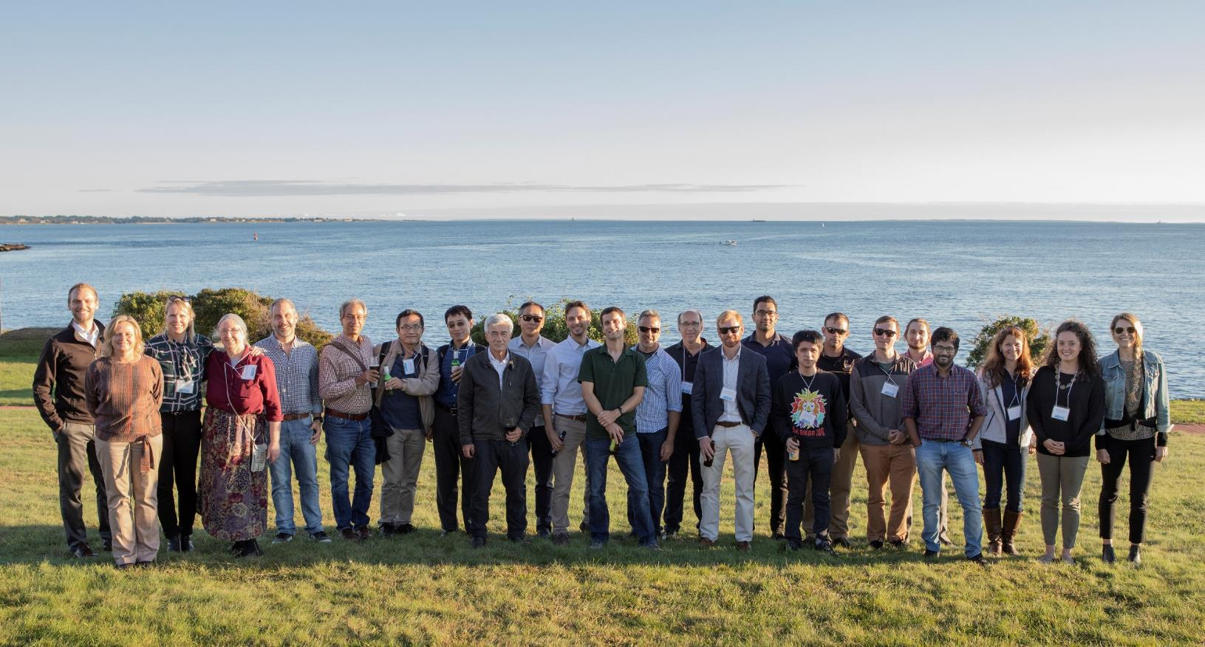
PACE Science and Applications Team (SAT)
Monthly meetings to discuss mission/algorithm synergies, new papers & opportunities , gaps,
6-8 October 2021 Team Meeting UCONN Avery Point
Credit OskarLandi
Plus Streaming Totals: 75 Cities 195 Unique IP Addresses

Slide 8
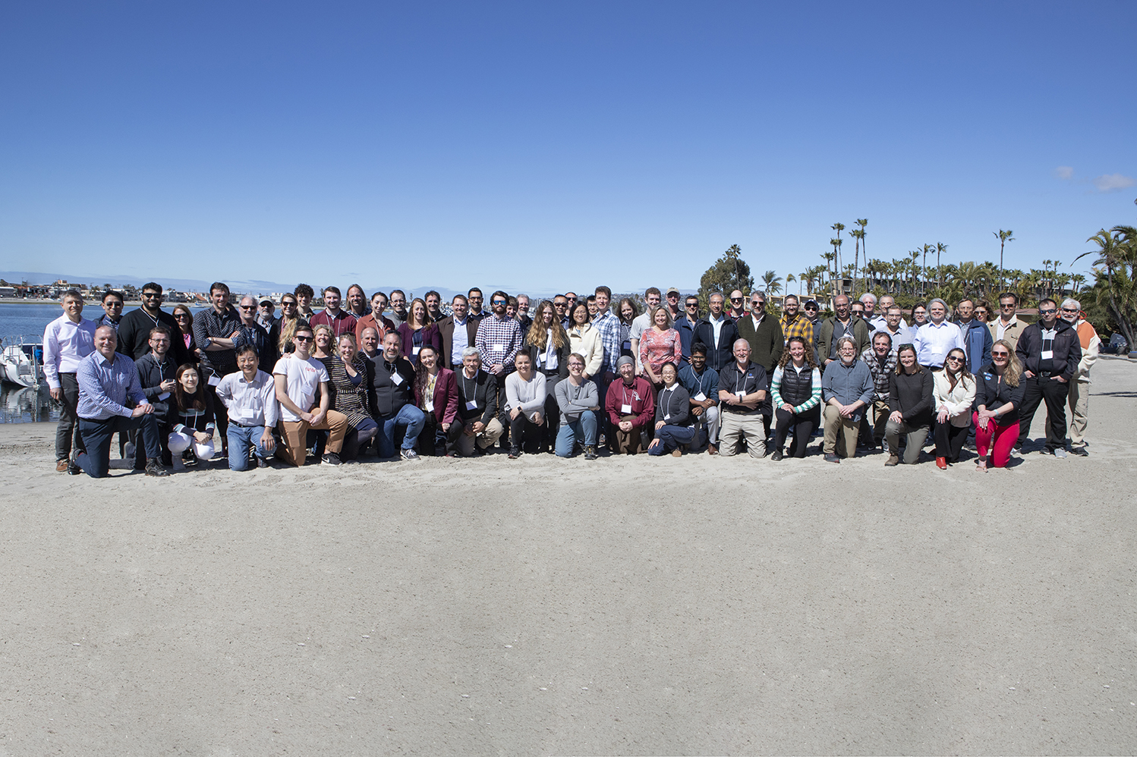
PACE SAT Meeting 2023
Bahia Resort Hotel, San Diego, CA 26 Feb – 1 March
WRAP-UP Slides,
Heidi and Lorraine
Photo: Oskar Landi

Slide 9
GOALS of Team
Algorithm production implemented as Standard, Provisional, Test or Special
Algorithm documentation to be available online
Algorithm performance including propagation of system-level uncertainties.
Protocols and strategies for science data product validation
Communication to the public with news and updates on PACE research.
Algorithm implementation with project team
Partnerships with end-users through Early Adopters Program.
Algorithm development
Algorithm performance
Outreach

Slide 10
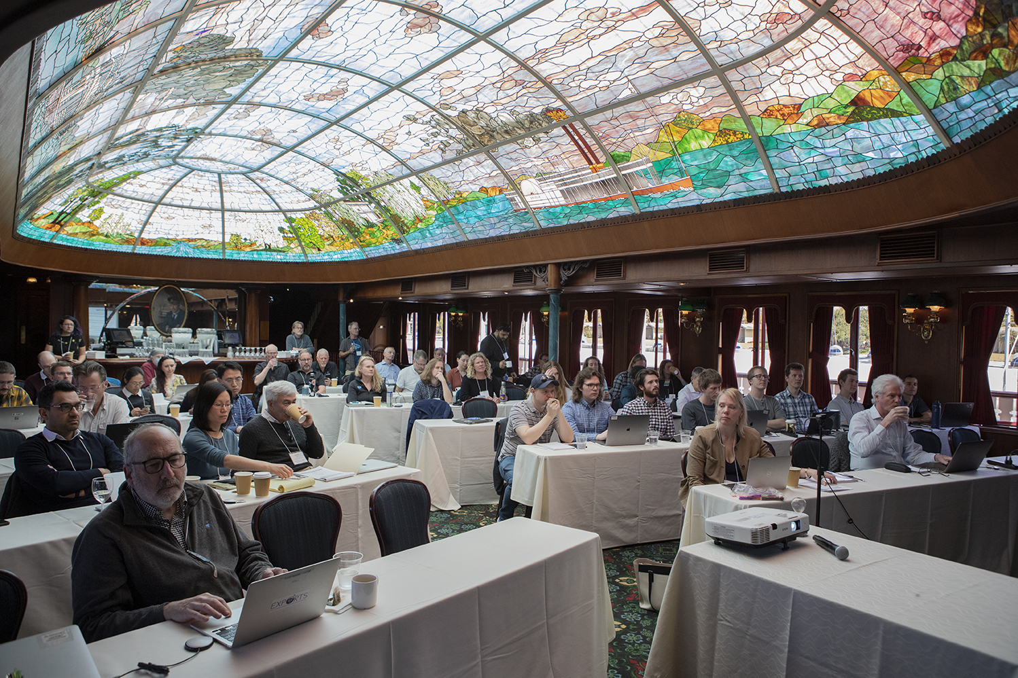
Validation
Uncertainties
Gaps

Slide 11
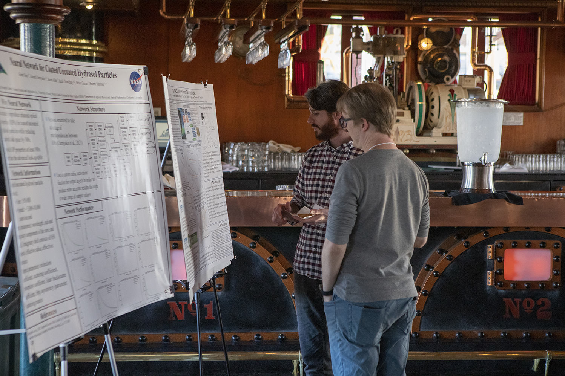

Slide 12
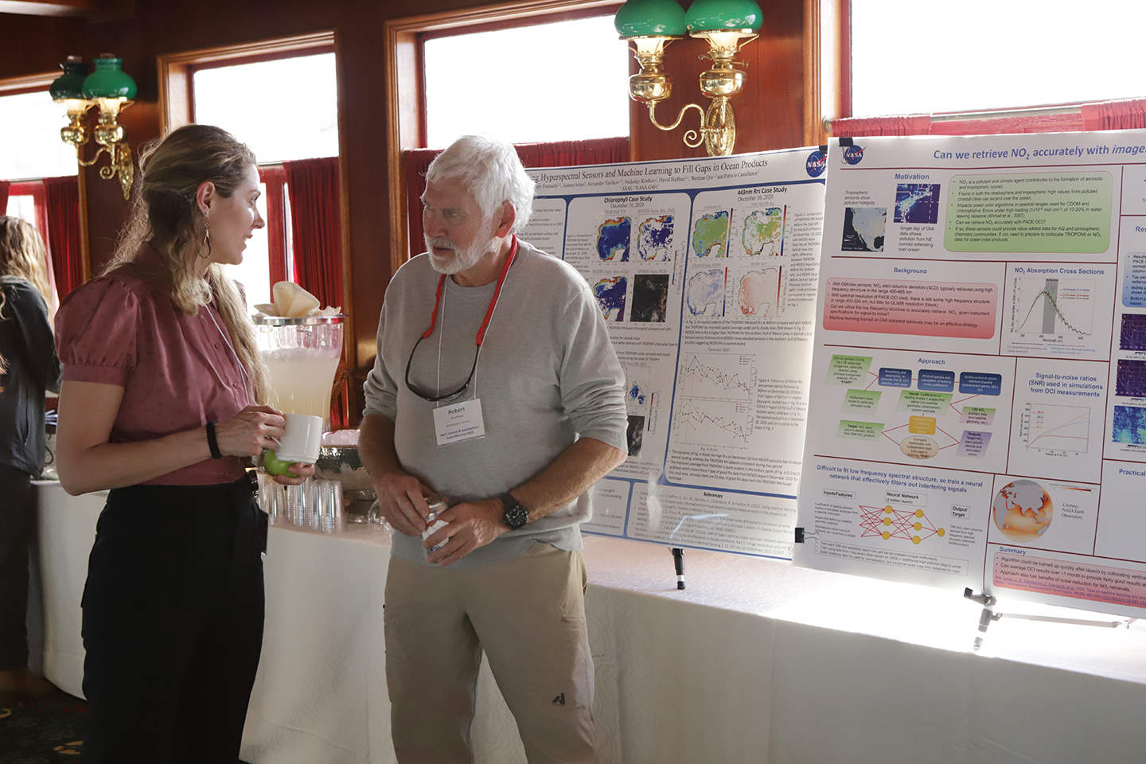

Slide 13
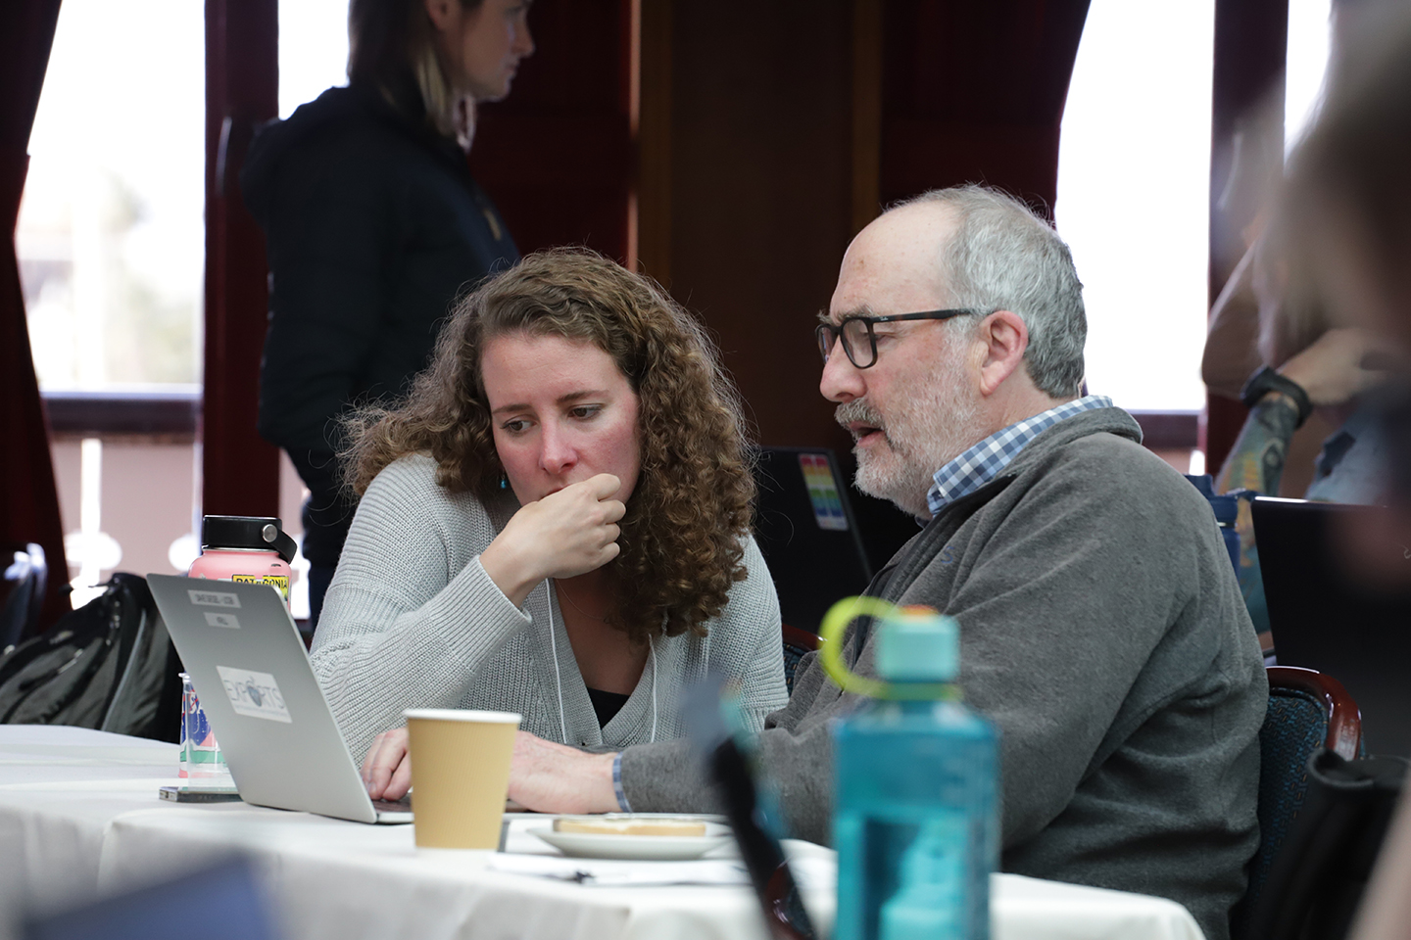

Slide 14
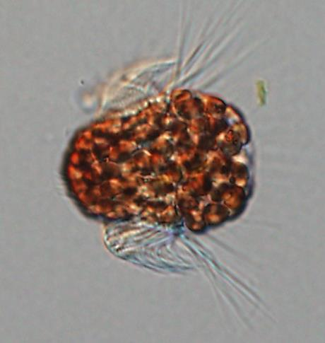
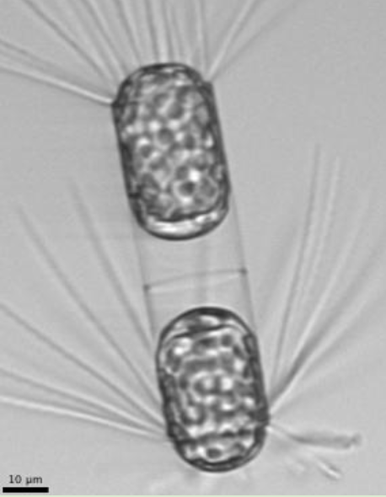

PACE SAT Review of Phytoplankton Community Composition from Space
Led by Ivona Cetinić and Cecile Rousseaux
Notes:
Moving beyond the pigments to more direct assessment of phytoplankton cells in the water
Now I’ll explain in more detail the quantitative plankton imagery data I referenced earlier. This data comes from the IFCB instrument, etc.
The imagery data provides both info on cell size, and taxonomic/categorical classification.
size cutoffs can change but for simplicity here showing 7 um as IFCB min
http://www.pnas.org/content/106/26/10400.full
https://utex.org/products/utex-l-2973
http://www.biomarks.eu/s05808-pelagomonas-calceolata

Slide 15
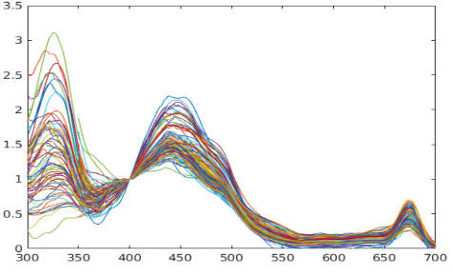

UV Paper in the works
Stramski Chowdhary et al.

Slide 16
Standard Product Suites So Far…

Slide 17
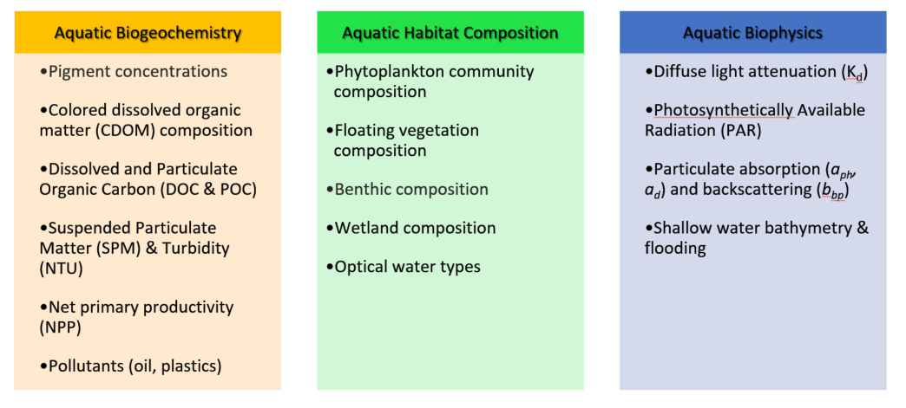
Algorithms

Slide 18
PACE SAT Provisional Algorithms Upcoming
Unified algorithm for aerosol characterization from OCI | Remer
Radiative Transfer Simulator and Polarimetric Inversion for PACE | Zhai
Inverse retrieval of the ocean surface refractive index | Ottaviani
Joint polarimetric aerosol and ocean color retrievals with deep learning | Gao
Algorithms to obtain inherent optical properties of seawater | Stramski
The PACE-MAPP collaborative algorithm project | Stamnes
Freshwater Hyperspectral HABs Algorithms | Shuchman
Retrieving water quality indicators via MDNs | Pahlevan
Chi factor and BRDF | Zhang
PACE UV Retrieval of Oceanic and Atmospheric Data products | Chowdhary
Spectral Derivative Methods for Quantifying Phytoplankton Pigments for PACE | Siegel
Unified Aerosol
OSIRIS
FastMAPOL
3SAA (aph,ad,ag,bbp,Kd)
PACE-MAPP
Aquaverse
Pigments

Slide 19
IOP Inversion and BRDF algorithms for PACE | Twardowski
MAIAC Processing of OCI Over Land: Aerosol Chemical Speciation | Lyapustin, Go
HARP2 Level 1 Data Processing Plan | Xu
Remote sensing of cloud properties using PACE SPEXone and HARP-2 | van Diedenhoven
Phytoplankton Algorithms and Data Assimilation: Preparing a Pre-launch Path to Exploit PACE Spectral Data | Rousseaux
PACE implementations for optically shallow waters | Barnes
A toolbox for the diagnostic assessment of spectral behavior | Vandermeulen
Radiative products for PACE | Boss, Frouin
Support for PACE OCI Cloud Products | Meyer
Hyperspectral algorithms for OCI atmospheric correction and UV penetration | Krotkov
Net Primary Production for PACE OCI | Westberry
HARP2 | Vanderlei
SPEXONE - Aerosols | Hasekamp
Spectral Decomposition: Chl b, Chl c, and grouped photoprotective carotenoids | Chase, Gaube
ZTT Model IOP, BRDF
MAIAC
RSP Heritage
AVW
All things radiative
NPP, FLH, PhytoC
remoTAP
Pigments

Slide 20
Water Quality Suite
  TSS - Total Suspended Solids (TSS) also called TSM or SPM
  Chlorophyll a
  Cyanobacterial Pigment or Indicator
  K_{d}(PAR) - Diffuse Attenuation coefficient integrated from 400-700 nm
  a_{g}(440) - Absorption by CDOM at 440 nm
  Turbidity - from b_{bp}
  NPP – Net Primary Productivity
  AVW – Apparent Visible Wavelength
  Shallow water indicator
  Floating algae indicator

Slide 21
Radiative products for the PACE era
•Code delivered to NASA OBPG:
<E_{d}(0⁺, PAR)>, <E_{d}(0⁻, PAR)>, <E_{o}(0⁻, PAR)>, <µ(0⁻, PAR)>
•Remaining tasks:
-Surface albedo
-Association of uncertainties (bias, standard deviation)
Emmanuel Boss (Umaine) & Robert Frouin (UCSD-SIO)

Slide 22
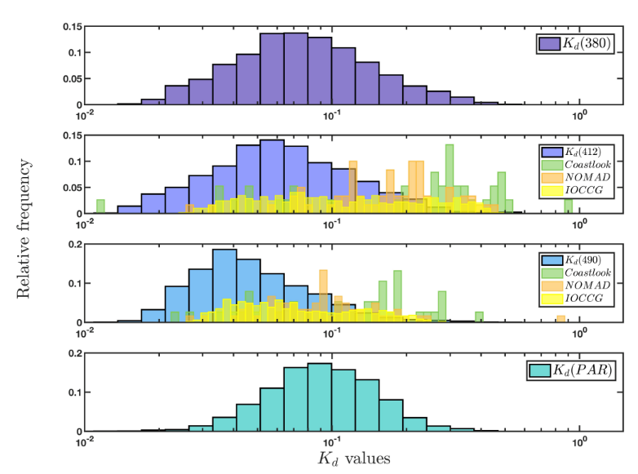
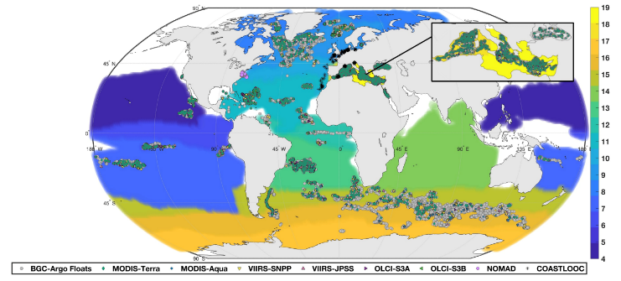
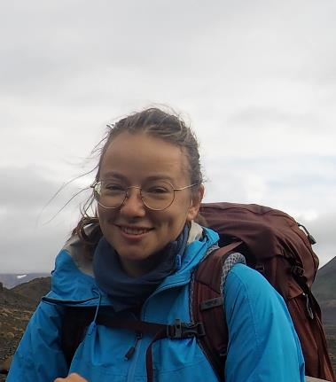

Evaluation of existing algorithms for k_{d}(λ) and k_{d}(PAR) with 6 OCR satellites.
Bottom line:
All existing algorithms are biased significantly in clear waters due to lack of such data in training datasets.
Austin & ZPLee’s algorithm works best (compared to NN). ZPLee is not limited to case 1.
Begouen Demeaux & Boss, 2022.
Notes:
Charlotte Begouen Demeaux has worked with me in the past two years and has been very active. She retrieved a large data set of Kd from profiling floats and matched it to six satellites.
Profiling floats do not only have the largest available data set of radiometric profile in the ocean, they span a much larger area than any existing dataset and do not suffer from boat shadow.
She found all algorithms (Lee’et al., 2005, updated Austin-Mueller ane Neural Network to be biased, particularly so at low values. The reason seem to be that these empirical algorithm did not have very clear when they were tuned (e.g. Kd<0.026m^-1).

Slide 23

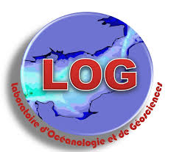

Dariusz Stramski (PI)
Next generation algorithms based on PACE capabilities to obtain inherent optical properties of seawater associated with phytoplankton, nonalgal particles, and colored dissolved organic matter
Rick A. Reynolds (Co-I)
Scripps Institution of Oceanography
University of California San Diego
Matthew Kehrli (Graduate Student)
Ishan D. Joshi (Postdoctoral Scholar)
Collaborators in France
Hubert Loisel
Laboratoire d’Océanologie et de Géosciences, Wimereux, France
Cédric Jamet
Daniel Jorge
NASA PACE Science and Applications Team Meeting; 27 February – 1 March 2023

Slide 24
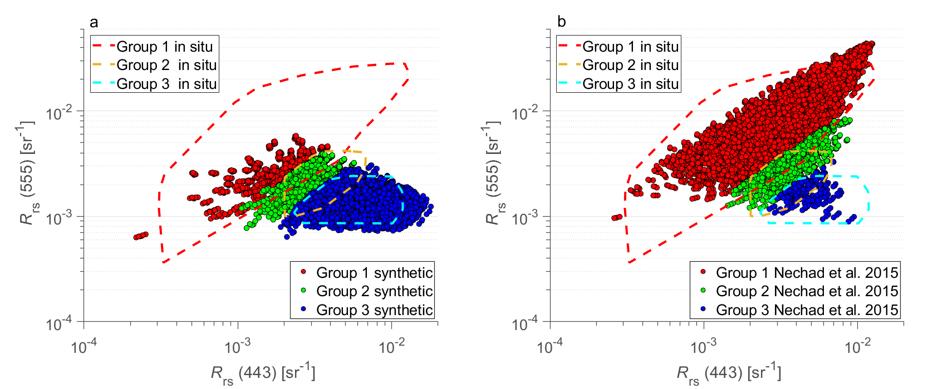
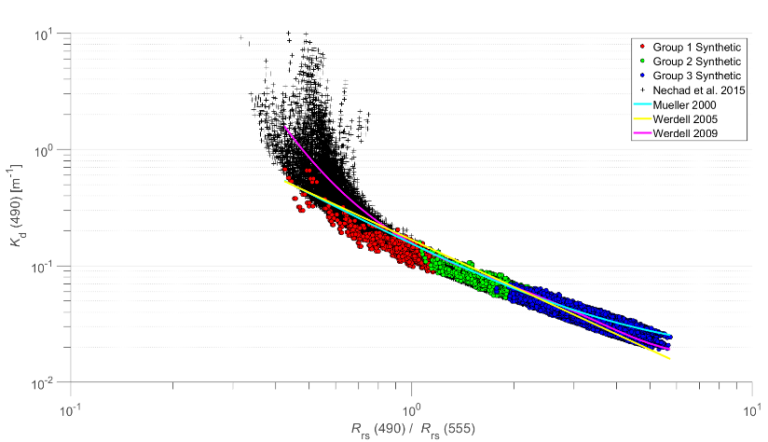
✓
Nearly 30,000 radiative transfer simulations with Hydrolight model that produced in-water and water-leaving light fields and apparent optical properties (AOPs) for different scenarios of IOPs, boundary conditions, and inelastic radiative processes
Example results of R_{rs}(λ) and <K_{d}(490)>₁
(a) R_{rs}(555) vs. R_{rs}(443) for the synthetic database (colored data points) and in situ dataset (colored contours). (b) Same as panel (a) but for the synthetic dataset of Nechad et al. (2015) which was developed for coastal waters. The color coding refers to the optical water groups assigned according to reflectance-based classification (Group 1 is representative of turbid waters, Group 2 mostly productive coastal and open-ocean waters, and Group 3 the vast areas of mesotrophic and oligotrophic ocean).
<K_{d}(490)>₁ vs. R_{rs}(490)/R_{rs}(555) for the synthetic database. The red, green, and blue data points represent the three optical water groups 1, 2, and 3, respectively. The black cross-mark data points are from the Nechad et al. (2015) synthetic dataset. The relationships from Mueller (2020), Werdell (2005), and Werdell (2009) are also displayed.
✓
Development of database has been completed. Database will be available at World Data Center PANGAEA
Loisel, H., Jorge, D. S. F., Reynolds, R. A., and Stramski, D., A synthetic database generated by radiative transfer simulations in support of studies in ocean optics and optical remote sensing of the global ocean. Earth Syst. Sci. Data, submitted February 2023.
5/15

Slide 25
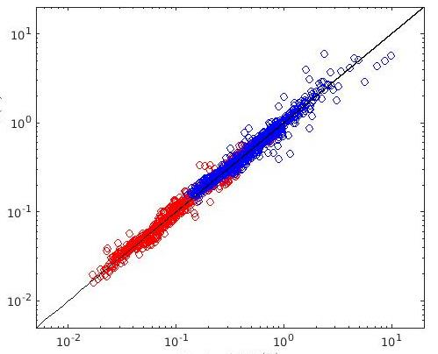
K_{d} algorithms based on neural network approach (French team)
✓
Reformulation of K_{d} algorithms using a new synthetic optical database has been completed.
This effort improves the previous versions of K_{d} algorithms (Jamet et al. 2012; Loisel et al. 2018; Jorge et al. 2021). The algorithms use input values of R_{rs} at four, five, or six wavelengths available on multispectral ocean color sensors (SeaWiFS, MODIS-Aqua, VIIRS-SNPP, MERIS, and OLCI). These new algorithms are applicable to PACE-OCI.
MERIS/OLCI algorithm
Data points:
400-700 nm at 10 nm
Relative error 9.7%
Model-derived <K_{d}>₁ (m⁻¹)
R_{rs}(490)/R_{rs}(560) > 0.85
R_{rs}(490)/R_{rs}(560) ≤ 0.85
Reference <K_{d}>₁ (m⁻¹)
Current tasks:
Investigation of potential enhancement of K_{d} algorithm with additional input wavelengths. The recent focus has been on the use of input R_{rs} at 14 wavelengths between 400 and 700 nm.
Evaluation of algorithm performance (including the near-UV spectral range) using independent field datasets.
Jamet, C. et al. New Kd algorithms based on neural network approach, in preparation.
6/15

Slide 26
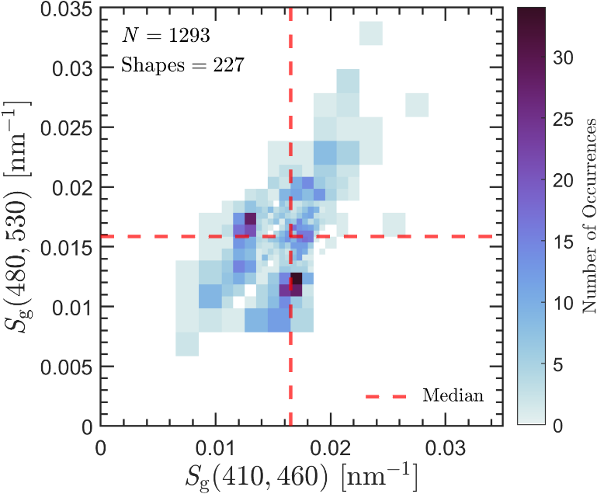
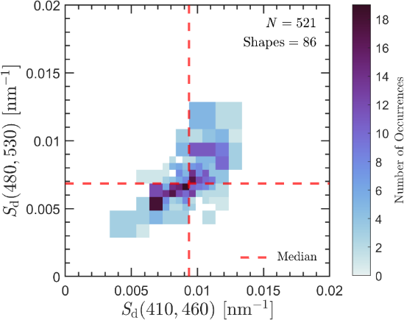
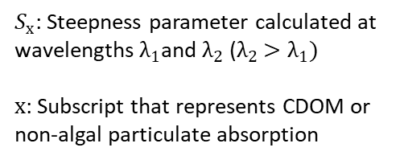
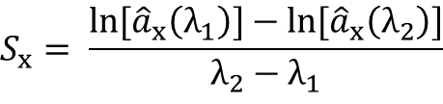
✓
Formulation and evaluation of ADG partitioning model
Flowchart of the model (builds upon and enhances the previous ADG model of Stramski et al. 2019)
Joint probability distributions of steepness parameters are defined in the blue (410–460 nm) and the blue-green (480–530 nm) spectral regions to capture spectral shape variability in a_{g}(λ) and a_{d}(λ)
Assembly of development dataset
a_{d}(λ)
Approximately the same as for the extrapolation model
a_{g}(λ)
Determination
of spectral shape library
Classify with spectral shapes
Classify with spectral shapes
â_{d} (λ)
â_{g}(λ)
Determination of speculative solutions
All pairs
â_{d} (λ) and â_{g}(λ)
$$S_{x}= \frac{\ln{{[\hat{a}}_{x}\left(λ_{1}\right)]−\ln{[{\hat{a}}_{x}\left(λ_{2}\right)]}}}{λ_{2}−λ_{1}}$$
Weighting
factor w
â_{dg} (λ)
Main outputs: Optimal solutions for a_{d}(λ) and a_{g}(λ) and range of feasible solutions
Determination of feasible and optimal solutions
If
0< w <1
$S_{x}$: Steepness parameter calculated at wavelengths $λ_{1}$and $λ_{2}$ ($λ_{2}$ ${>λ}_{1})$
$x$: Subscript that represents CDOM or non-algal particulate absorption
Input:
a_{dg}(λ)
Feasible solutions a’_{d}(λ) and a'_{g}(λ)
Selection criteria
Speculative solutions
a’_{d}(λ) and a'_{g}(λ)
12/15

Slide 27


Development of Robust Spectral Derivative Algorithms for Phytoplankton Pigment Concentrations on Local to Global Scales
Dave Siegel (PI), Stéphane Maritorena (co-PI), Dylan Catlett (now WHOI), Sasha Kramer (now MBARI) & Kaley Sten (GSR)
Earth Research Institute, UC Santa Barbara

Slide 28
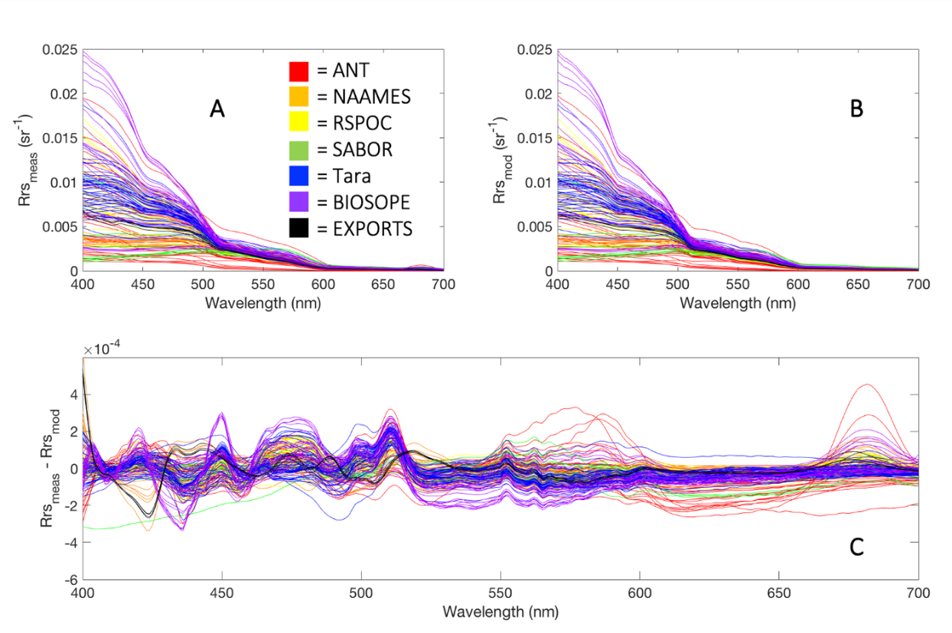
Modeling Global Pigments Using Rrs(λ) Residuals
Use IOP inversion model to model hyperspectral Rrs(λ) estimates from Rrs(λ) obs
Calculate residual Rrs(λ) spectra from the obs-model difference
First order effects of the dominant IOPs will be removed
Rrs(λ) residual spectra should provide information about phytoplankton community composition
Data
Model
Residual
Kramer et al. RSE [2022]

Slide 29
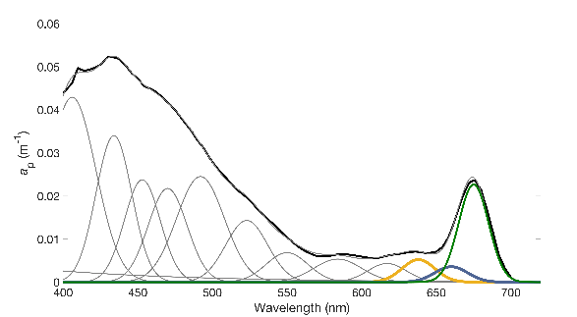
Chase, Gaube et al. using Gaussian Functions to estimate Phytoplankton Pigments
L_{w}(λ,0⁺)
absorption Gaussian functions
R_{rs}(λ) =
E_{d}(λ)
a_{p} (m⁻¹)
Normalized R_{rs}(λ)
Wavelength (nm)
Wavelength (nm)
Chase et al. 2017, JGR-Oceans
Notes:
The analysis to get pigments from Rrs was done with data from several regions across the globe. The appeal of this is a robust algorithm that can be applied in many places, as is currently done with algorithms to estimate chl from space, and then tuned regionally when necessary/appropriate.

Slide 30

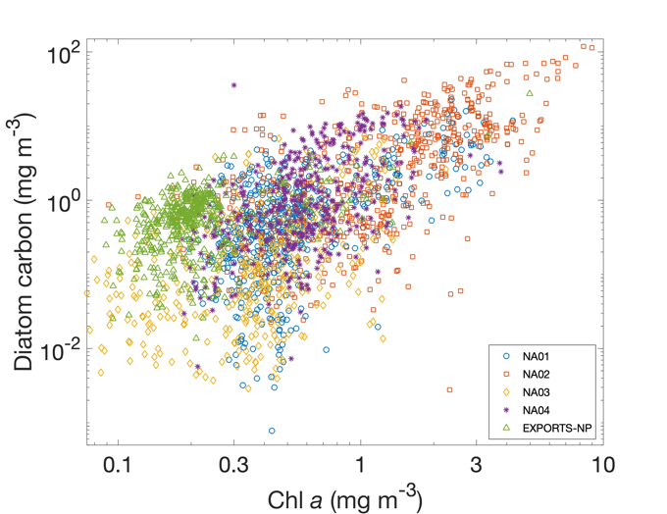
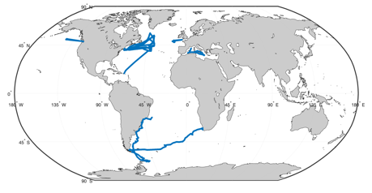

Phytoplankton communities from PACE: toward a global diatom product
Ali Chase, Peter Gaube
Applied Physics Laboratory, University of Washington

Slide 31
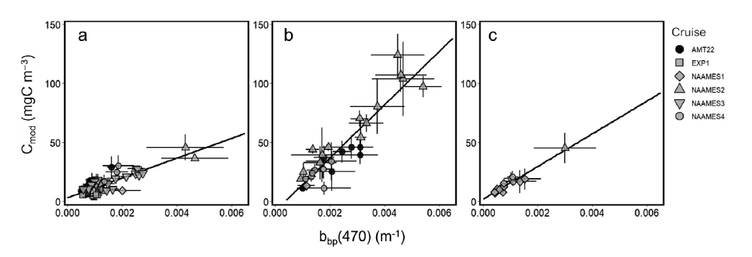
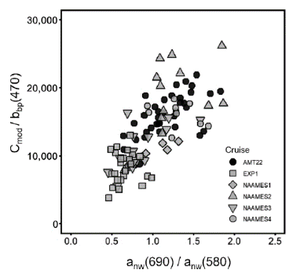
Team members:
Toby Westberry (PI)
Mike Behrenfeld (Co-I)
Jason Graff (Co-I)
Phytoplankton carbon biomass (C_{phyto}, mg m⁻³)
‘Heritage’ approach to estimate C_{phyto} is a static, linear conversion of b_{bp}(470 or 443nm)
However, we anticipate variability due to attributes of particle assemblage (e.g., phytoplankton community composition)
Evaluate conversion after stratifying by phyto. group and identify a factor (taken from a_{ph}(λ)) that covaries
Net primary production and chlorophyll fluorescence from PACE OCI
SF=8372
SF=22495
SF=13832
Variable SF
Cyanobacteria &
Haptophytes
Diatoms &
Dinos.
Green algae OR
Mixed pop.
Provides a way to impart taxonomic variation into estimates of C_{phyto} using a_{ph}(λ)
Fox et al. (2022) L&O Methods

Slide 32
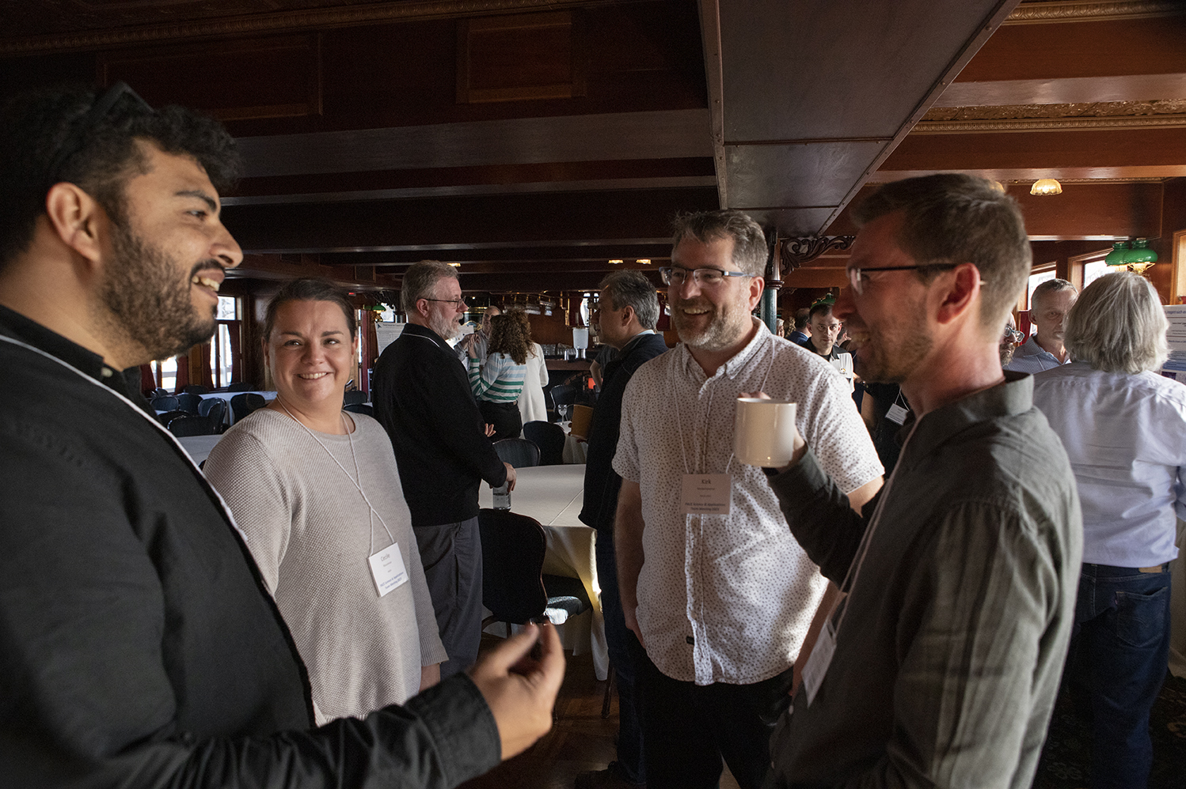
Smiles

