Slide 1





Update on Geostationary Littoral Imaging and Monitoring Radiometer
Antonio Mannino, Joseph Salisbury,
Maria Tzortziou & many more (GLIMR Team)
https://eos.unh.edu/glimr

Slide 2


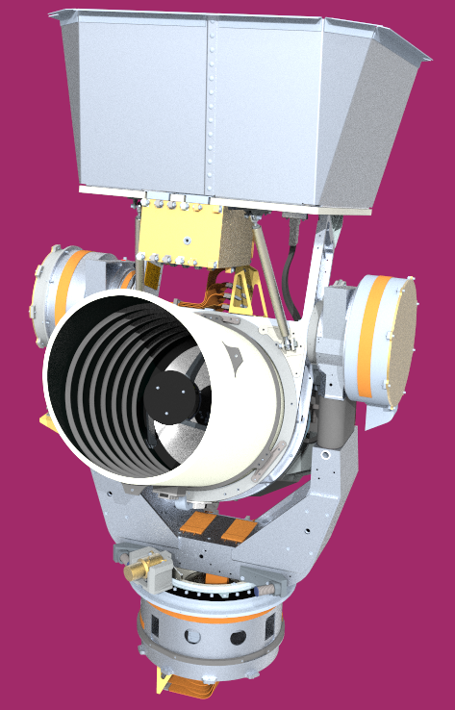

What is GLIMR?
NASA’s latest Ocean Color instrument:
Hyperspectral sensor in Geostationary orbit (98° W ± 10°)
NASA’s Earth Venture Instrument 5
PI: Joe Salisbury (UNH)
UNH: PI, management, systems engineering, science ops center, & INR
Instrument by Raytheon; Safety mission assurance by SwRI
GSFC: deputy PI, science data segment, and science
Science & Applications team from various academic and federal institutions
Mission management by Earth System Science Pathfinder Program Office
Status and Schedule
Project start: 17 May 2021
KDP-C: 6 March 2023
CDR: 20-23 June 2023
Instrument delivery: ~January 2025
Launch TBD: ~2027
Notes:
GLIMR is the Geostationary Littoral Imaging and Monitoring Radiometer
it’s and Earth Venture Instrument program within NASA that enables PIs to propose satellite instruments to accomplish a scientific investigation.
Selection of GLIMR took place nearly 2 years ago; after a prolonged contract negotiation period, GLIMR formally began Phase A in mid-May
Launch will be contracted by NASA at a future date but no earlier than 2026.
Joe Salisbury at UNH is the PI; I’m his deputy;
UNH will manage the project and Science Ops Center (instrument monitoring and plan post-launch operations)
Raytheon will build the instrument
SwRI provides SM&A
OBPG at OEL will perform customary role of ocean color missions such as PACE to process the data, on-orbit calibration, and validation analysis
SAT of co-Is and collaborator 8-15 institutions including international collaborators in Korea, Europe, and Australia.
The program office is based at NASA Langley

Slide 3
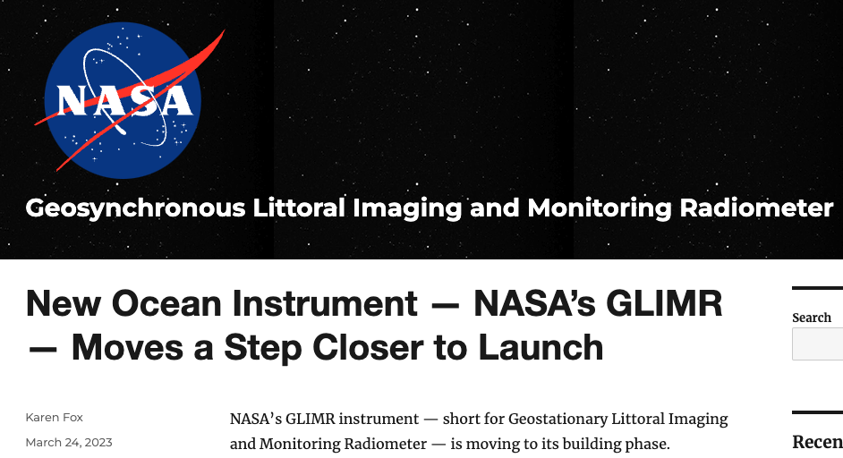
GLIMR Confirmed!
GLIMR is now in Phase C!
Focus on completing design, building and testing the instrument
NASA’s Confirmation Review (KDP-C) of GLIMR held on March 6, 2023
  KDP-C: NASA’s directorate management (“gate”) review to proceed to Phase C
  UNH submitted a revised budget plan to boost reserves
    Reductions in Phase C science activities (UNH, GSFC, & all other science team members)
  NASA SMD confirmed GLIMR to proceed to Phase C on March 21, 2023
    No additional funds for unanticipated inflation and supply chain delays
    Challenges are not technical but largely programmatic
    Access to Space portion will be reviewed at a second KDP-C to occur prior to instrument delivery
Critical Design Review (CDR) – June 20-23, 2023
Notes:
NASA’s Confirmation Review (KDP-C) of GLIMR held on March 6, 2023
NASA SMD requested GLIMR team to augment reserve budget posture
UNH submitted a revised budget plan with descopes (predominantly in science activities) to increase GLIMR’s budget reserves to address unknowns during Phase C
NASA SMD approved/confirmed GLIMR to proceed to Phase C
Only instrument completion approved
Access to Space portion will be reviewed at a second KDP-C to occur prior to instrument delivery in Q2 2025.

Slide 4
A glimpse into GLIMR’s capabilities
Hyperspectral UV-Vis-NIR
340-1040 nm
<2 to <10 nm spectral resolution across UV-Vis
<1 to <5 nm sampling UV-Vis
High Temporal
~hourly scans of Gulf of Mexico (6x/day)
2x to 3x/day other regions
3x/day HAB target sites
High Spatial
300 m nadir Ground Sample Distance (GSD)
~328 m Gulf of Mexico
<500 m over coastal continental US
High SNR
Requirements at Ocean Ltyp
360-380 nm: >420 *
380-415 nm: > 650
415-580 nm: > 1000
580-650 nm: > 750
650-880 nm: > 580 ^
Adaptive Scheduling & Targeting
Flexibility to target episodic events & hazards
* Best effort <360 nm
^ SNR >=500 (700-720nm)
GLIMR’s combined capabilities are unprecedented
Notes:
Not as good as a hyperspectral SBG for spatial resolution, Not as good as PACE in spectral range (and ability for atm correction), but it’s very good

Slide 5
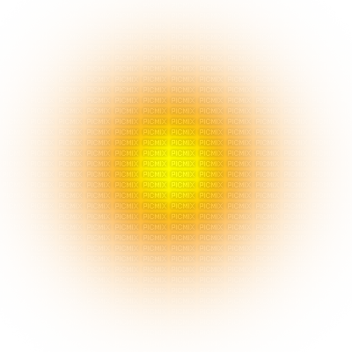
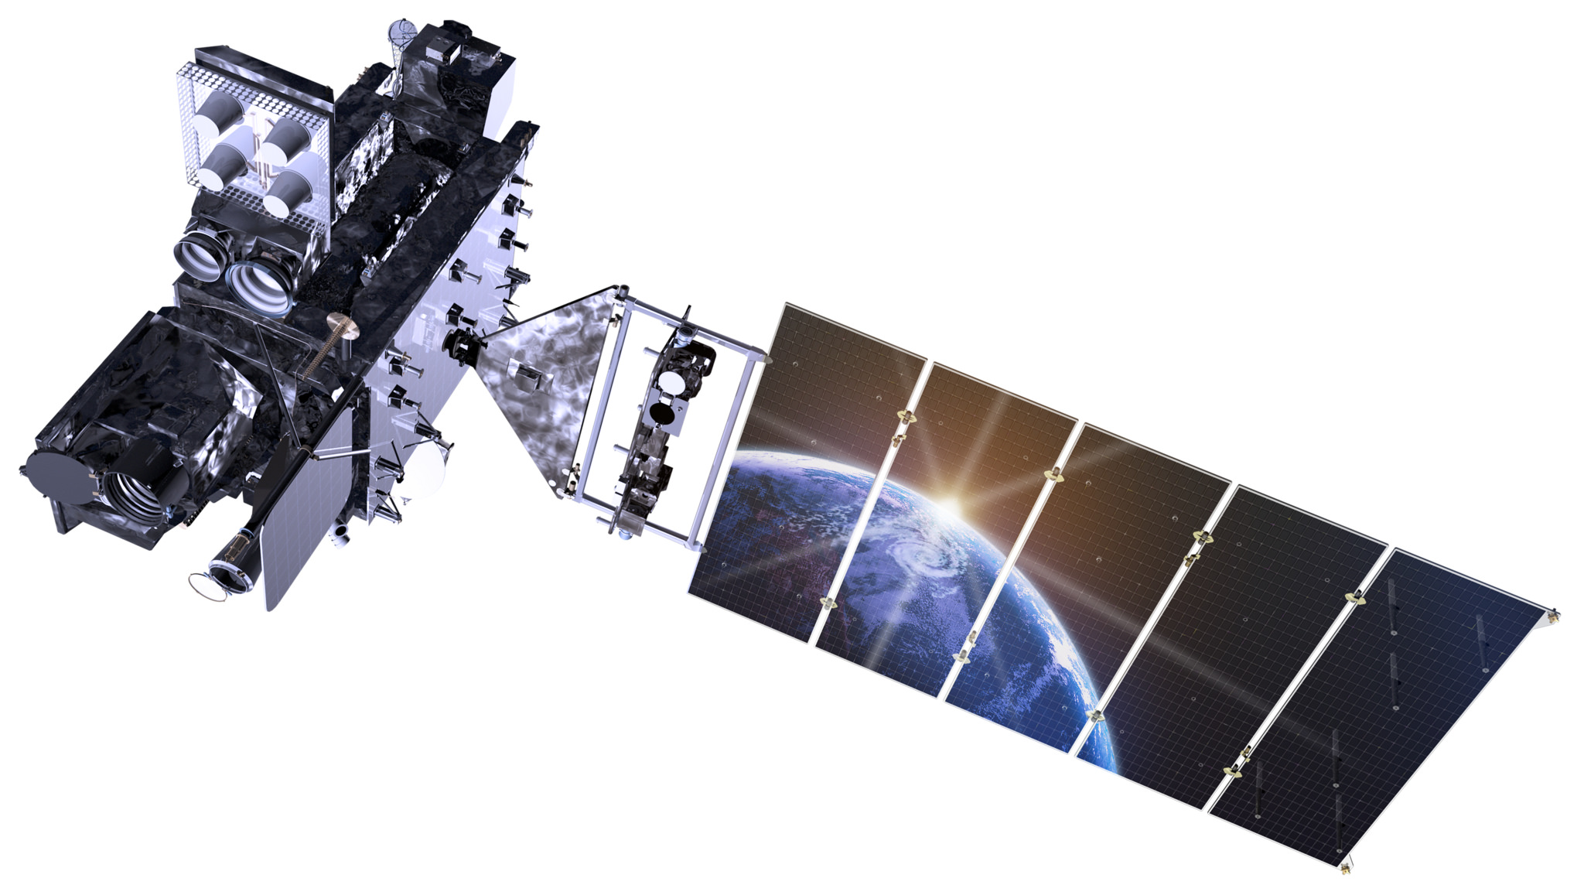



GLIMR Science from Geo Vantage Point
Phytoplankton Growth and Physiology
  Observe, quantify, and understand processes associated with rapid changes in phytoplankton growth rate and community composition at their intrinsic timescales
Short Term Coastal Processes
  Quantify high frequency fluxes of sediments, organic matter, and other materials between and within coastal ecosystems and investigate how these regulate the productivity and health of coastal ecosystems.
GLIMR aims to provide large scale quantification of rapid changes in phytoplankton growth rate, community composition, and fluxes from land to ocean
GLIMR will enable us to move beyond studying the effects of the process, and into the study of the processes themselves.

Slide 6

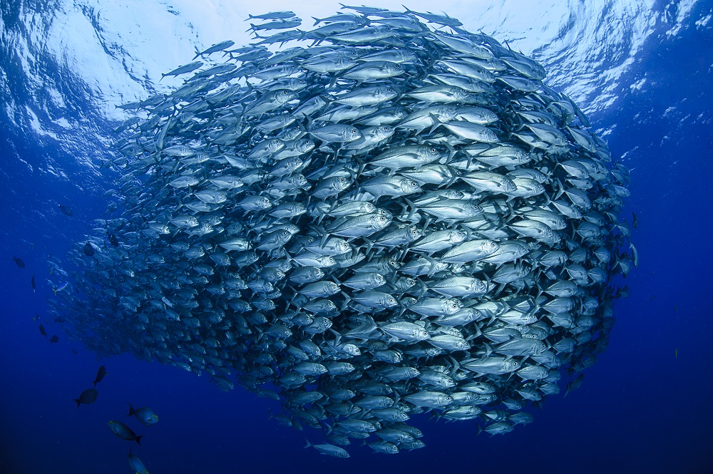

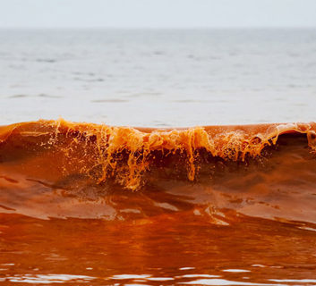
Applied Science Foci Areas
Targeting the formation, magnitude, and trajectory of coastal hazards, for improved management & mitigation
harmful algal blooms
oil spills
fisheries
water quality
pathogens
surface currents
navigation
floating algae
food security
coastal management
conservation
tourism
recreation
forecasting

Slide 7
Applied Science: What is unique in GLIMR
GLIMR 1st Applications Workshop: ~350 participants
What GLIMR capability would be more useful for your work?
~ 85%
high temporal

Slide 8
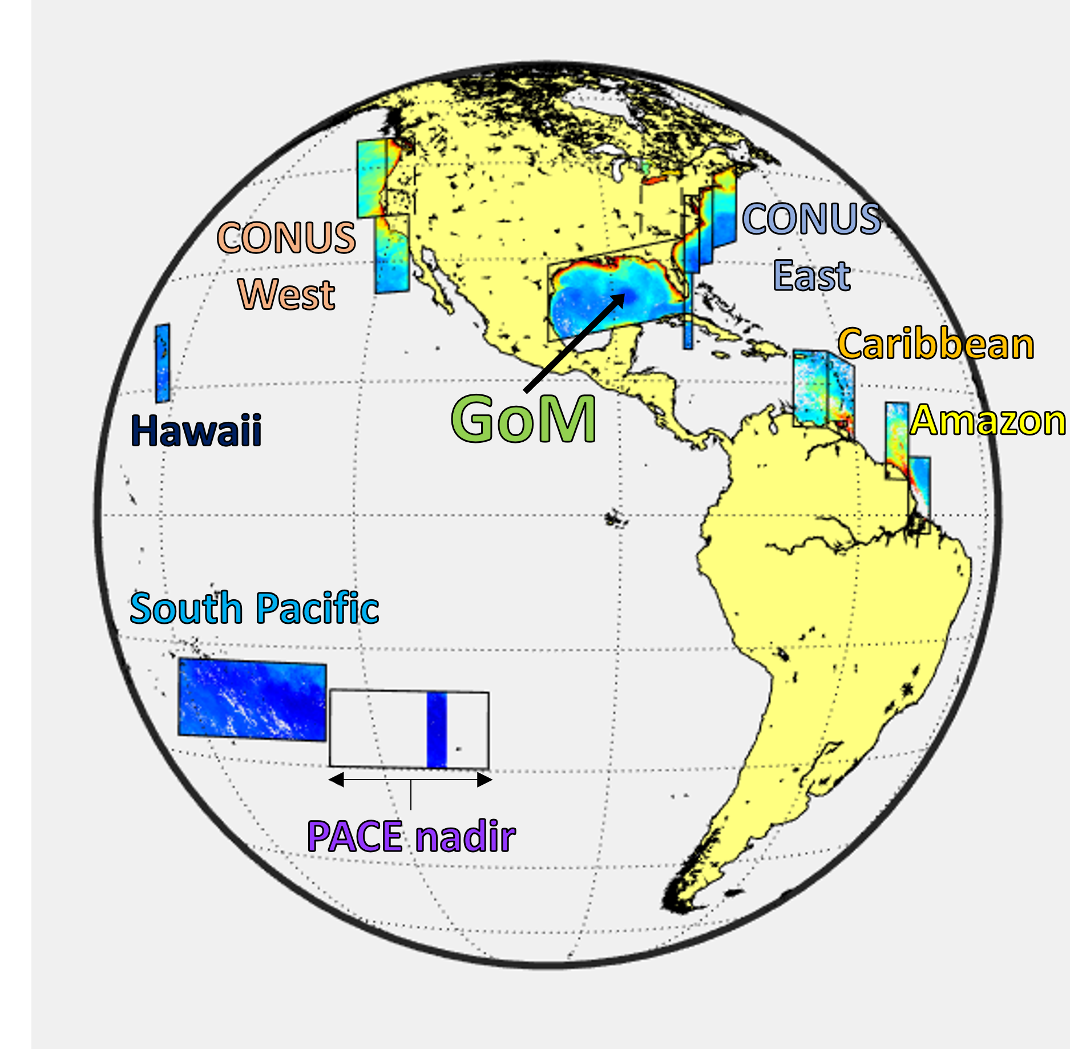
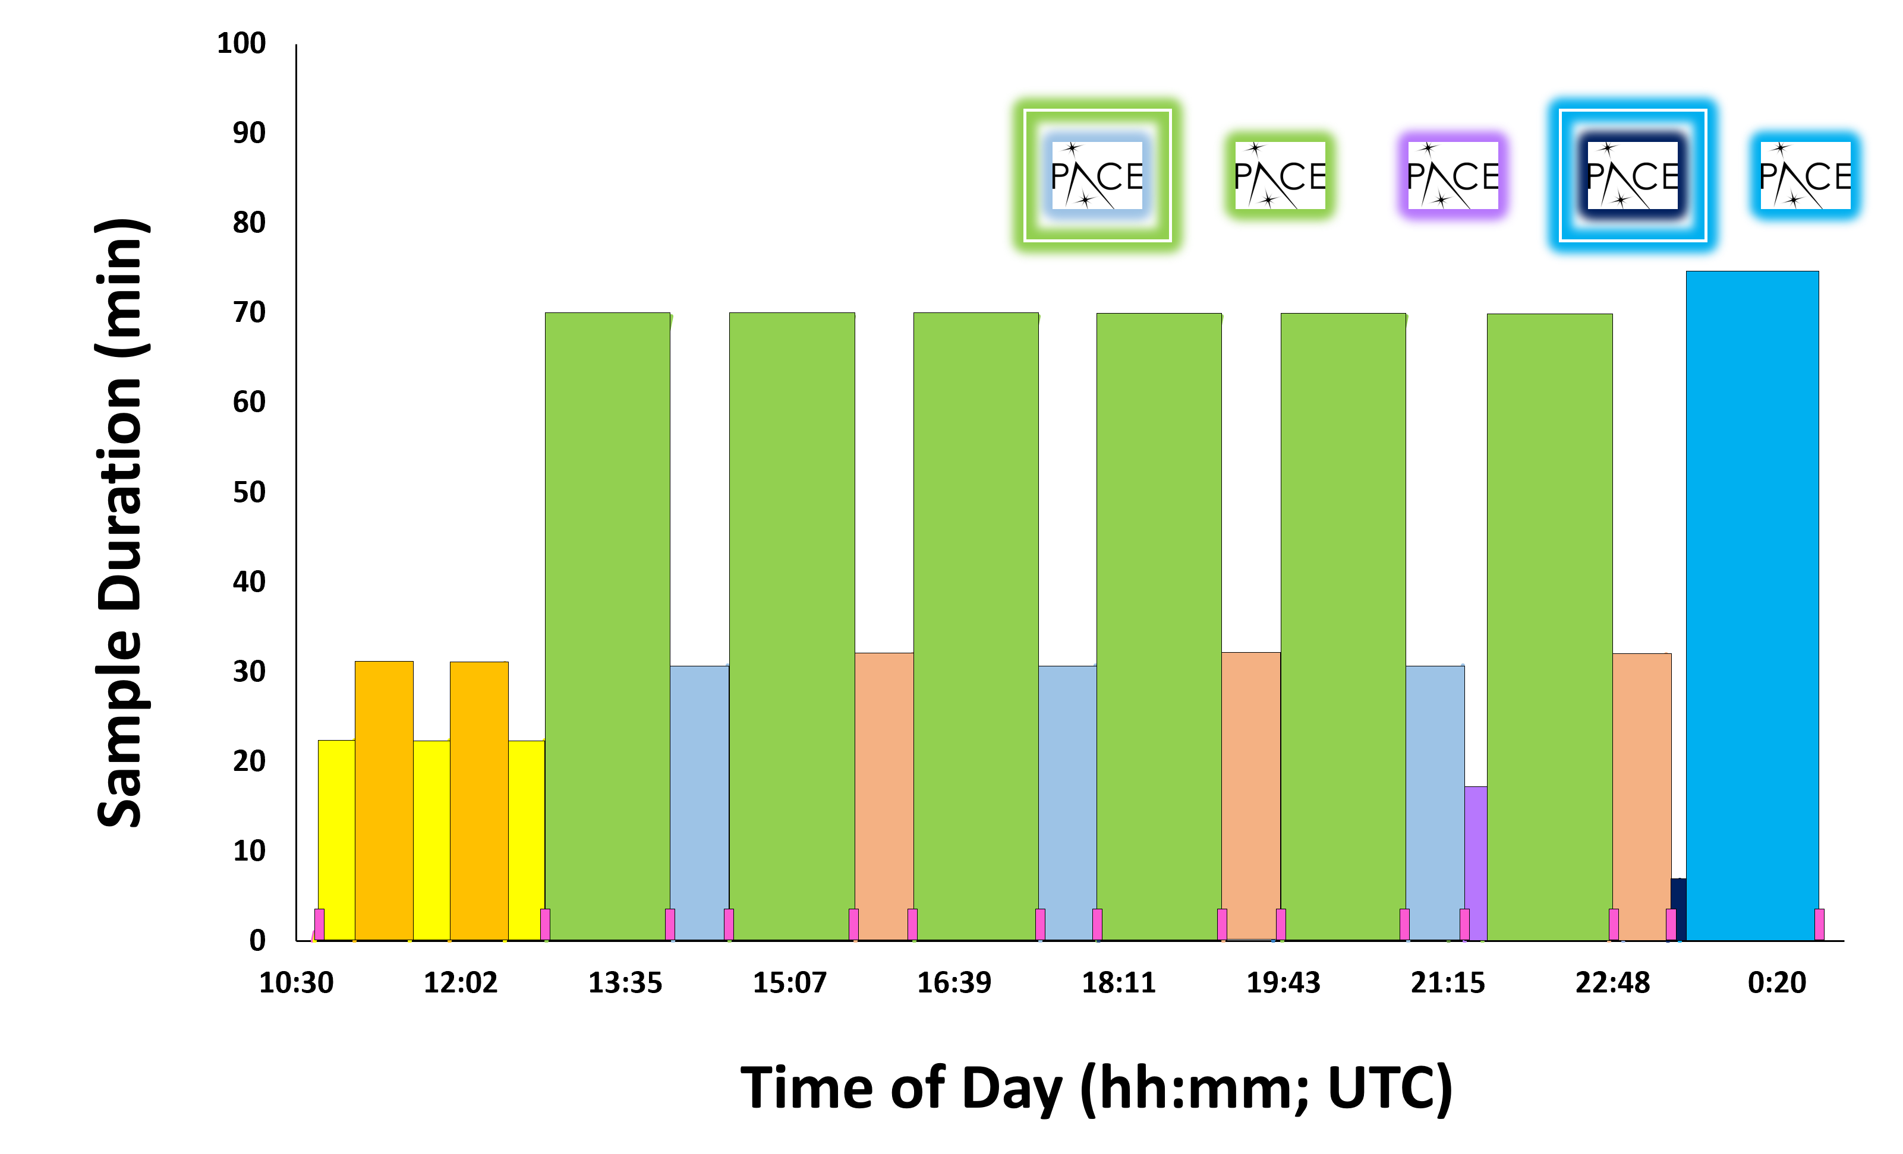
Observing Regions & Daily Schedule
Baseline Scan Regions | Frequency
Gulf of Mexico | 6x/ day
East & West CONUS coastal waters | 2x/ day
Amazon River Plume region³ | 2x/ day
Caribbean Sea region of interest | 2x/ day
Hawaii region of interest³ | 2x/ day
Other HAB target sites | 3x/ day
Cross-calibration w/ other sensors | 3x/ day
Invariant South Pacific clear waters | 2x/ day
*
*
*
*
*
*Anticipated PACE overlap

Slide 9
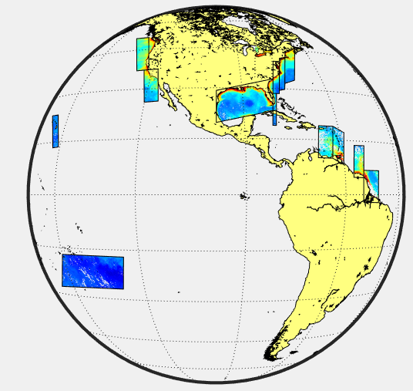
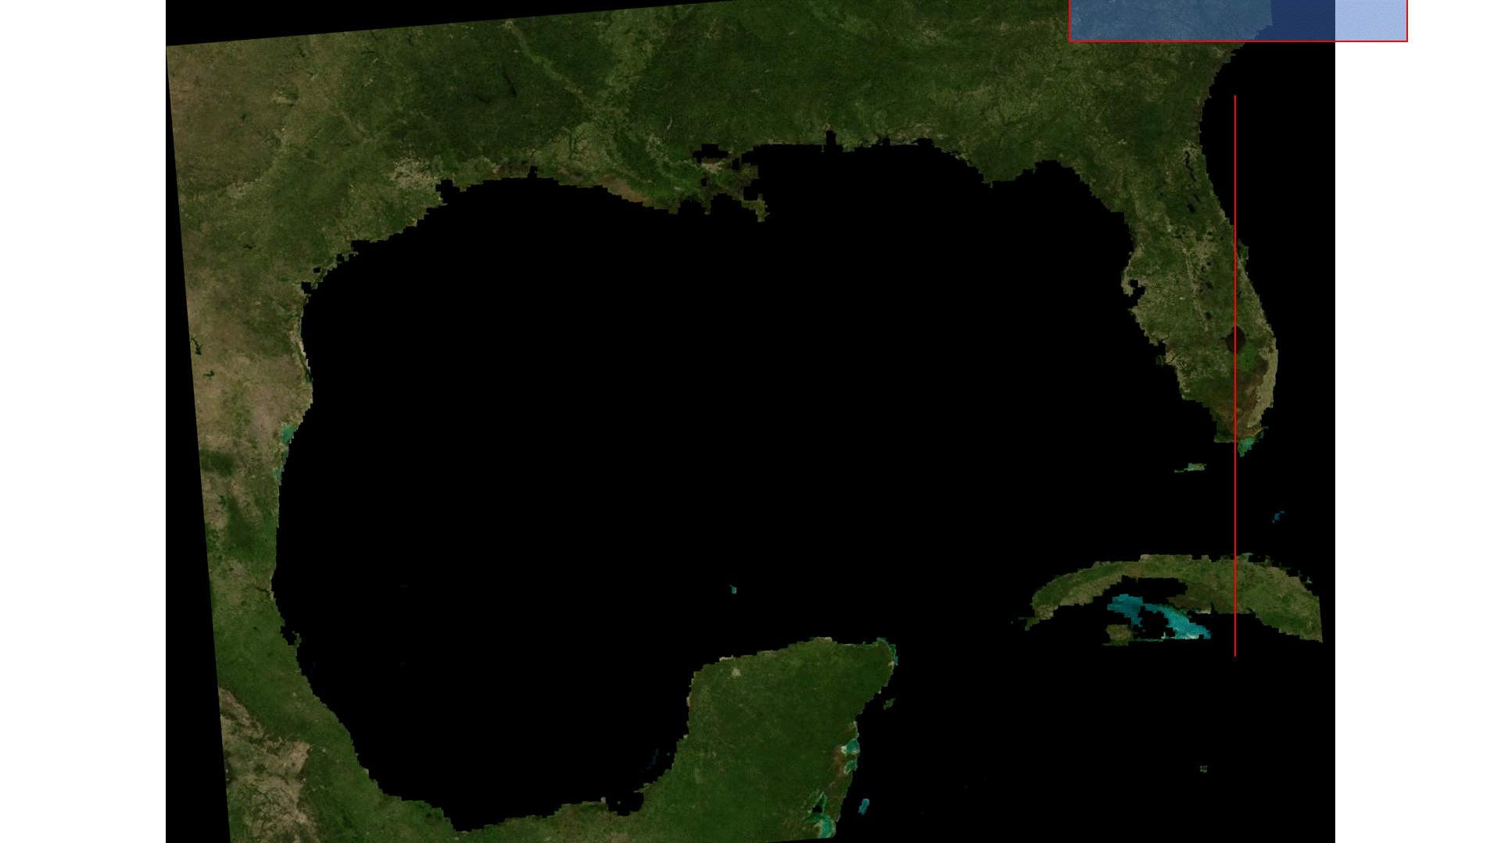
How GLIMR Images Primary Observing Regions

Slide 10
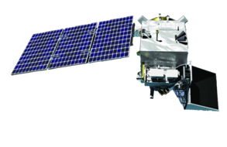
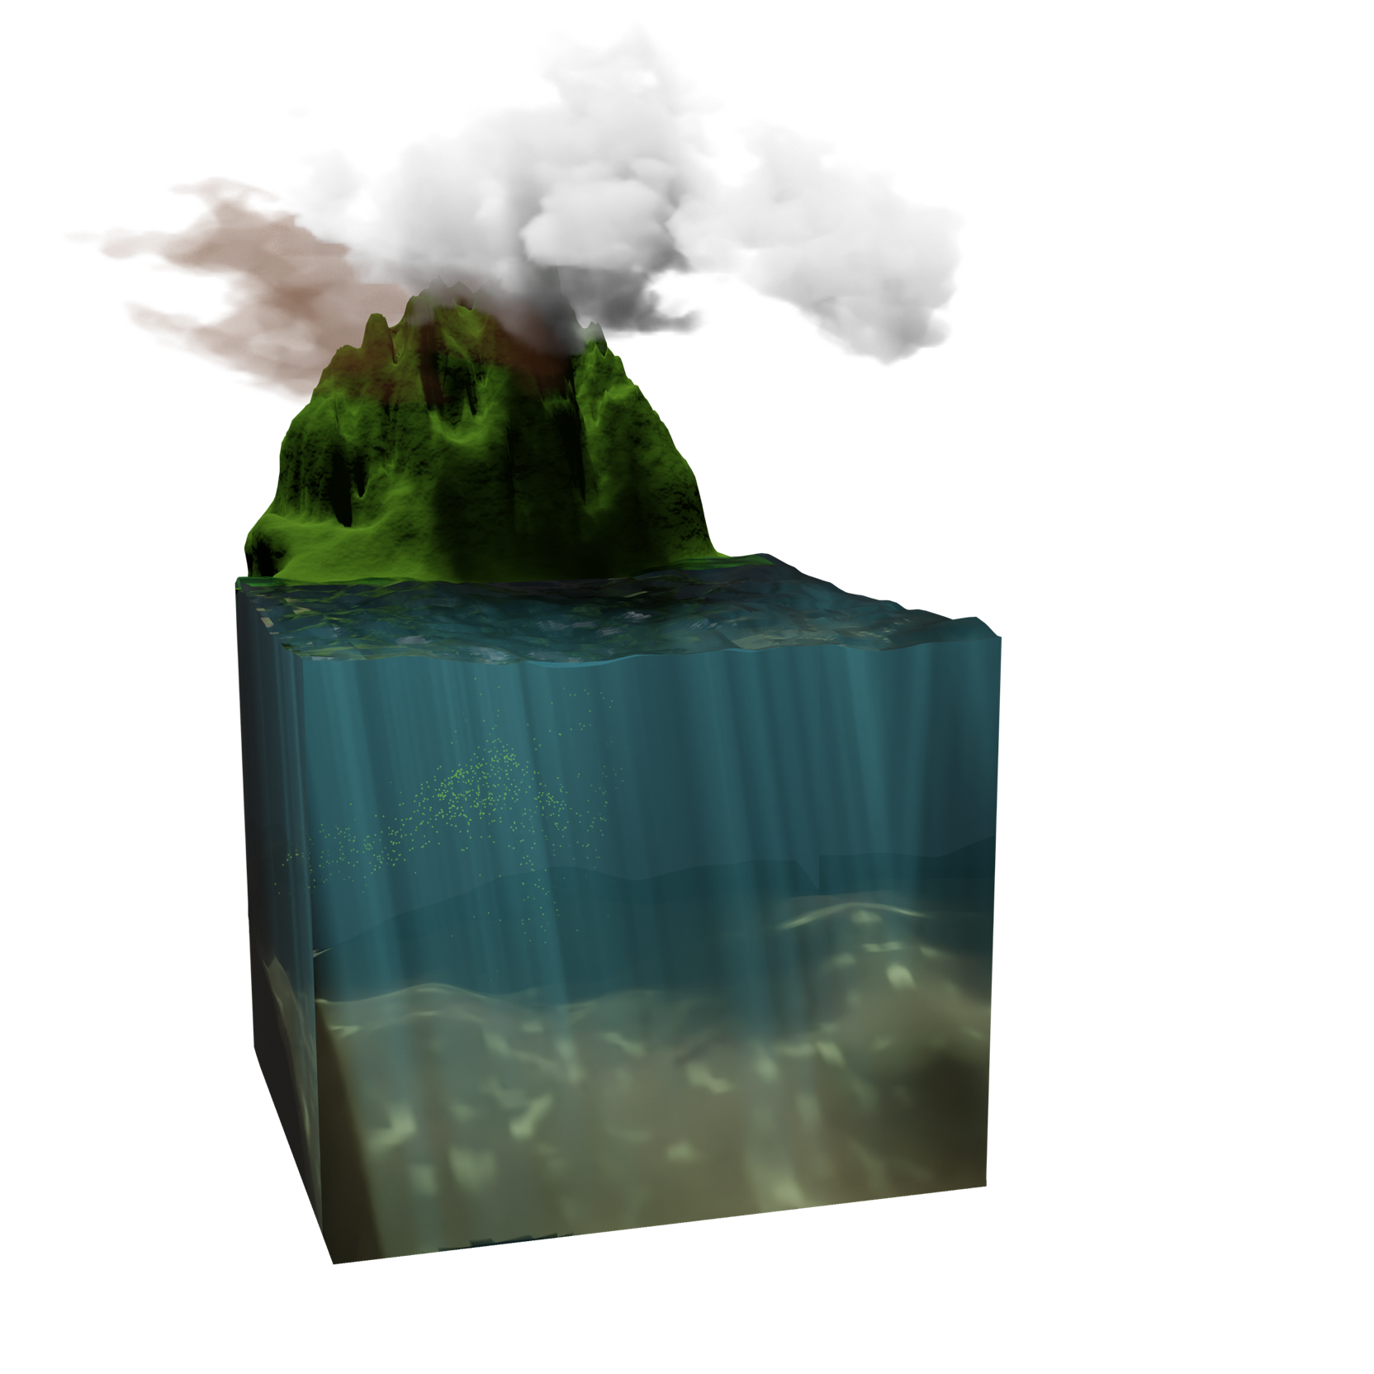
Top-of-Atmosphere Radiance
GLIMR
PLANNED OCEAN
COLOR DATA
PRODUCTS
Water-leaving Radiance

Slide 11

GLIMR
OCEAN COLOR
DATA PRODUCTS
“Typical”
OC Products
Remote sensing reflectance
Light penetration
Angular light distributions
Particulate and
dissolved organic carbon
Suspended matter
Particle size distribution
PAR: photosynthetically available radiation
Photosynthetic pigments
Fluorescence
Phytoplankton community composition
Modeled net primary production
Light transmission
Absorption properties
Scattering properties

Slide 12
Petroleum detection and thickness
Oil density
Floating algae biomass
GLIMR
OCEAN COLOR
DATA PRODUCTS
GLIMR RATES AND
FLUXES PRODUCTS
Surface ocean currents
Fluxes of SPM, POC and DOC
Particle size distribution
Water type
classifications
GLIMR APPLICATIONS
PRODUCTS
Net primary production (NPP)
Net community production of POC
Fluxes of SPM, POC and DOC
HAB detection index
Karenia brevis cell count index
Microcystis cell count index

Slide 13
Update on Project Activities
Team is preparing for CDR
  formal NASA review with Standing Review Board (SRB) of experts
Raytheon completing procurements and building instrument sub-systems
Team delivering various NASA deliverables (documents & models)
  Requirements, Concept of Operations (on-orbit), Radiometric calibration, etc.
UNH developing the Science Operations Center (SOC)
UNH & A. Kamel developing image navigation & registration algorithms
GSFC/SDS developing L0-to-L1 and L1-to-L2 code
GSFC Science performance modeling
Community outreach & publications
  Virtual Applications Workshop in Sept 2023
  Scientific conferences and meetings
Engaging PACE, TEMPO, GeoXO OCX missions
Notes:
NASA’s Confirmation Review (KDP-C) of GLIMR held on March 6, 2023
NASA SMD requested GLIMR team to augment reserve budget posture
UNH submitted a revised budget plan with descopes (predominantly in science activities) to increase GLIMR’s budget reserves to address unknowns during Phase C
NASA SMD approved/confirmed GLIMR to proceed to Phase C
Only instrument completion approved
Access to Space portion will be reviewed at a second KDP-C to occur prior to instrument delivery in Q2 2025.

Slide 14
Thank You

Slide 15
Update on Project Activities
Wu, J., Goes, J.I., do Rosario Gomes, H., Lee, Z., Noh, J.H., Wei, J., Shang, Z., Salisbury, J., Mannino, A., Kim, W. and Park, Y.J., 2022. Estimates of diurnal and daily net primary productivity using the Geostationary Ocean Color Imager (GOCI) data. Remote Sensing of Environment, 280, p.113183.
Salisbury, J. E., Jönsson, B. F., Mannino, A., Kim, W., Goes, J. I., Choi, J.-Y., & Concha, J. A. (2021). Assessing net growth of phytoplankton biomass on hourly to annual time scales using the Geostationary Ocean Color Instrument. Geophysical Research Letters, 48, e2021GL095528. https://doi.org/10.1029/2021GL095528
Gomez, F.A., Lee, S.K., Stock, C.A., Ross, A.C., Resplandy, L., Siedlecki, S.A., Tagklis, F. and Salisbury, J.E., 2022. RC4USCoast: A river chemistry dataset for regional ocean model applications in the US East, Gulf of Mexico, and West Coasts. Earth System Science Data Discussions, pp.1-19.
Brewin, R. J., Sathyendranath, S., Kulk, G., Rio, M. H., Concha, J. A., Bell, T. G., ... & Woolf, D. K., 55 authors (2023). Ocean carbon from space: Current status and priorities for the next decade. Earth-Science Reviews, 104386.
Jönsson, B.F., Salisbury, J., Atwood, E.C., Sathyendranath, S. and Mahadevan, A., 2023. Dominant timescales of variability in global satellite chlorophyll and SST revealed with a MOving Standard deviation Saturation (MOSS) approach. Remote Sensing of Environment, 286, p.113404.
Brewin, R.J.W., S. Sathyendranath, T. Platt, H. Bouman, S. Ciavatta, G. Dall'Olmo, J. Dingle, S. Groom, B. Jönsson, Tihomir S. Kostadinov, G. Kulk, M. Laine, V. Martínez-Vicente, S. Psarra, D. E. Raitsos, K. Richardson, M-H. Rio, C. S. Rousseaux, J. Salisbury, J. D. Shutler, P. Walker. (2023) Sensing the ocean biological carbon pump from space: A review of capabilities, concepts, research gaps and future developments, Earth-Science Reviews, Volume 217, 2021,103604
Fichot, C.G., M. Tzortziou, A. Mannino (2023) Remote sensing of dissolved organic carbon (DOC) stocks, fluxes and transformations along the land-ocean aquatic continuum: advances, challenges, and opportunities (Submitted to Earth Science Reviews)
Dierssen, H.M., M. Gierach, L.S. Guild, A. Mannino, J. Salisbury, S. Schollaert Uz, J. Scott, K. Turpie, M. Tzortziou, E. Urquhart, R. Vandermeulen, and P.J. Werdell (2023). Synergies between NASA’s Hyperspectral Aquatic Missions PACE, GLIMR, and SBG: Opportunities for new science and applications. (Submitted to Journal of Geophysical Research-Oceans)
Schaeffer, B.A., P. Whitman, R. Vandermeulen, C. Hu, A. Mannino, J. Salisbury, B. Efremova, R. Conmy, M. Coffer, W. Salls, H. Ferriby, N. Reynolds (2023) Assessing potential of the Geostationary Littoral Imaging and Monitoring Radiometer (GLIMR) for water quality monitoring. (Submitted Marine Pollution Bulletin)
Westberry, T.K., G.M. Silsbe, M. J. Behrenfeld. (2023) Gross and net primary production in the global ocean: An ocean color remote sensing perspective, Earth-Science Reviews, Volume 237, 2023,104322.
Bloomer, J.D., J. J. Puschell, C. R. Koontz (2023). Geostationary Littoral Imaging and Monitoring Radiometer (GLIMR) Instrument Capability and Overview. Geoscience and Remote Sensing Symposium (IGARSS) Proceedings Paper, July 17-21, Pasadena, CA
Notes:
NASA’s Confirmation Review (KDP-C) of GLIMR held on March 6, 2023
NASA SMD requested GLIMR team to augment reserve budget posture
UNH submitted a revised budget plan with descopes (predominantly in science activities) to increase GLIMR’s budget reserves to address unknowns during Phase C
NASA SMD approved/confirmed GLIMR to proceed to Phase C
Only instrument completion approved
Access to Space portion will be reviewed at a second KDP-C to occur prior to instrument delivery in Q2 2025.

Slide 16
GLIMR Science from Geo Vantage Point
Phytoplankton Growth and Physiology
  Observe, quantify, and understand processes associated with rapid changes in phytoplankton growth rate and community composition at their intrinsic timescales
GLIMR aims to provide large scale quantification of rapid changes in phytoplankton growth rate, community composition, and fluxes from land to ocean

Slide 17
GLIMR Science from Geo Vantage Point
Phytoplankton Growth and Physiology
  Observe, quantify, and understand processes associated with rapid changes in phytoplankton growth rate and community composition at their intrinsic timescales
Short Term Coastal Processes
  Quantify high frequency fluxes of sediments, organic matter, and other materials between and within coastal ecosystems and investigate how these regulate the productivity and health of coastal ecosystems.
GLIMR will enable us to move beyond studying the effects of the process, and into the study of the processes themselves.

Slide 18
GLIMR Science from Geo Vantage Point
Because rapidly changing observations are not enabled by LEO satellites, GLIMR is poised to revolutionize our understanding of:
Ocean Productivity
Phenology, Phytoplankton community changes
Coastal ecosystem dynamics
Biology-physics interactions at sub/meso-scale
Ocean Data assimilation techniques
Episodic fluxes of Carbon and sediments
Carbon deposition in continental margins
Detection and prediction of HABs evolution
Oil spill thickness, extent and prediction
GLIMR aims to provide large scale quantification of rapid changes in phytoplankton growth rate, community composition, and fluxes from land to ocean
GLIMR will enable us to move beyond studying the effects of the process, and into the study of the processes themselves.

Slide 19
Science Objectives
Phytoplankton Growth and Physiology
  Observe, quantify, and understand processes associated with rapid changes in phytoplankton growth rate and community composition at their intrinsic timescales
Short Term Coastal Processes
  Quantify high frequency fluxes of sediments, organic matter, and other materials between and within coastal ecosystems and investigate how these regulate the productivity and health of coastal ecosystems.

Slide 20

GLIMR planned OC data products
“Typical” Ocean Color Products
Remote sensing reflectance (UV-Vis)
Spectral diffuse attenuation coefficients
Apparent visible wavelength
Spectral absorption (a_{t}, a_{p}, a_{ph}, a_{cdm}, a_{g}) and backscatter coefficients
CDOM absorption spectral slope coefficients
Chlorophyll-a
Phytoplankton pigments
Phytoplankton community composition
Daily and instantaneous PAR
Fluorescence line height
Euphotic depth
Particulate organic carbon
Dissolved organic carbon
Suspended particulate matter
Particle size distribution
Net Primary Production (NPP) - modeled
GLIMR Rates and Fluxes Products
Net primary production (NPP)
Net community production of POC
Fluxes of SPM, POC and DOC
Surface Ocean Currents
GLIMR Applications Products
HAB detection index
Karenia brevis cell count index
Mycrocystis cell count index
Floating algae biomass
Water type classification
Petroleum detection and thickness
Oil density
GSFC Ocean Biology Processing Group - 25 years of ocean color heritage

Slide 21
GLIMR Science and Applications Team Roles
Planned Science & Applications Products
1. Turbidity, Water Clarity *
2. Surface Ocean Currents/Lateral Fluxes *
3. Hyperspectral HAB algorithms *
4. Water type classification *
5. Net Community production *
6. Ecosystem processes via modeling
7. Net Primary Production (w/Hyperspectral data) *
8. Net Primary Production (using GEO data) *
9. Water Quality Indicators (e.g., CDOM quality, HABs) *
10. Petroleum detection and thickness *
11. Oil density *
12. Inherent optical properties *
13. Rrs, Chl, FLH, PAR, K_{d} *
14. DOC, POC *
15. Karenia brevis & Mycrocystis indices, other HABs *
Team Members (GLIMR-funded)
Maria Tzortziou (City College of NY & GSFC) ^{1,9,14}
Blake Schaeffer (EPA) ^{1,9}
Antonio Mannino (NASA GSFC) ^{1,2,4,9,14}
Joseph Salisbury (Univ New Hampshire) ^{2,5,6}
Toby Westberry (Univ New Hampshire) ^{7,8}
Steven Lohrenz (Univ Mass Darthmouth) ⁷
Douglas Vandemark (Univ New Hampshire) ²
Joaquim Goes (Columbia Univ/LDEO) ^{3,5,8}
Dirk Aurin (NASA GSFC/Morgan State Univ) ^{2,4,9}
Chuanmin Hu (Univ S. Florida) ^{3,10,11}
Post-Doc, Bror Jonsson (Univ New Hampshire) ^{2,5,6}
Bryan Franz & Sean Bailey (NASA GSFC) ^{12,13}
Team Members (other funding)
Steven Ackleson (NRL) ^{1,12}
Stephanie Schollaert Uz (NASA GSFC) ^{1,9}
Michelle Tomlinson & Rick Stumpf (NOAA) ^{3,9,15}
Ryan Vandermeulen NOAA
Jianwei Wei (NOAA/GST) ^{4,12}
Cara Wilson (NOAA) ⁶
Question-Hypothesis
Q1-H2; Q2
Q2
Q1-H1,H2,H3
Q1-H1,H2,H3
Q1-H1
Q1-H1
Q1-H2
Q1-H1,Q2
Q1-H2,H3,Q2
Q2
Q1-H1
Q1-H3
Collaborator Role
Applications
Applications
Applications
Advisor/ Collaborator
Advisor/ Collaborator
Applications
* Produced and sent to the DAAC
Validated Science Products for both coastal and offshore Gulf of Mexico and other coastal regions including stocks and rates

